Slide 1
SELNET MDT VIRTUAL MEETING
Sophia Vitoria Lozano Ballena MD
Medical Oncology
Instituto Nacional de Enfermedades Neoplásicas
Lima - Perú

Slide 2
CASE #01
14 y/o, female.
No comorbidities.
Family history: mother with ovarian cancer.
Pain and increased volume in the right knee.
March 2020: (general hospital)
Knee CT: Lytic lesion in the proximal epiphyseal metaphyseal region of the right tibia, probable giant cell tumor.
July 2020: (INEN).
Right knee core biopsy: BONE GIANT CELL TUMOR.
Bilateral knee X-ray: expansive lytic lesion involving the proximal right tibia, suggestive of GIANT CELL TUMOR, subcutaneous cell tissue edema on proximal pre tibial region.
Notes:
POR QHE HAY 1° Y 2° NO ENTINEDO,
EL POLICO LO DETECTARON POR Q MEDIO?

Slide 3
27/07/2020
19/08/2020
A
B
C
D
Expansive lytic lesion that involves the proximal epiphyse-metaphyseal-diaphyseal region of the right tibia, thins the cortical bone, a narrow transition zone, is not associated with a periosteal reaction, or a soft tissue tumor, suggestive of a giant cell tumor.

Slide 4
November - 20
RIGHT TIBIA TUMOR RESECTION + CEMETOPLAST:
BONE GIANT CELL TUMOR
December-20
Bilateral leg and knee X-ray
Proximal tibial lytic lesion, filled with bone cement.
DENOSUMAB
x 3 courses
(feb – april 21)
May-21
TUMOR BIOPSY
HIGH GRADE SARCOMA COMPATIBLE WITH OSTEOSARCOMA.
ChT MAP
Week 5 and 6
July - 21

Slide 5
A
B
C
19/08/2020
Expansive lytic lesion that involves the proximal epiphyse-metaphyseal-diaphyseal region of the right tibia, thins the cortical bone, a narrow transition zone, is not associated with a periosteal reaction, or a soft tissue tumor, suggestive of a giant cell tumor.
D
E
F
Post-treatment changes in the proximal region of the tibia, with bone fragment; Heterogeneous solid tissue is observed with isignal in T1, high signal in Stir, T2, measures 14. 1 cm in longitudinal diameter, compromises the proximal epiphysometaphysodiaphyseal region and in the third medium, restricts qualitative diffusion; they replace the medullary and cortical bone extending proximally, compromising the articular surface with deformation of the lateral tibial plateau; compromises the soft tissues of both the anterior and posterior compartments, with a predominance of the latter with infiltration of the posterior tibial muscle, flexor digitorum longus, and soleus.

Slide 6
Diagnosis:
TUMOR OF GIANT CELLS FROM RIGHT TIBIA TRANSFORMED TO HIGH-GRADE OSTEOSARCOMA

Slide 7
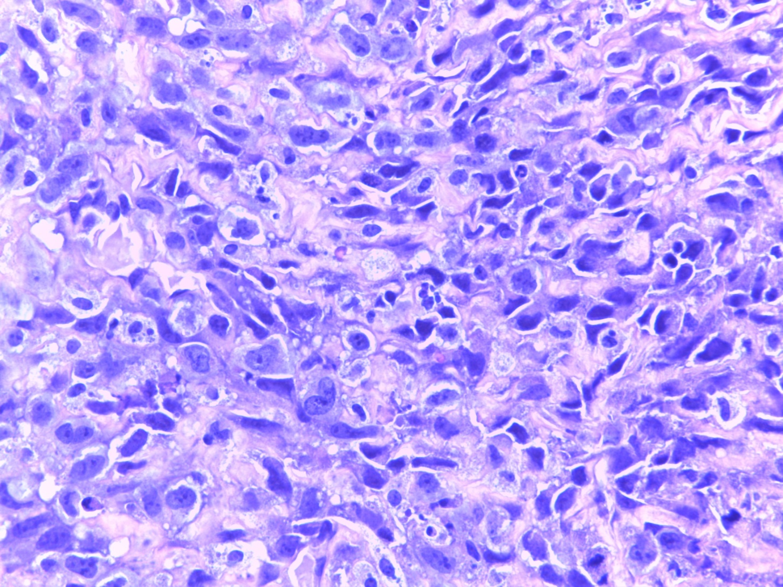
Case 21-7614

Slide 10
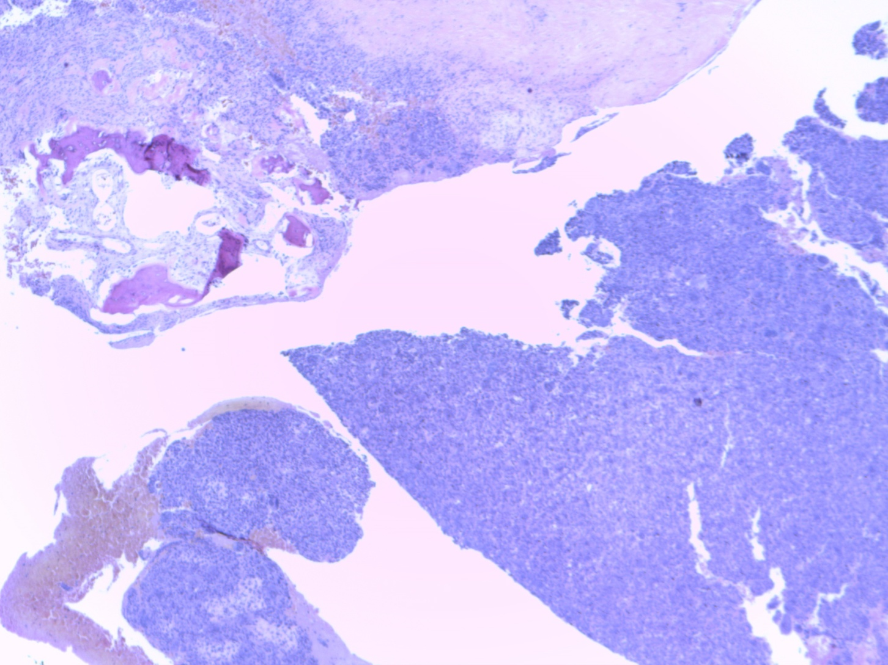
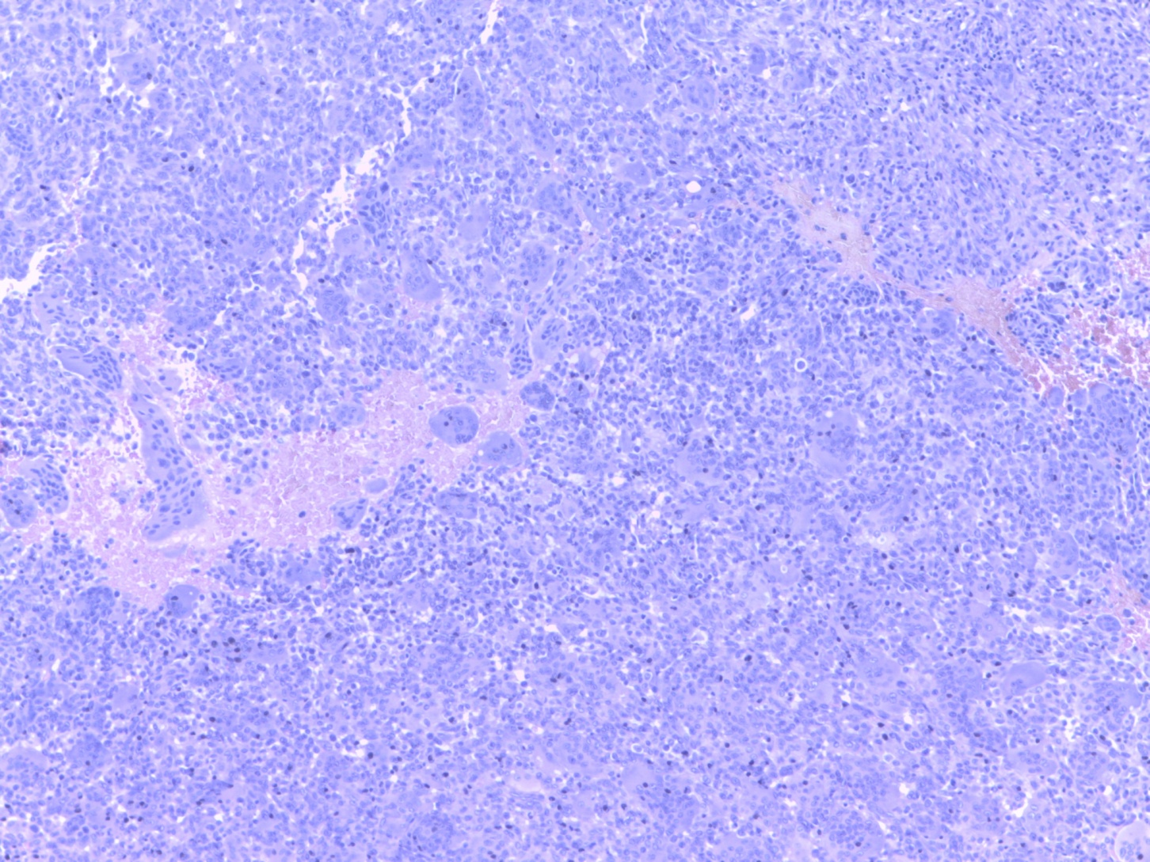
Caso 20-14066

Slide 13
QUESTIONS?
What is the most frequent malignant transformation of the bone giant cell tumor?
Can rank inhibition with denosumab promote carcinogenesis by increasing the predisposition to several nuclear oncogens?
What are the most frequent mutations related to bone transformed giant cell tumor?
What would be the best treatment in the case of transformation to OSTEOSARCOMA?

Slide 14
SELNET MDT VIRTUAL MEETING
Kelvin Gustavo Díaz Reaño MD
Medical Oncology
Instituto Nacional de Enfermedades Neoplásicas
Lima - Perú

Slide 15
26 y/o, female.
No comorbidities, No family history.
July 2018: (INEN)
Right hand MRI: extensive lesion involving the entire right first metacarpal, deforming the cortex without breaking it, 45x40mm
Chest tomography: no metastatic lesions.
Right thumb biopsy: giant cell forming tumor compatible with bone giant cell tumor.
August 2018:
Resection of tumor + cementoplasty: Giant cell tumor of bone without histological signs of malignancy.
October 2018:
Hand X-ray: post surgical changes, trabeculated lytic component in the first metacarpal suggestive of persistence of the disease.
Received 5000 cGy radiotherapy in 25 sessions with adequate tolerance.
Observation

Slide 16
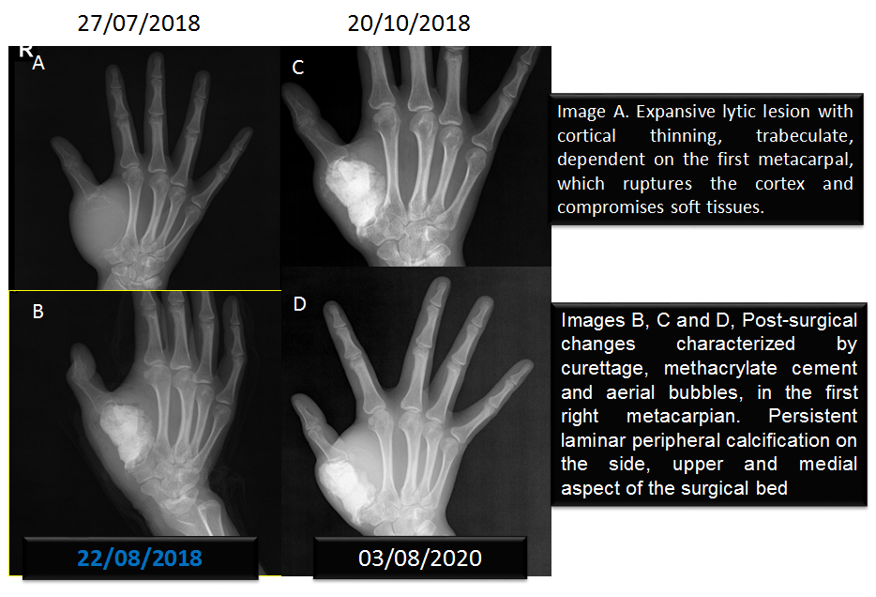

Slide 17
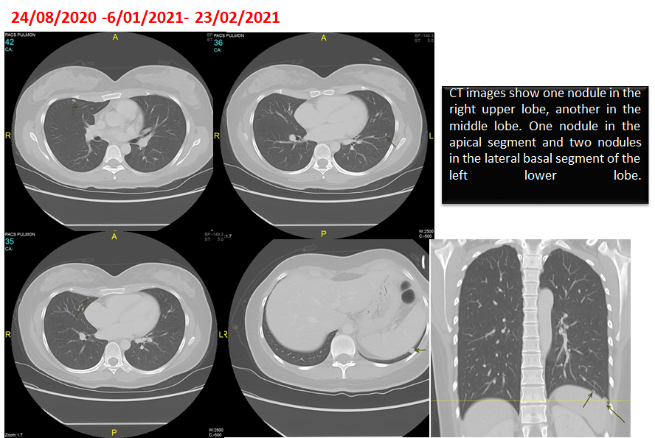

Slide 18
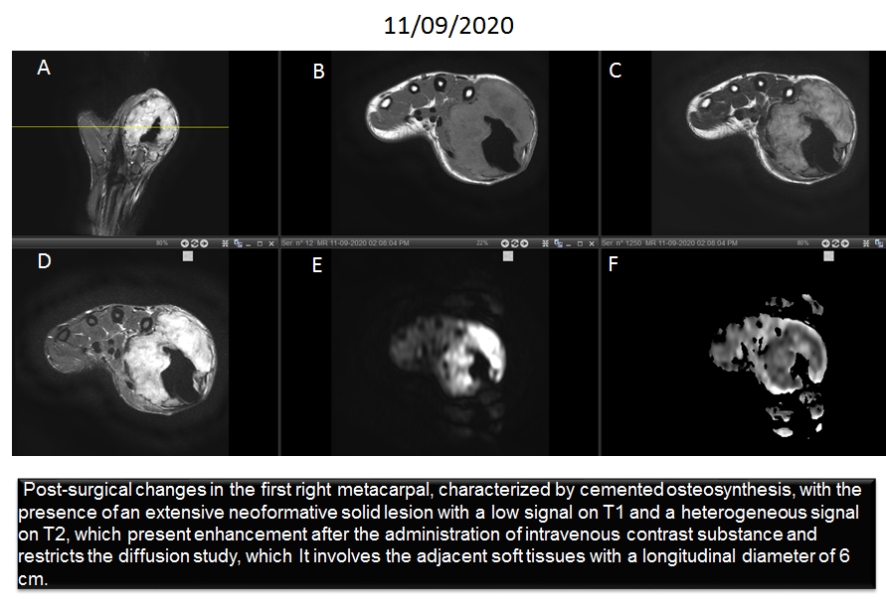

Slide 19
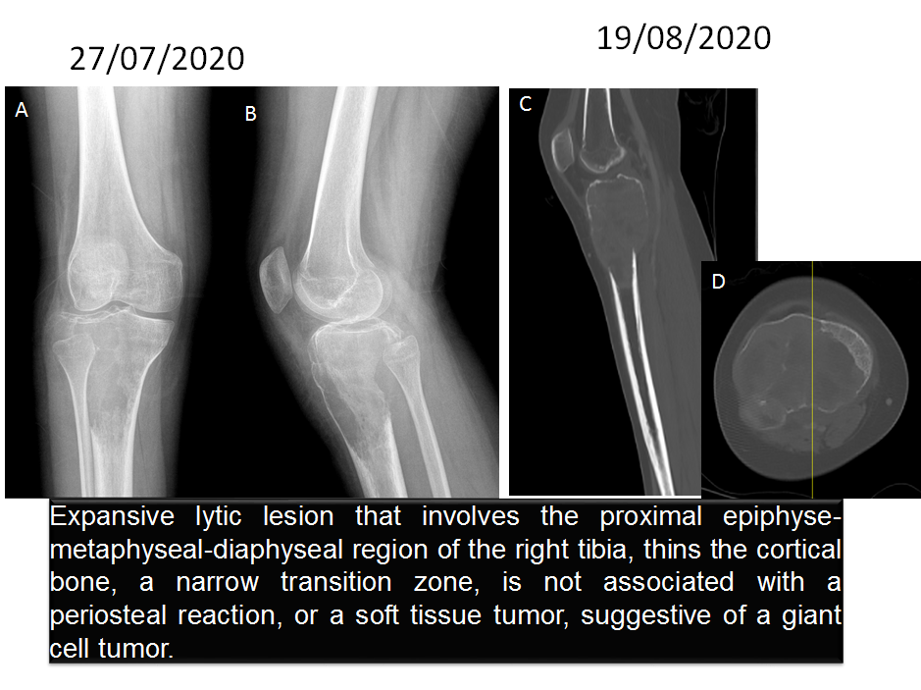

Slide 21
October 2020: (INEN)
Resection of a recurrent tumor of the right hand: giant cell tumor,
Surgery findings: tumor tissue adhered to the second metacarpal without obvious macroscopic lesion.
February 2021:
Chest CT: multiple nodules with a secondary aspect, diffusely distributed in both pulmonary fields predominantly on the left one, the largest in the left posterobasal segment of 8.7mm
April 2021:
Left exploratory thoracotomy + metastasectomy of pulmonary nodules (3). Pathology: giant cell tumor metastasis, negative margins.
Clinical: tumor growthin on proximal phalanx of the first finger of the right hand.

Slide 22
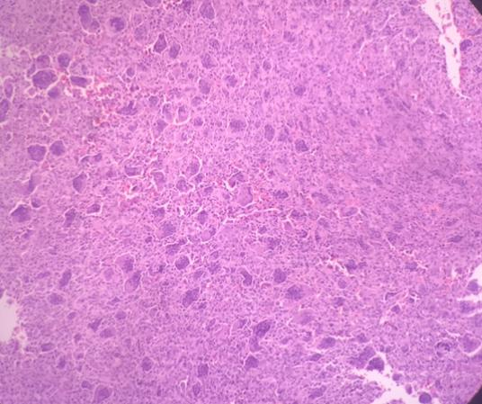

Slide 23
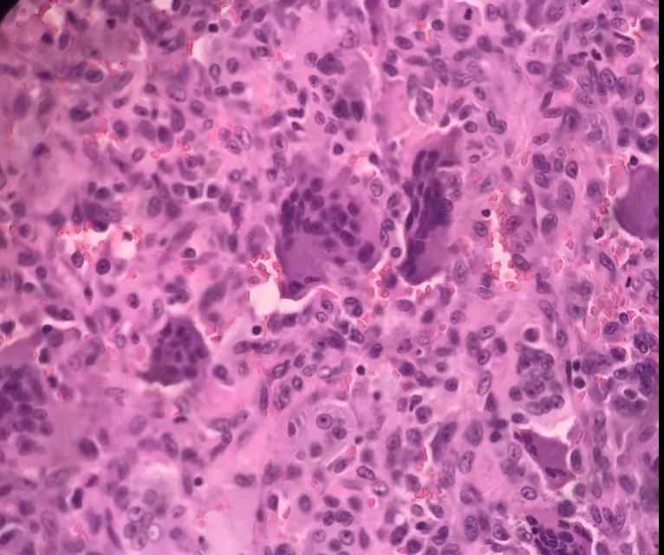

Slide 24
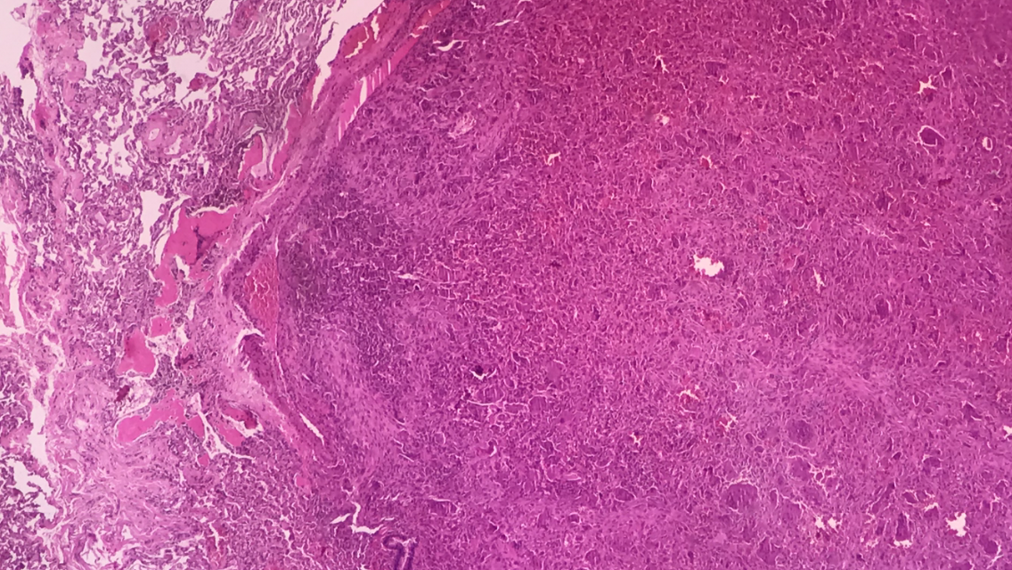

Slide 25
Diagnosis:
Giant cell bone tumor of the right thumb + operated local recurrence + pulmonary metastasis

Slide 26
Questions:
Could a new surgery be performed for the residual pulmonary nodule?
In case of operated metastases, and without evidence of disease, the use of Denosumab is valid, for how long?
New radiotherapy modalities may be a treatment option in subsequent unresectable lung metastases?

Slide 27
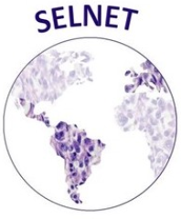
SELNET tumor board
Argentina, Alexander Fleming Institute
18th June 2021

Slide 28
65 y-o male patient
no smoking history or asbestos exposure
August 2020 progressive back pain associated with cough

Slide 29
November 2020 health check:
Chest X-ray: right opacity (atelectasis vs plural effusion)
CT: atelectasis of right lower and middle lobe and moderate pleural effusion
Thoracoscentesis was performed: 1ltr of exudate, cytology with no atypical cell

Slide 30
In November 2020 non-oncological surgery with decortication and pleural biopsy
Pathological report:
Macroscopy: several fragments (the 3 largest) of 8x5.2x2.5cm, 4x2.5x1cm and 3.8x1.7x1.5cm
Microscopy: tissue with a spindle cell growth pattern with long intertwined bundles. Sectors with greater nuclear pleomorphism including large, irregular and hyperchromatic nuclei with prominent nuclei and pale cytoplasms
Immunohistochemistry: AML +, desmin +, CK-, CK5-, calretinin -, CD34 , S100-
Diagnosis: leiomyosarcoma

Slide 31
I requested a review of the pathology and a CT scan

Slide 32
37mm contrast enhancing lesion

Slide 33
The review at our institution confirms leiomyosarcoma
It was discussed with the thoracic surgery team and due to the difficulty of performing a surgery with complete resection, we decided to perform chemotherapy
between January and April, he performed 4 cycles of doxorubicin plus dacarbazine without serious toxicities

Slide 34
CT control post chemotherapy
pre chemotherapy
post chemotherapy

Slide 35
We decided to re-discuss it with the thoracic surgery team and a decortication was performed in June
Patology report: complete response

Slide 36
We decided to present in this committee:
infrequent location
infrequent response
infrequent histology
Questions to the committee:
- alternatives diagnoses?
- Continue in control or complete chemotherapy?

Slide 37
Clinical Case
Dr. R. Badilla G.
Calderón Guardia Hospital
San José, Costa Rica

Slide 38
A 23 year male, with a history of two months of pelvic pain
CT: Retrovesical infiltrating tumor, compressing sigmoid colon. Peritoneal nodule in the abdominal wall and hepatic nodule. Thorax (-)
MRI: Huge retrovesical heterogeneous pelvic tumor, compressing neighboring structures
Colonoscopy: Extrinsic compression of the sigmoid colon
Germ cell tumor markers (-)

Slide 39
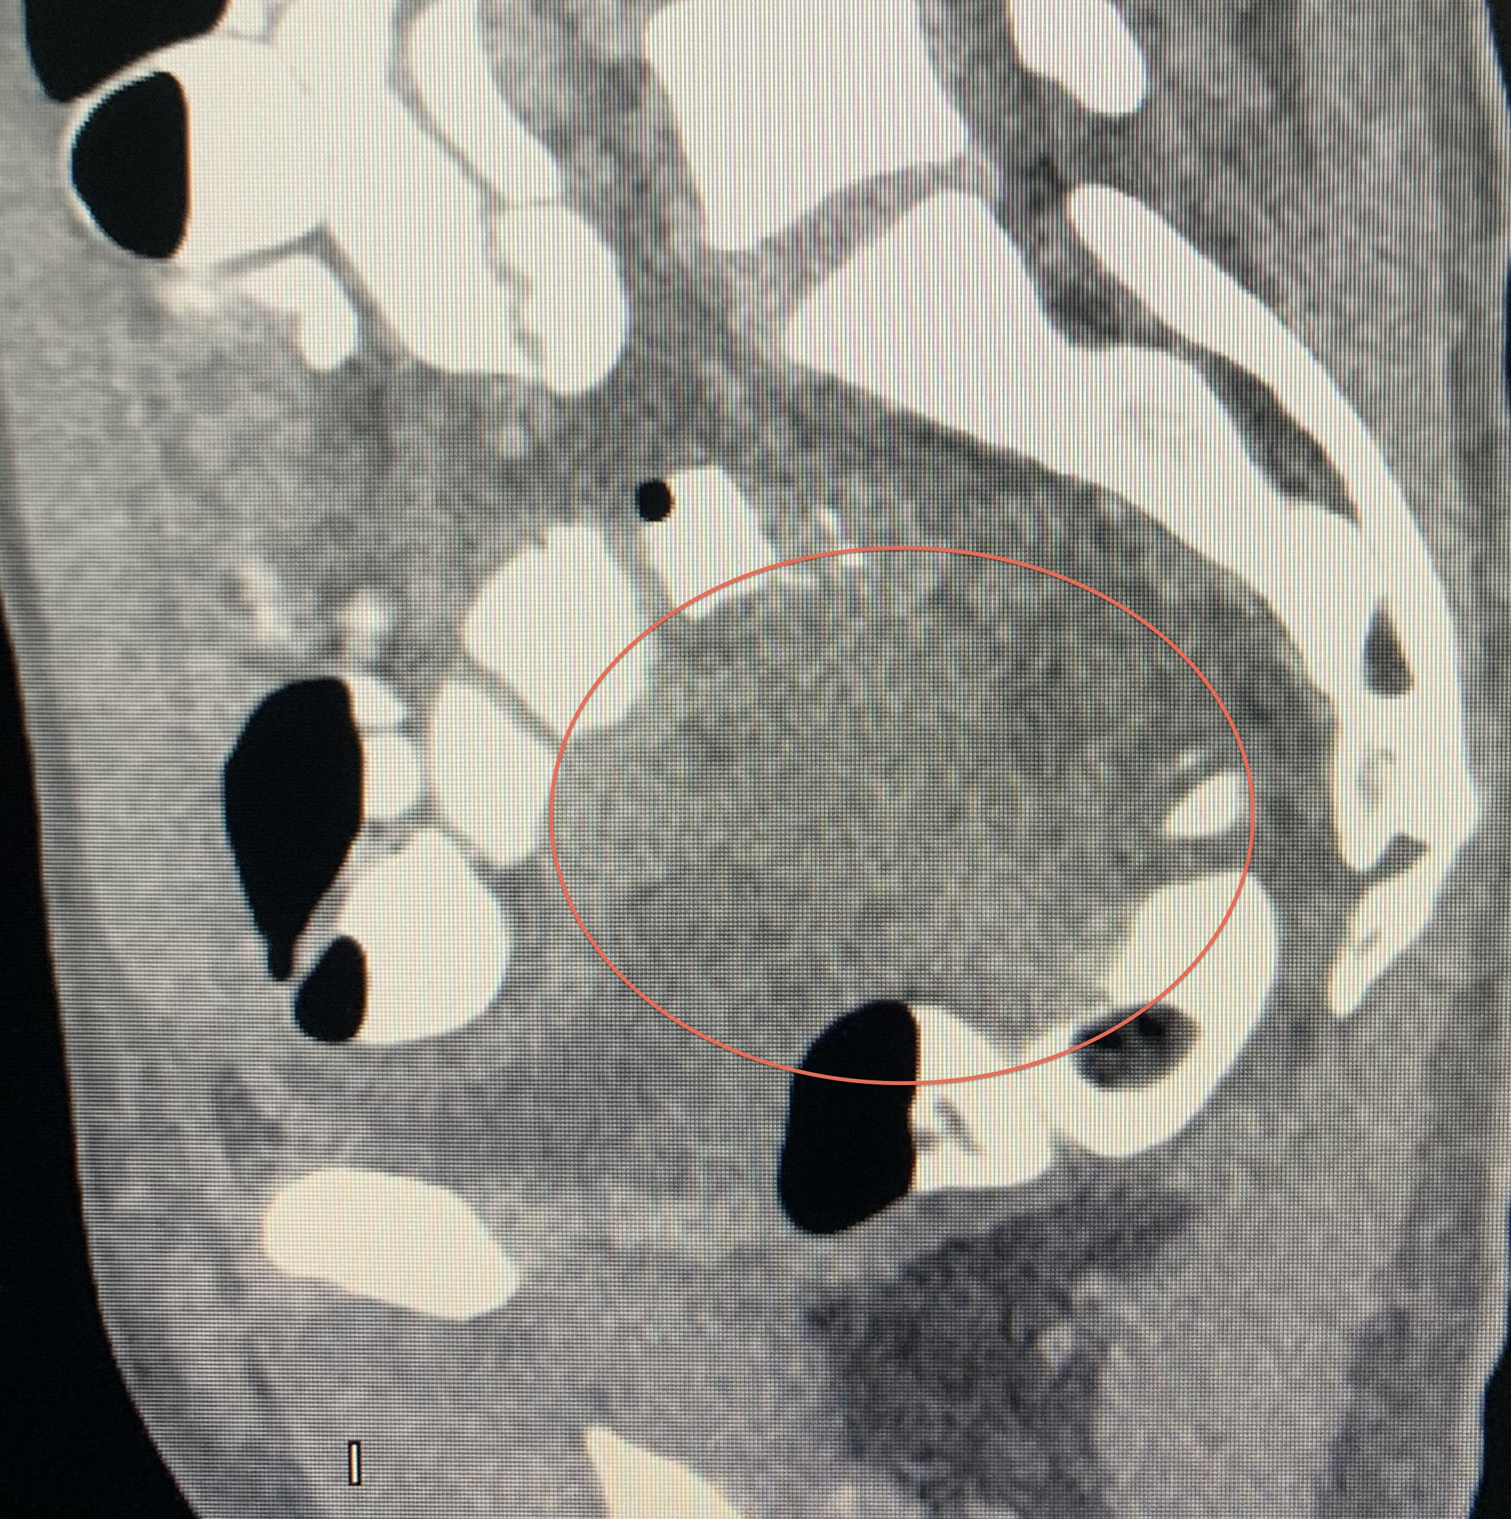
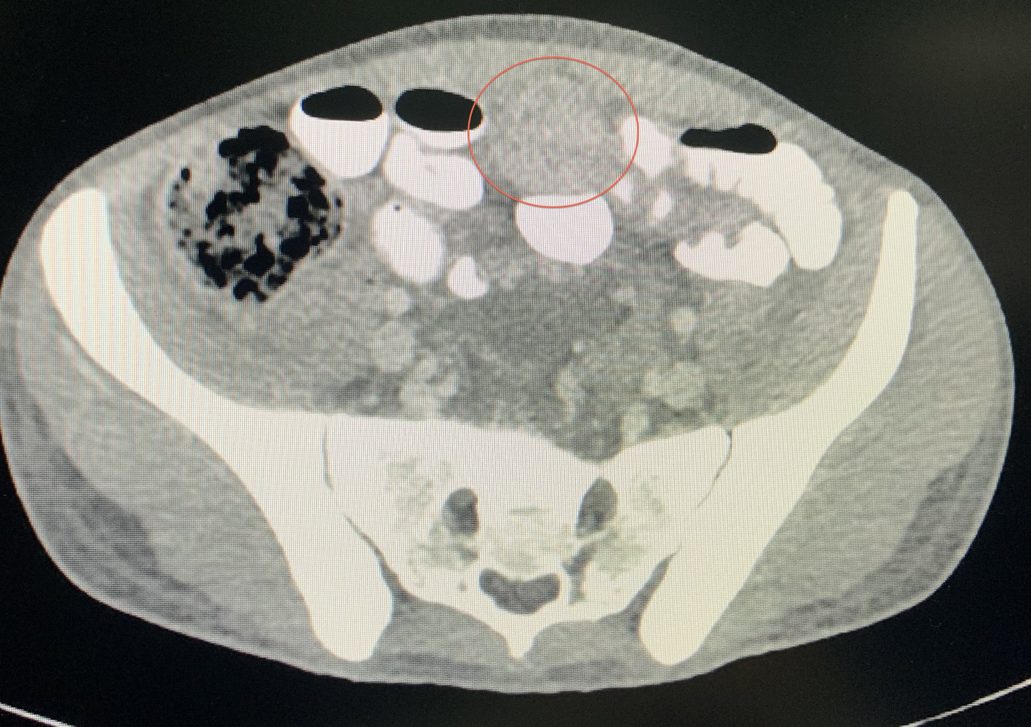
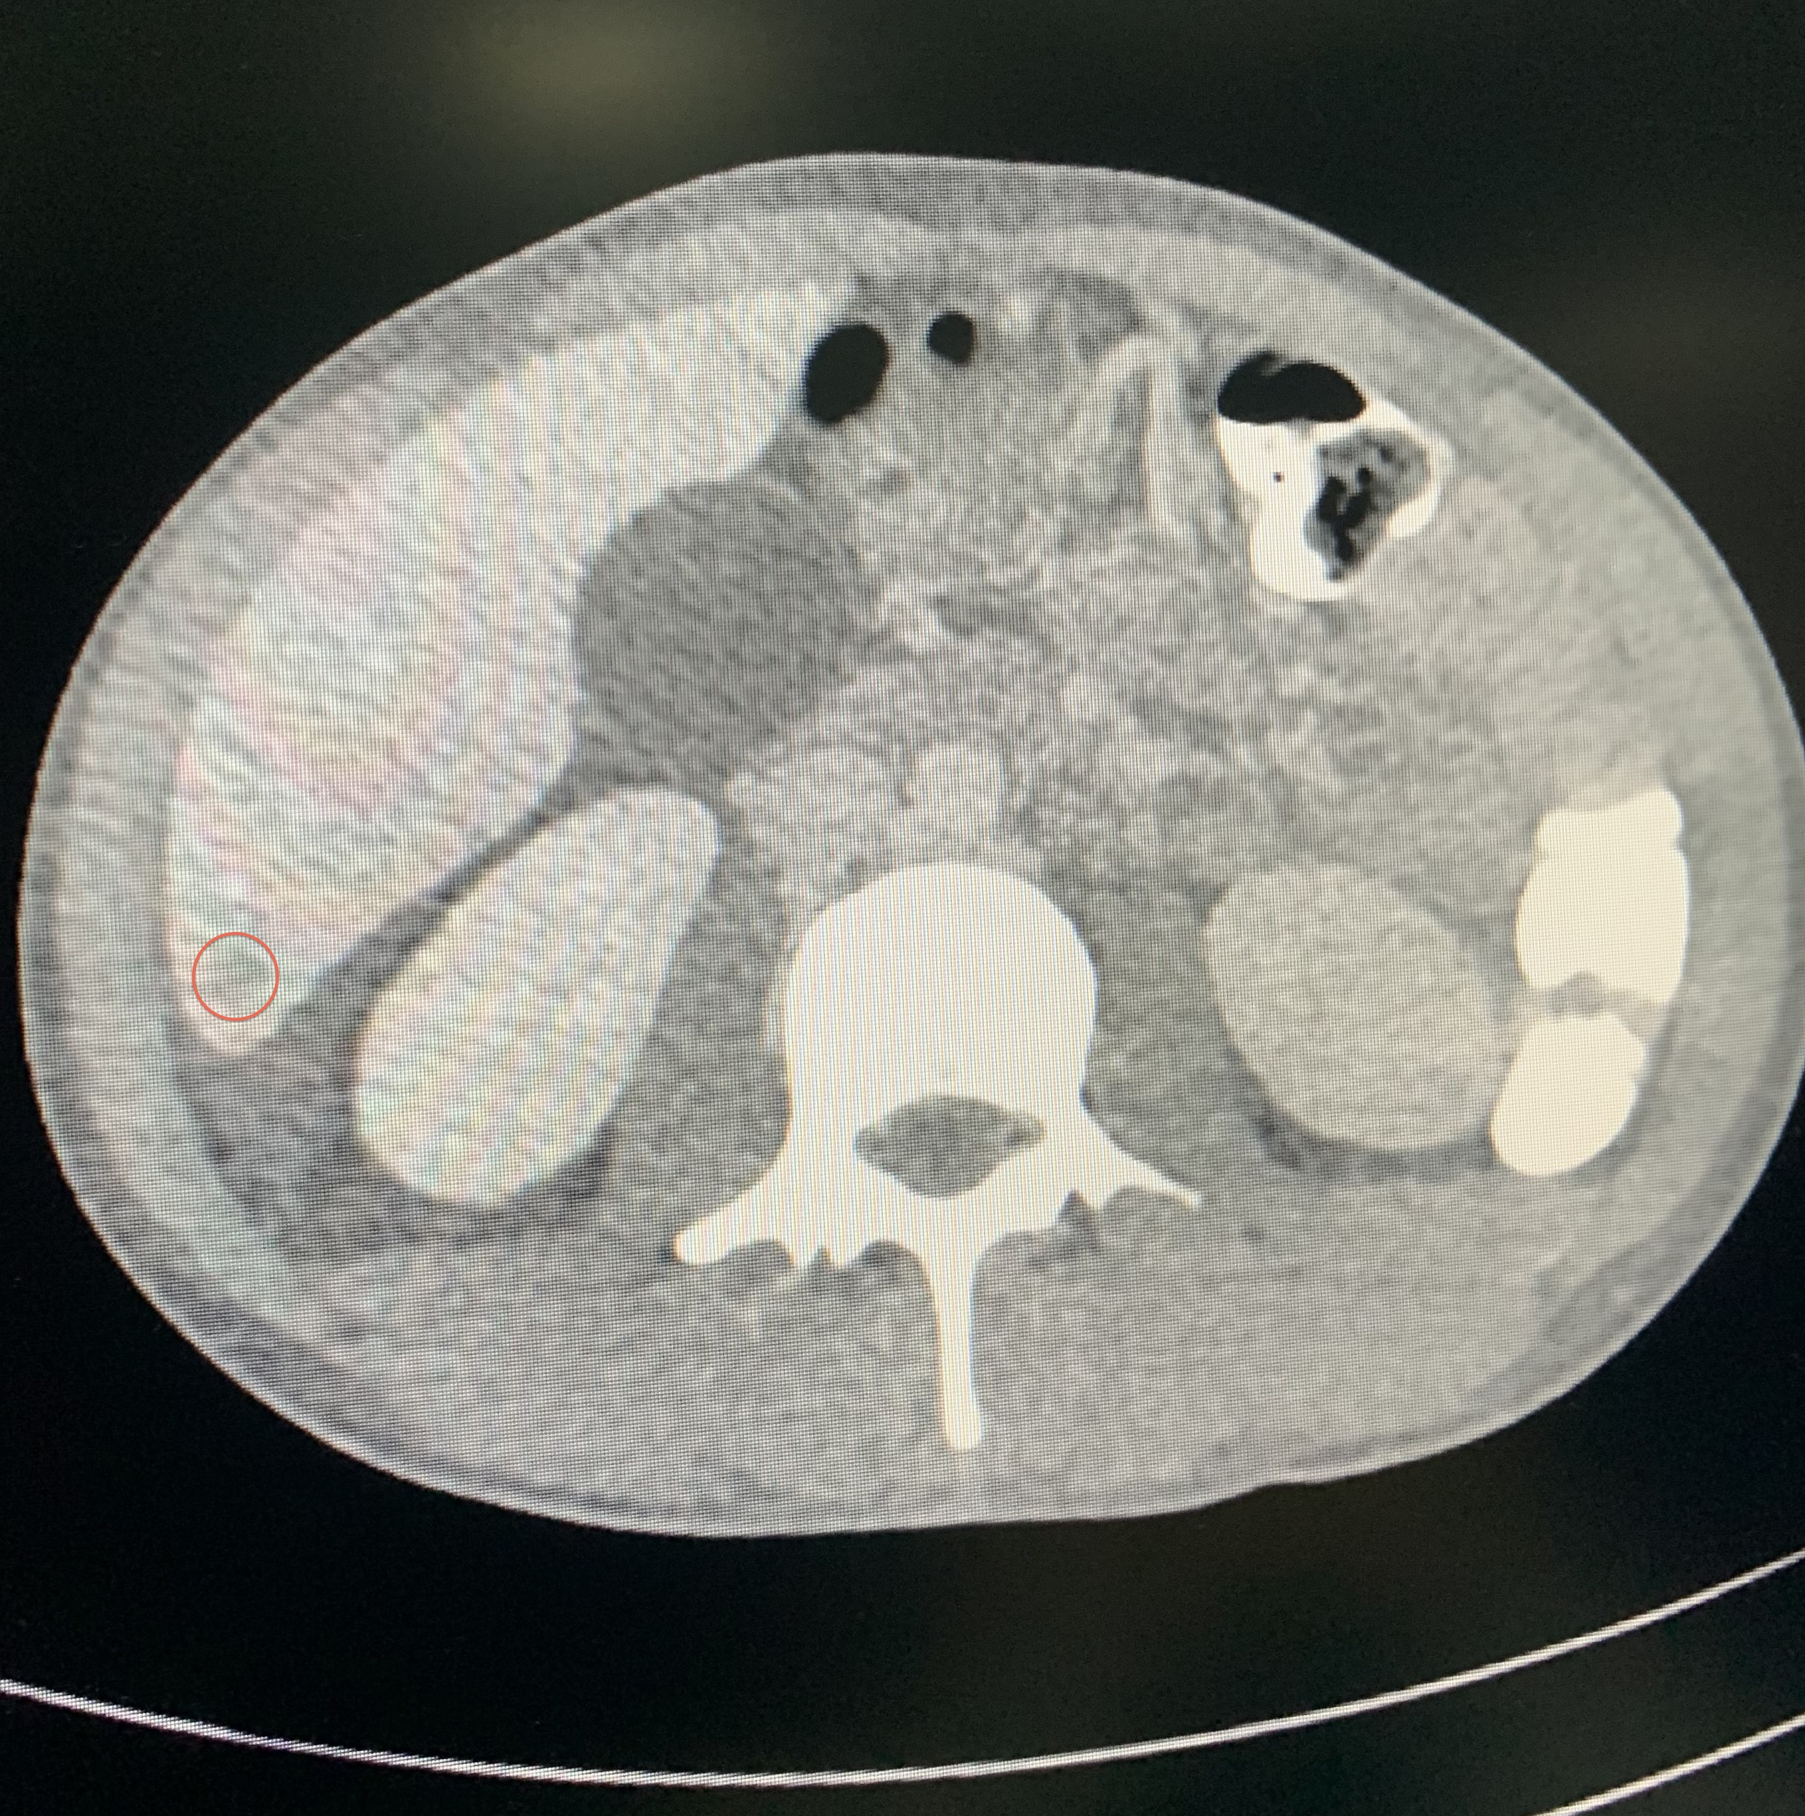

Slide 40
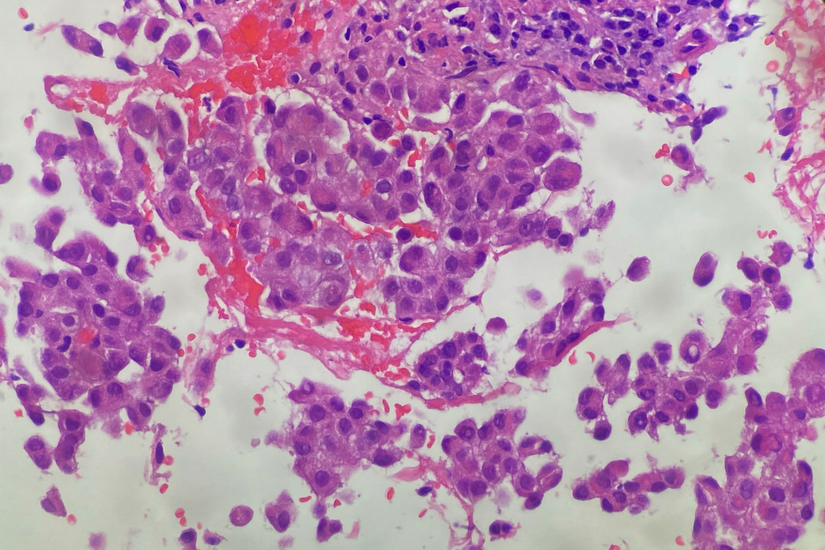
Biopsy: Epithelioid Sarcoma

Slide 41
Exploratory Laparotomy (July 15, 2021): Diaphragmatic peritoneal implants, abdominal wall and bladder implants. Unresectable pelvic tumor
Questions:
Tazemetostat not available in our country
If Chemotherapy: Antracycline/regimen vs Gemcitabine/regimen? (Oncology.2014;87(2):95-103/JAMA Oncol.2018; 4(9):e180219/Cancer.2021; 127(8): 1311-1317)
Foundation One Heme?

Slide 42
Impression: 43 yo, femal, with plexiform neurofibroma sciatic nerve (type I neurofibromatosis)
Post chordotomy with no pain relieve
Current – intrathecal implantable infusion pump with opioids
Discussion – systemic treatment with
Selumetinib – FDA approved/not availabe in Brazil? Trametinib – available in Brazil ?

Slide 43
SELNET TUMOR BOARD
Bruna David e Carolina Cardoso – Oncoclínicas

Slide 44
Clinical history
Male, 40yo, no comorbidities
Aug/19- nodular lesion on the left neck region, with progressive growth.
Sep/19 - CT head and neck:
Expansive lesion affecting the deep musculature from the lower 1/3 of the neck to the left, insinuating the supraclavicular fossa, without a cleavage plan with the scalene muscle.
Sep/19 - Core Biopsy: desmoid fibromatosis (SMA +, Betacatenin +, CD20 +, CD3 +)
No room for surgery / symptomatic tumor growth after biopsy

Slide 45
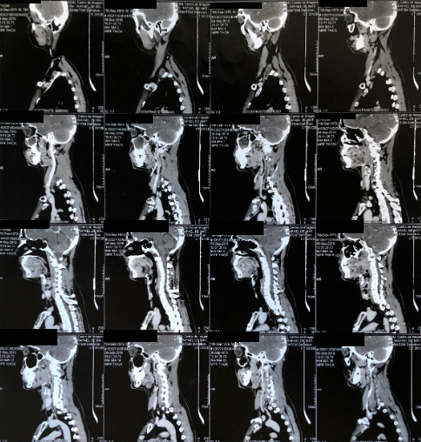
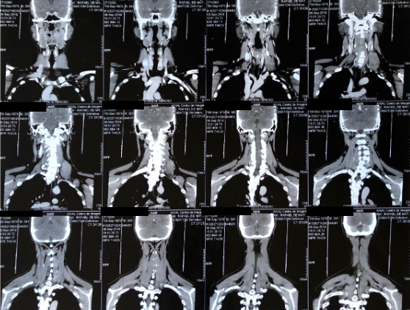
CT Sep/2019

Slide 46
Clinical history
Nov/19 – Mar/21:
-Pazopanib 800mg daily – well tolerated
(no images right before starting Pazopanib, after biopsy)
-Better response: Stable disease – no changes in the tissue characteristics or tumor size.
Apr/21:
Clinical progression: arm pain
-MRI:
Slight dimension increase comparing to Oct/20 (10.0 x 9.2 x 5.5 cm comparing to 9.6 x 7.6 x 4.9 cm)

Slide 47
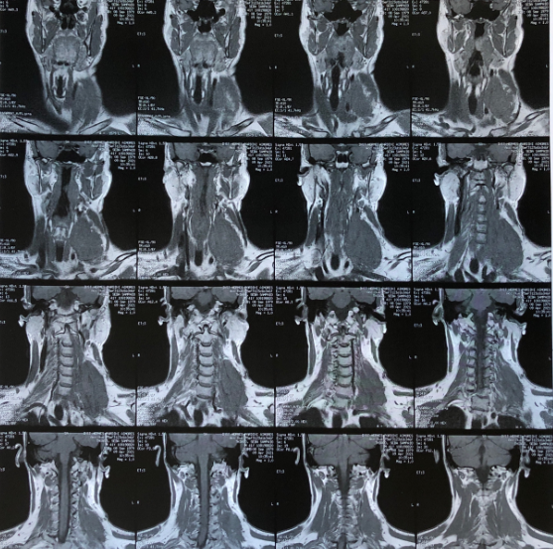
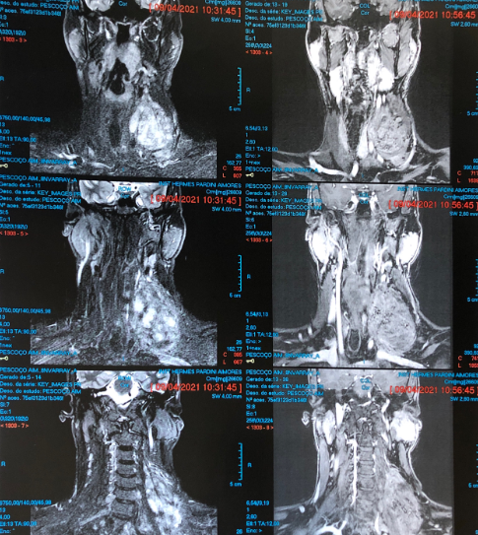
MRI April/2021

Slide 48
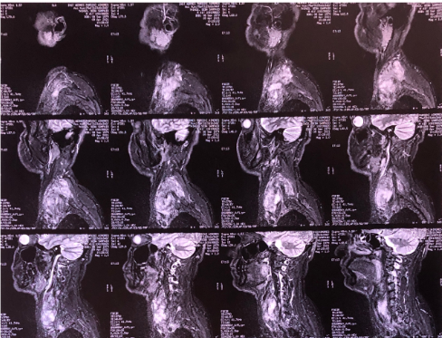
MRI April/2021

Slide 49
Clinical history
May/2021: started on chemo (Doxo 60mg/m2 + Dacarbazine 750mg/m2 D1 q3w)
-Well tolerated. Mild tumor pain/no arm pain. Clinical tumor growth (discrete) after starting treatment.
July/21: after 2 cycles of chemo
MRI:
-new slight dimension increase comparing to April/21: (11.1 x 8.9 x 5.0cm comparing to10.0 x 9.2 x 5.5cm)
-no changes in the tissue characterists – predominant viable tumor, suggesting active disease.

Slide 50
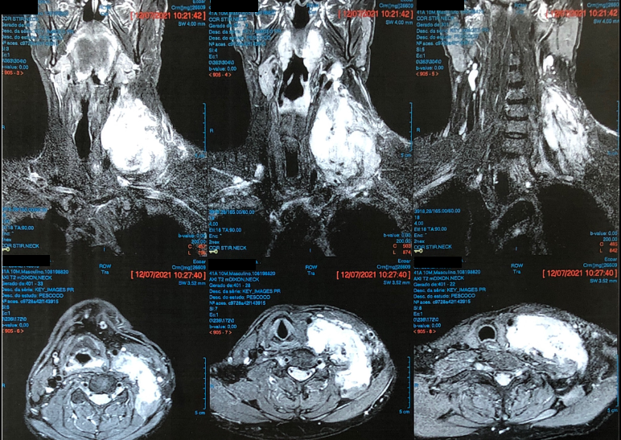
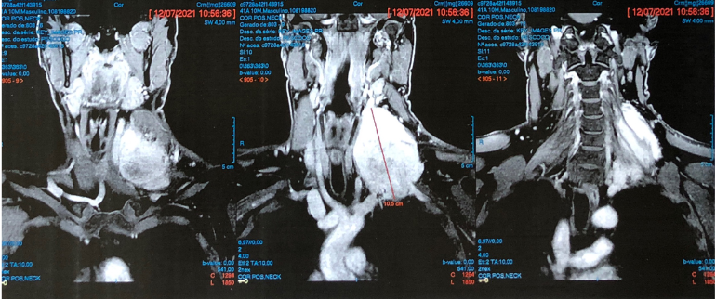
MRI July/2021

Slide 51
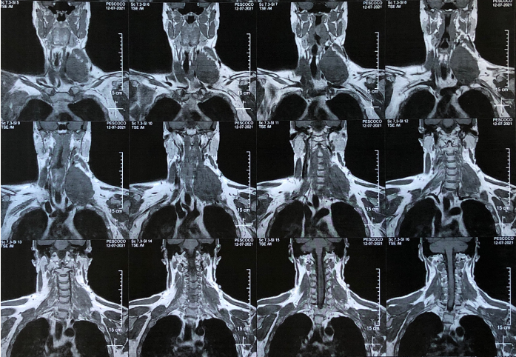
MRI July/2021

Slide 52
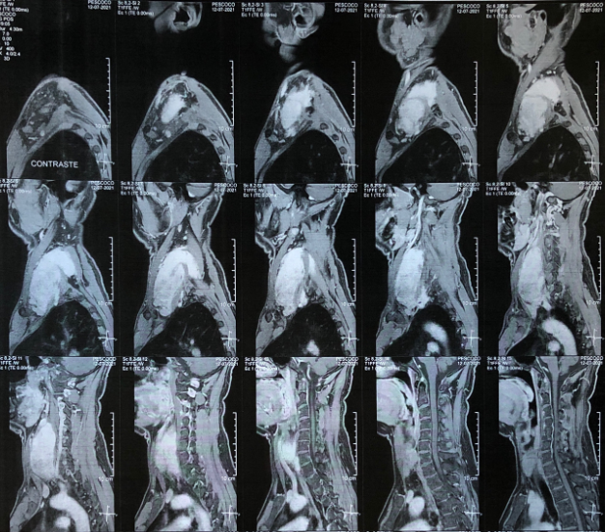
MRI July/2021

Slide 53
Questions:
Switch systemic therapy?
-Is it considered treatment failure after 2 cycles of chemo?
-In case of changing therapy, which one would you suggest?
Or
Resuming chemo and restaging after 2 aditional cycles?

