Slide 1
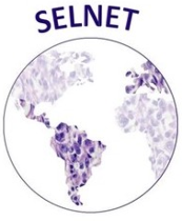
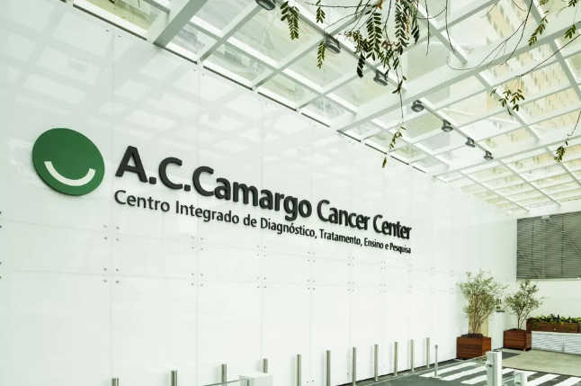
SELNET Tumor Board
May 27th, 2021
A.C. Camarg Cancer Center

Slide 2
Case | Category | Diagnosis/Hypothesis | Discussion | Team | MD
1 | RP | Leiomyosarcoma | Ressectability | AC Camargo | Samuel Aguiar
2 | Bone | GCT | Diagnosis/treatment | Fundación Jimenez Díaz (Madrid) | Nadia Hindi
3 | Bone | Lipossarcoma | Diagnosis/Treatment | IAF | Tomas Soule
4 | Visceral | Leiomyosarcoma | Diagnosis/Treatment of atypical lung lesions | IAF | Martin Angel
5 | Extremity | Sclerosing Epithelioid Fibrosarcoma | Ressection | INEN | Luis Agramonte
6 | Head and Neck | Desmoid tumor | Treatment (local x systemic) | INCA/Oncoclínicas-RJ | Bruna Davi
7 | Rare | PILA/Dabska Tumor | Systemic treatment x amputation | AC Camargo | Celso Mello
8 | Visceral/RP | Leiomyosarcoma | Adjuvant Tx | IAF | Kober
Objective presentations – 5 minutes to present
Objective discussions – 10 minutes to discuss

Slide 3
VIRTUAL
MDT BOARD
Jacqueline Nunes de Menezes, MD
Surgical Oncology Residency Program at A.C.Camargo Cancer Center - São Paulo / Brazil

Slide 4
67 yo, female, ECOG 0
Previous Medical History:
papillary thyroid carcinoma
Total Thyroidectomy on july 2019 + iodotherapy.
Ex-smoker; social alcoholism
No previous abdominal surgery
No family history of cancer
Oct 2020: Abdominal pain CT scan showed bulky retroperitoneal mass + inespecific hepatic nodule.
Dec 2020: Palpable abdominal mass measuring ~30 cm
Chest CT with no evidence of disease.
Percutaneus core Biopsy = High Grade Leiomyosarcoma
SELNET Virtual MDT Board São Paulo, 27th May 2021

Slide 5
67 yo, female, ECOG 0
High Grade Retroperitoneal Leiomyosarcoma
Neoadjuvant Chemotherapy:
Ifo 1500mg/m2 d1-d2-d3 + Epirrubicin 50mg/m2 d1-d2 x 3 cycles
Feb 2021: Abdominal + Chest CT – no major changes
May 2021: after 5 cycles = clinical benefit + Stable Disease (RECIST)
Bulky mass of apparent retroperitoneal location on the RUQ, measuring approximately 174 x 134 x 175 mm
SELNET Virtual MDT Board São Paulo, 27th May 2021

Slide 6
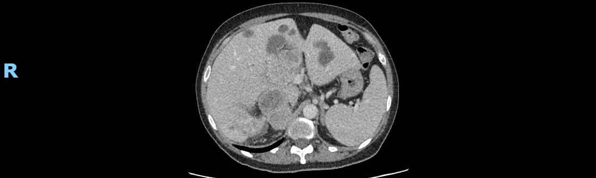
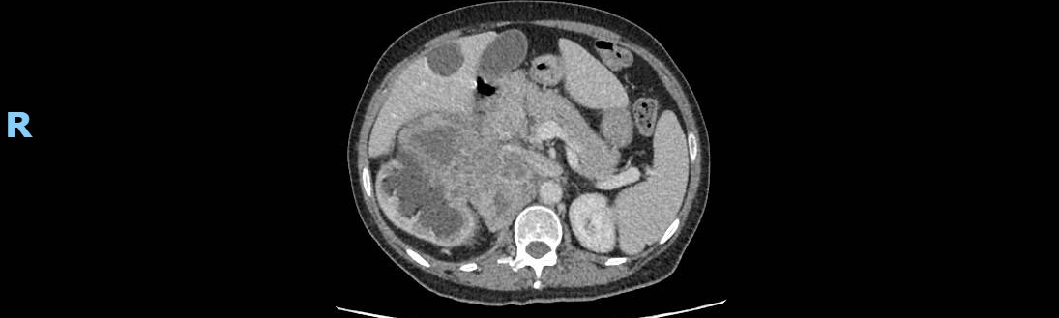
Female 67 year-old patient, ECOG 0
CT Scan (april 2021):
CT
SMA
Superiorly: wide contact surface with the visceral face of the hepatic segments IVb, V and VI, as well as splenic vein and portal vein trunk, with no signs of invasion.
Portal Vein
SELNET Virtual MDT Board São Paulo, 27th May 2021

Slide 7
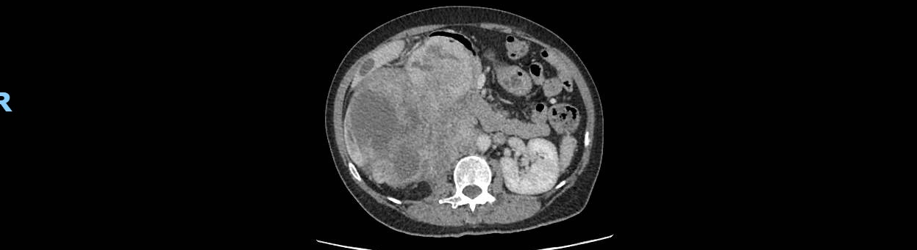
Female 67 year-old patient, ECOG 0
CT Scan (april 2021):
Right Renal Vein
CT
SMA
LHA
SELNET Virtual MDT Board São Paulo, 27th May 2021

Slide 8
Female 67 year-old patient, ECOG 0
CT Scan (april 2021):
Relation with duodenum and aortic artery
Medially: wide contact surface with aorta and bowel.
Anteriorly: wide contact surface with the 1st, 2nd, and 3rd duodenal portions, displacing them anteriorly, without determining obstruction.
It also has contact with the pancreatic head.
SELNET Virtual MDT Board São Paulo, 27th May 2021

Slide 9
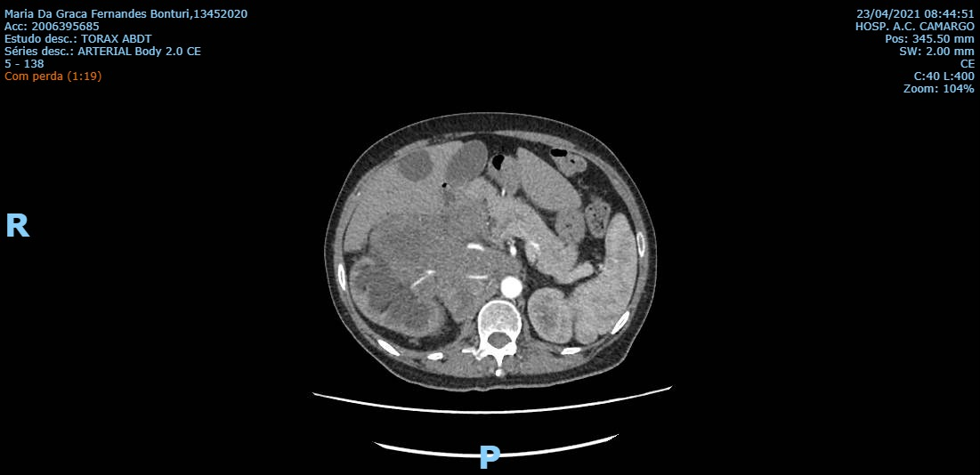
Female 67 year-old patient, ECOG 0
CT Scan (april 2021):
Relation with the spine
Laterally: compression of the right kidney, with moderate pyelocalicinal dilation. Right ureter not characterized.
Posteriorly: signs of invasion of the psoas major muscle and obstruction of the inferior infrarenal vena cava, which is not seen along its intratumoral pathway. Tapering of the right renal vein and artery is also noted, and ectasia of both gonadal veins.
SELNET Virtual MDT Board São Paulo, 27th May 2021

Slide 10
Thank you!
Is the lesion resectable?
Menezes JN, Arras DAMS, Lobo MM, Calsavara VF, Pinto CAL, Bertolli E, Duprat Neto JP
A.C.Camargo Cancer Center - São Paulo/SP.
SELNET Virtual MDT Board São Paulo, 27th May 2021

Slide 11
MEDICAL HISTORY
Female, 31 years
Hypothyroidism
Infection SARS-Co-2 (no need of hospitalization), in May-June 2020
June-July 2020: PAIN in left hip
GP: sequelae from COVID? → NSAIDs
Lack of improvement in next months→ referral to Orthopedic surgeon

Slide 12
DIAGNOSTIC PROCEDURES
15 April 2021: first evaluation for Orthopedic surgeon
Physical Exam: suspicion of trochanteric problem → request of US
17 April 2021: Emergency Department
PAIN + FALL (functional impairment)
Simple X Ray: subcapital femoral fracture

Slide 13
IMAGING STUDIES

Slide 14
IMAGING STUDIES (2)
CT scan: pathological fracture
Tru-cut biopsy (20/April/2021) : evidence of giant cells, osteoclastic-like
No evidence of atypia, no evidence of osteoid formation, no mitosis, no necrosis
Probable Giant Cell Tumor of Bone
MRI: pathological fracture

Slide 15
QUESTIONS
Is this an usual location for GCT of bone?
Which IHC/molecular findings could help in the diagnosis?
The patient is admitted with functional impairment (walking disability). Would you perform any surgical procedure? Which one?
Would you recommend any systemic therapy? Schedule? Duration?

Slide 16
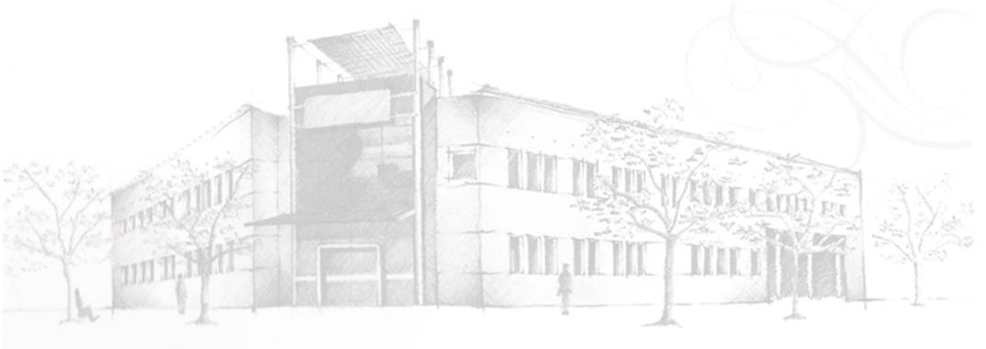
November surgery
Pathology report left thigh: tumor proliferation formed by lipomatous mesenchymal cells (with mild to moderate atypical patches) and foci of heterotopia or associated bone metaplasia
Diagnosis: Well differentiated liposarcoma (lipoma-simile type) with bone heterotopia. Wide and complete resection.
Immunohistochemistry:
EMA: POSITIVE
CD34: FOCAL POSITIVE
CALRETININ: NEGATIVE
SOX10: NEGATIVE
S100: NEGATIVE
MDM2: NEGATIVE
Q16: NEGATIVE

Slide 17
Surveillance indicated
Lost of follow-up during 2020
Her treating physician refers to us with the indication of amputation of the lower limb, due to the progression of the disease.

Slide 18
Previous studies are reviewed and no signs of disease progression are observed, pain, fever, changes in thigh size are denied.

Slide 19
What would be your treatment recomendation?

Slide 20
Intestinal Leiomyosarcoma
Martín Zarbá
Oncología Clínica
IAF

Slide 21
Case presentation
42 years old , male, no family history, no former smoker
Dec/2019: admitted to the ER for abdominal pain and vomiting due to intestinal occlusion. Surgery was performed.
Surgical report: at terminal ileum and apex, 22 mm exophytic nodular formation, ulcerated, occupying 50% of the circumference and obstructs 95% of the lumen.
Pathologic report:
Notes:
fascicles, spindle cells with moderate cellular pleomorphism and moderate mitotic index (12/ 10 HPF). GH1, resection margins free, in submucosa and muscularis propria

Slide 22
Case presentation
IHC:
CD117 negative, Cd34 negative, S100 negative
SMA diffuse positive, desmin weak diffuse positive,
Ki67 15%
DOG1: negative
Final diagnosis: intestinal leiomyosarcoma
Dec 2019: CT scan: no mets

Slide 23
Case presentation
Apr/2020: First follow up scan: showed at least two sub solid lung nodules. No other lesions
Jul/2020: Stable sub solid lung nodules
Dec/2020: Stable sub solid lung nodules

Slide 24
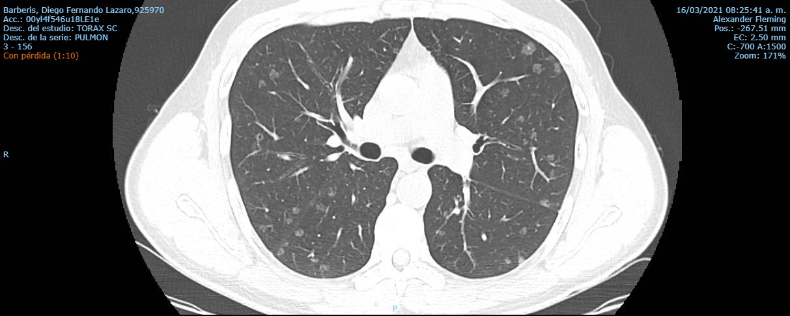
Case presentation
03/2021: multiple, bilateral, subsolid lung nodules
Asymptomatic

Slide 25
Questions?
Would you request a PET/SCAN?
Would you start treatment immediately or delay until symptoms appear?
Is a biopsy necessary?
Is there evidence that justify observation in this clinical scenario?
If treatment were to be started, which would be the prefered regimen?
Can NGS help us decide how to proceed?

Slide 26
SELNET MDT VIRTUAL MEETING
Luis André Salinas Agramonte MD
Medical Oncology
Instituto Nacional de Enfermedades Neoplásicas
Lima - Perú

Slide 27
23 y/o, female.
Childhood hepatitis A, an aunt with primary cancer of the jaw.
October 2005: (general hospital)
Inguinal tumor, with observational treatment.
November 2019: (INEN)
Tumor increases in size, limiting ambulation.
Biopsy: SCLEROSING EPITHELIOID FIBROSARCOMA.
IHQ: MUC 4 + ACL - S100 - CD 138 - KERATIN - DESMINE –
RM: Extensive heterogeneous lesion with defined multilobal borders measuring 9 x 9.5 x 13.8cm in transverse diameter, anteroposterior longitudinal; heterogeneous signal predominantly high in T2, with multiple diffusion restriction areas located at the level of the inguinal region; it contacts the common as well as the superficial femoral artery at 180 degrees.

Slide 28
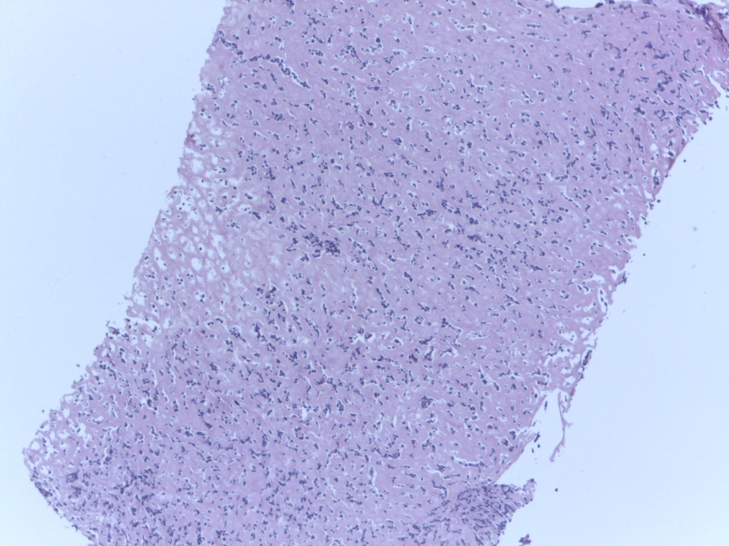

Slide 29
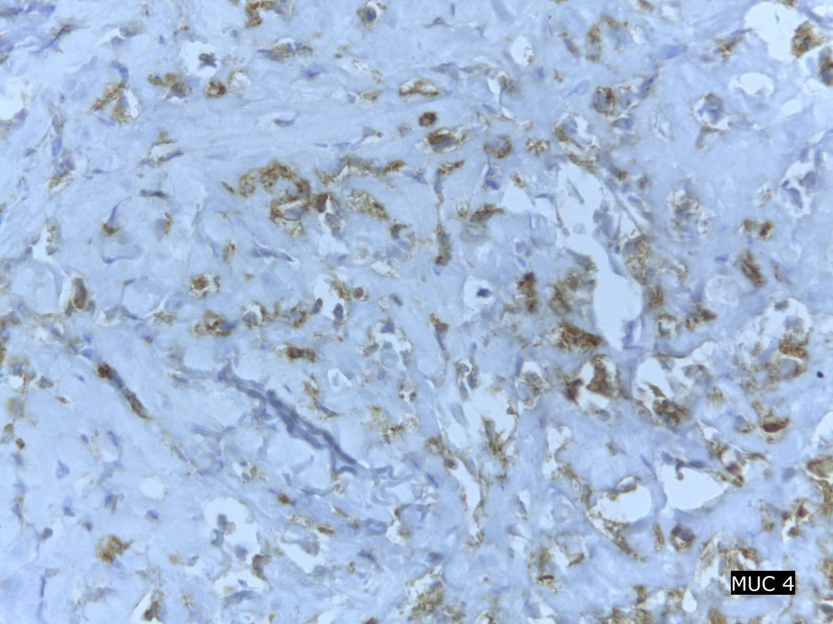
IHC: - MUC4 (+) - DESMIN (-) - PANKERATIN (-) - ACL(-) - CD138 (-)
DIAGNOSIS: SCLEROSING EPITHELIOID FIBROSARCOMA

Slide 30
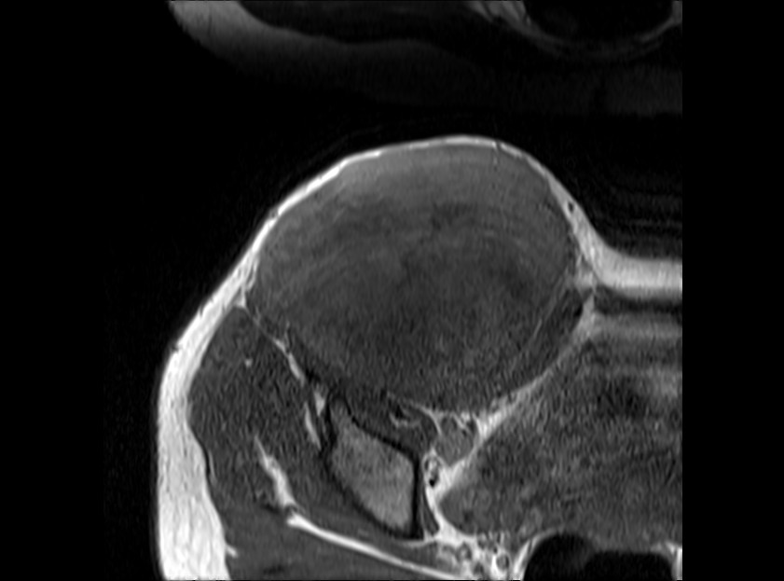
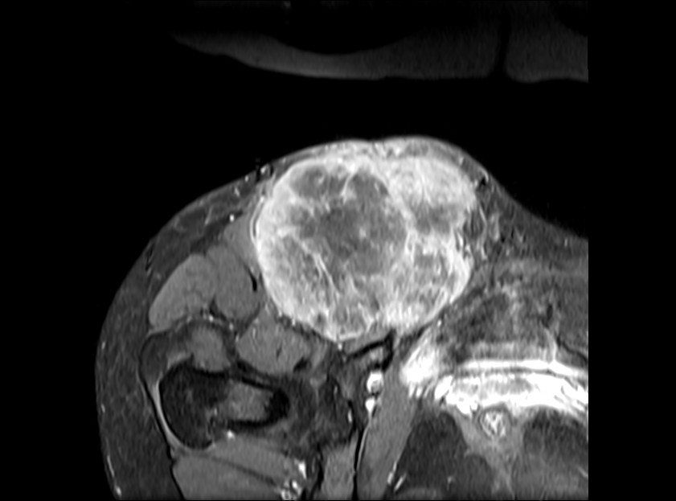
20/11/2019
A
B
C
D
E
F
G
H
02/05/2021
MRI with contrast in the axial (A, C, D, E, F and G), sagittal (B and H) planes, Extensive heterogeneous solid lesion with areas of low signal in T2 (A, B, G and H) and sequences T1 (C), with enhancement (D) and restriction in the diffusion sequence -ADC map (E and F) located in the inguinal region that extends to the lower lateral wall of the pelvis and the proximal region of the thigh contacts with the common femoral artery at 180 degrees, as well as encompassing the superficial femoral artery, contacts the sartorius muscle without categorical signs of infiltration. Displacement of the rest of adjacent muscular structures.

Slide 31
Diagnosis:
SCLEROSING EPITHELIOID FIBROSARCOMA OF RIGHT INGUINAL REGION EC III.

Slide 32
June 2020:
External radiotherapy a dose of 3900 cGy in 13 sessions in the right hemipelvis in APPA. (June 2020).
Chemotherapy with monodrug adriamycin x 6 courses (July 2020 – April 2021).
March 2021:
RM: Extensive solid lesion, dependent on soft tissues at the level of the right inguinal region, measuring 9 x 11 x 12 cm, completely encompassing the common femoral vessels and infiltrating subcutaneous cellular tissue.

Slide 33
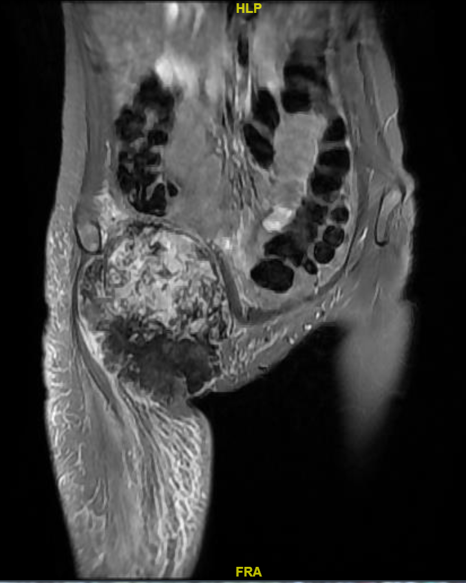
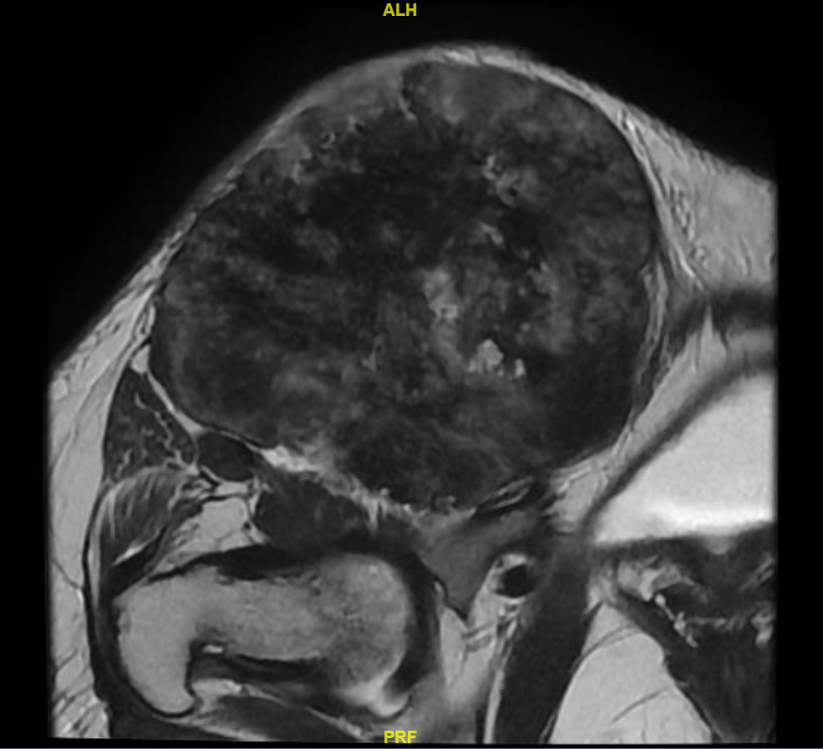
March 2021

Slide 34
TYPE OF RESPONSE ACHIEVED?
STABLE DISEASE

Slide 35
Questions:
What’s the role of chemotherapy in the treatment of FS?
What’s the role of radiotherapy in the treatment of FS?
What’s the best treatment in FS?

Slide 36
SELNET TUMOR BOARD
Bruna David e Carolina Cardoso – Grupo Oncoclinicas

Slide 37
Clinical history
Male, 40yo
Aug/19: nodular lesion on the left neck region, with progressive growth.
Sep/19 - CT head and neck: expansive lesion affecting the deep musculature from the lower 1/3 of the neck to the left, insinuating the supraclavicular fossa, without a cleavage plan with the scalene muscle.
Sep/19 - Core Biopsy: desmoid fibromatosis (SMA +, Betacatenin +, CD20 +, CD3 +)
No room for surgery

Slide 38
Nov/19 – Mar/21: Pazopanib 800mg daily – well tolerated
Apr/21: clinical progression: arm pain
MRI: slight dimension increase comparing to october/20

Slide 39
MRI April/2021

Slide 40
Questions:
Local treatment X Systemic therapy?

Slide 41
ID: Male, 46 yo, from São Paulo
Medical History
2008: patient presented with pain and swelling in the left thigh. MRI showed a 3.4 x 3.8-cm mass in the deep soft tissues of his left thigh.
2009: ressection of the lesion. Pathologic report: Endovascular papillary angioendothelioma (Dabska tumor). Negative surgical margins.
2010: local recurrence with painful lesion
From 2014 to 2020 several embolizations were performed.
After the last procedure (transarterial bleomycin embolization) in february/2020, the patient presented a worsening painful swelling in the upper left leg, associated with local bleeding and ulceration. Moreover, he related relevant weight loss and hyporexia and persistent anemia.
MRI performed in June/2020 showed a large 20 x 14 x 11-cm mass, with an exophytic component of 4 x 3-cm in the posterior and lateral compartment of the thigh (images)

Slide 42
MRI performed in June/2020 showed a large 20 x 14 x 11-cm mass, with an exophytic component of 4 x 3-cm in the posterior and lateral compartment of the thigh (images)
December/2020: Considering recently growth, at a progressive rate, it suggested a component of malignant transformation - a new biopsy was indicated - confirmed Dabska tumor
Initiated systemic chemotherapy: Weekly Paclitaxel 80 mg/m2 x 12 cycles with transient improve in bleeding and pain
March/2021: Worsening local bleeding and pain. New MRI showed signs of local progression (images) with bone destruction (femur)
April/2021: Initiated everolimus. Few days after he presented an episode of tumoral infection requiring inpatient treatment.

Slide 43
PMHx – non contributory
Allergy – no allergies
Habits – no smoking or drinking;
Family Hx – father with melanoma, grandfather with lung cancer, paternal uncle with lung cancer
Physical Exam – good condition, ECOG 1
Palpable mass on the left thigh, with ulceration and hemorrhagic and necrotic crusts
Diagnostic Tests
Pathologic review – Endovascular papillary angioendothelioma

Slide 44
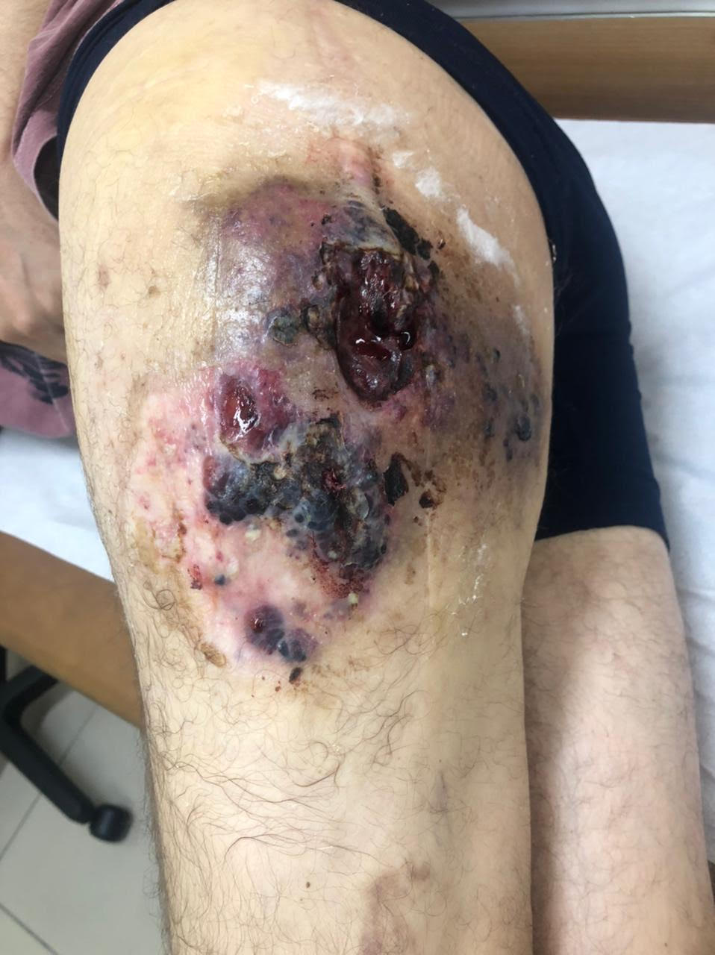
June/2020
March/2021

Slide 45
Impression:
Young adult with large PILA tumor of the right thigh, with limiting bleeding, pain and infection, previous treatment with multiple embolization and systemic chemotherapy.
Discussion:
Amputation (hemipelvectomy)
Systemic treatment for PILA or angiosarcoma
Radiation therapy

