Slide 1
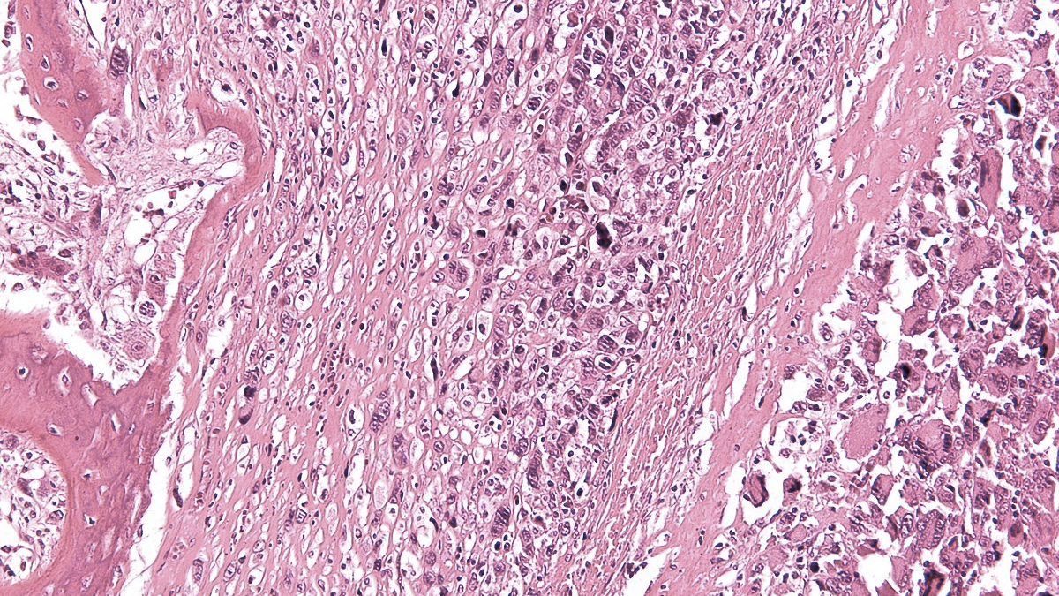


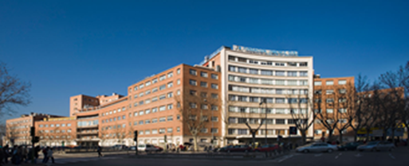
IX SELNET
CONSORTIUM MEETING
------WELCOME, INTRODUCTION & OVERVIEW------
2-March-2023
Maceió, Brazil
J Martin-Broto,
FJD; Madrid

Slide 2
DISCLOSURE
Consulting or Advisory Role
  PharmaMar, GSK, Novartis, Amgen, Bayer, Lilly, Roche, Tecnofarma, Asofarma
Speakers' Bureau
  PharmaMar
Research Funding
  Eli-Lilly, Novartis, Eisai, PharmaMar, Bayer, Pfizer, GSK, Lixte, Karyopharm, Celgene, BMS, Blue-Print, Deciphera, Nektar, Forma, Amgen, Daichii-Sanchyo.

Slide 3
INTRODUCTION
Checking the WP, Deliverables and Objectives
Networking is vital in sarcoma
Emphasizing MDT
Quo Vadis SELNET?

Slide 4





BRAZIL: The big brother

Slide 5
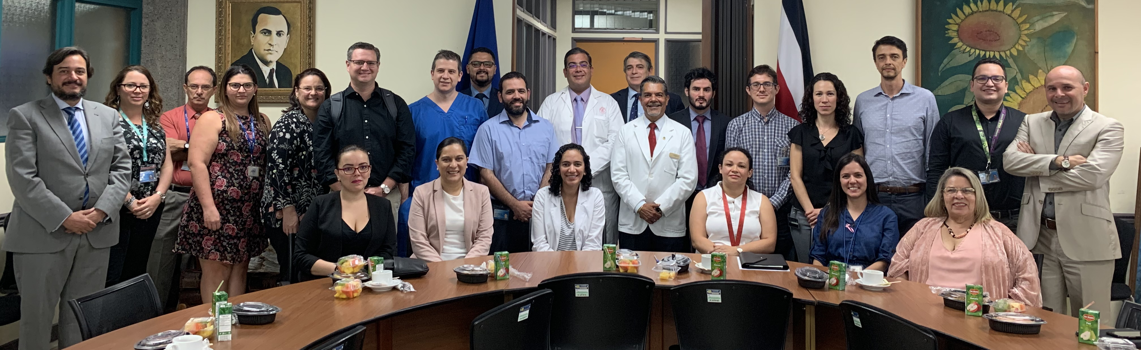
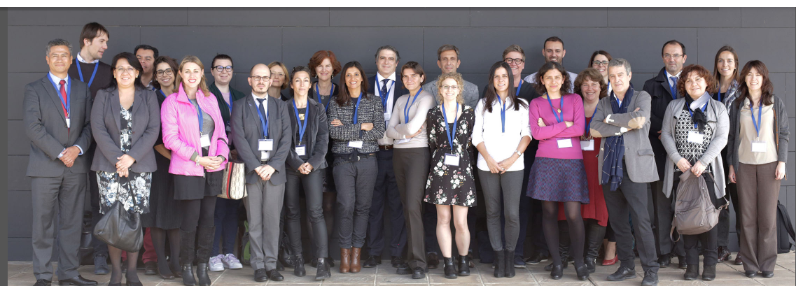
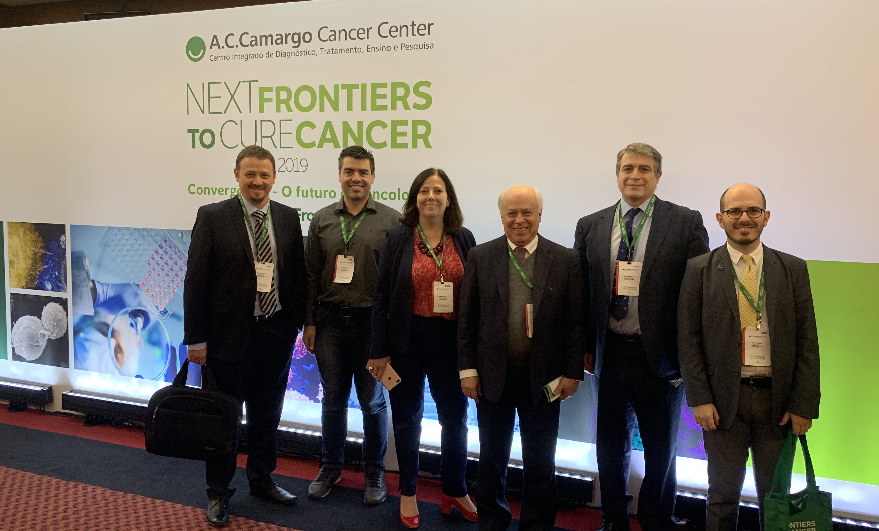
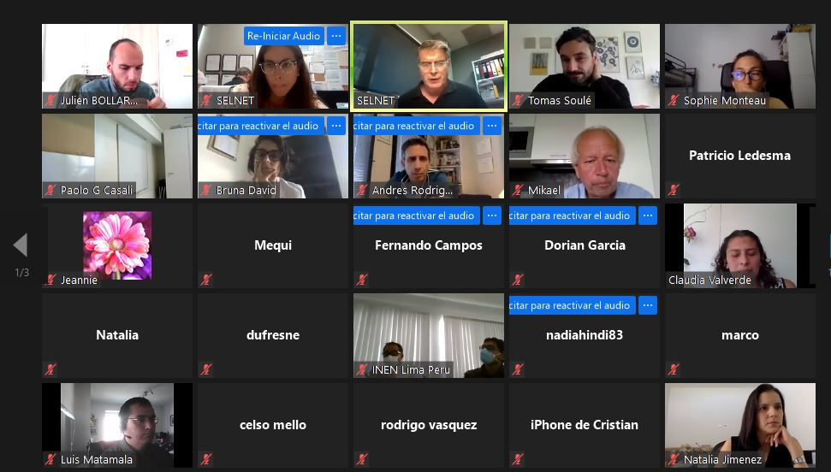
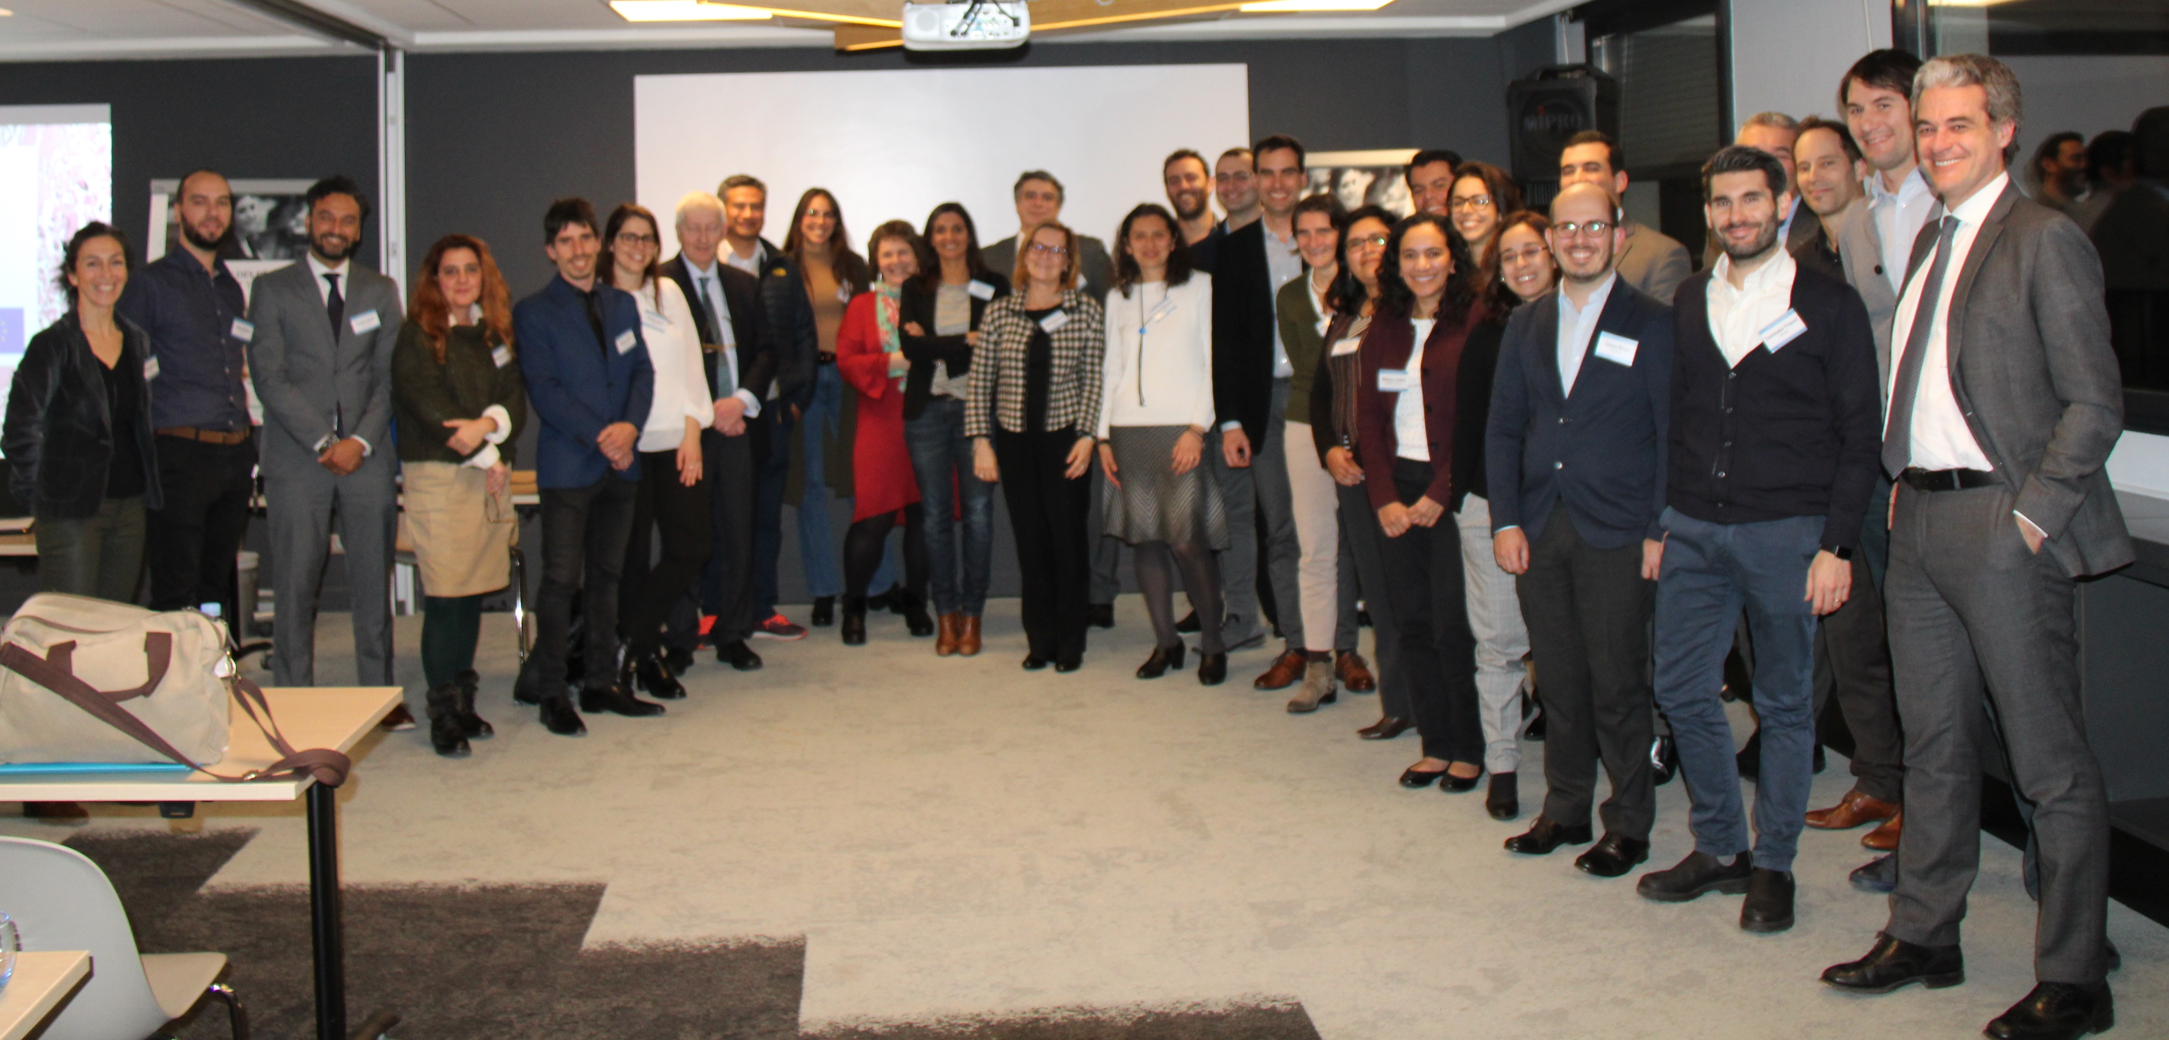
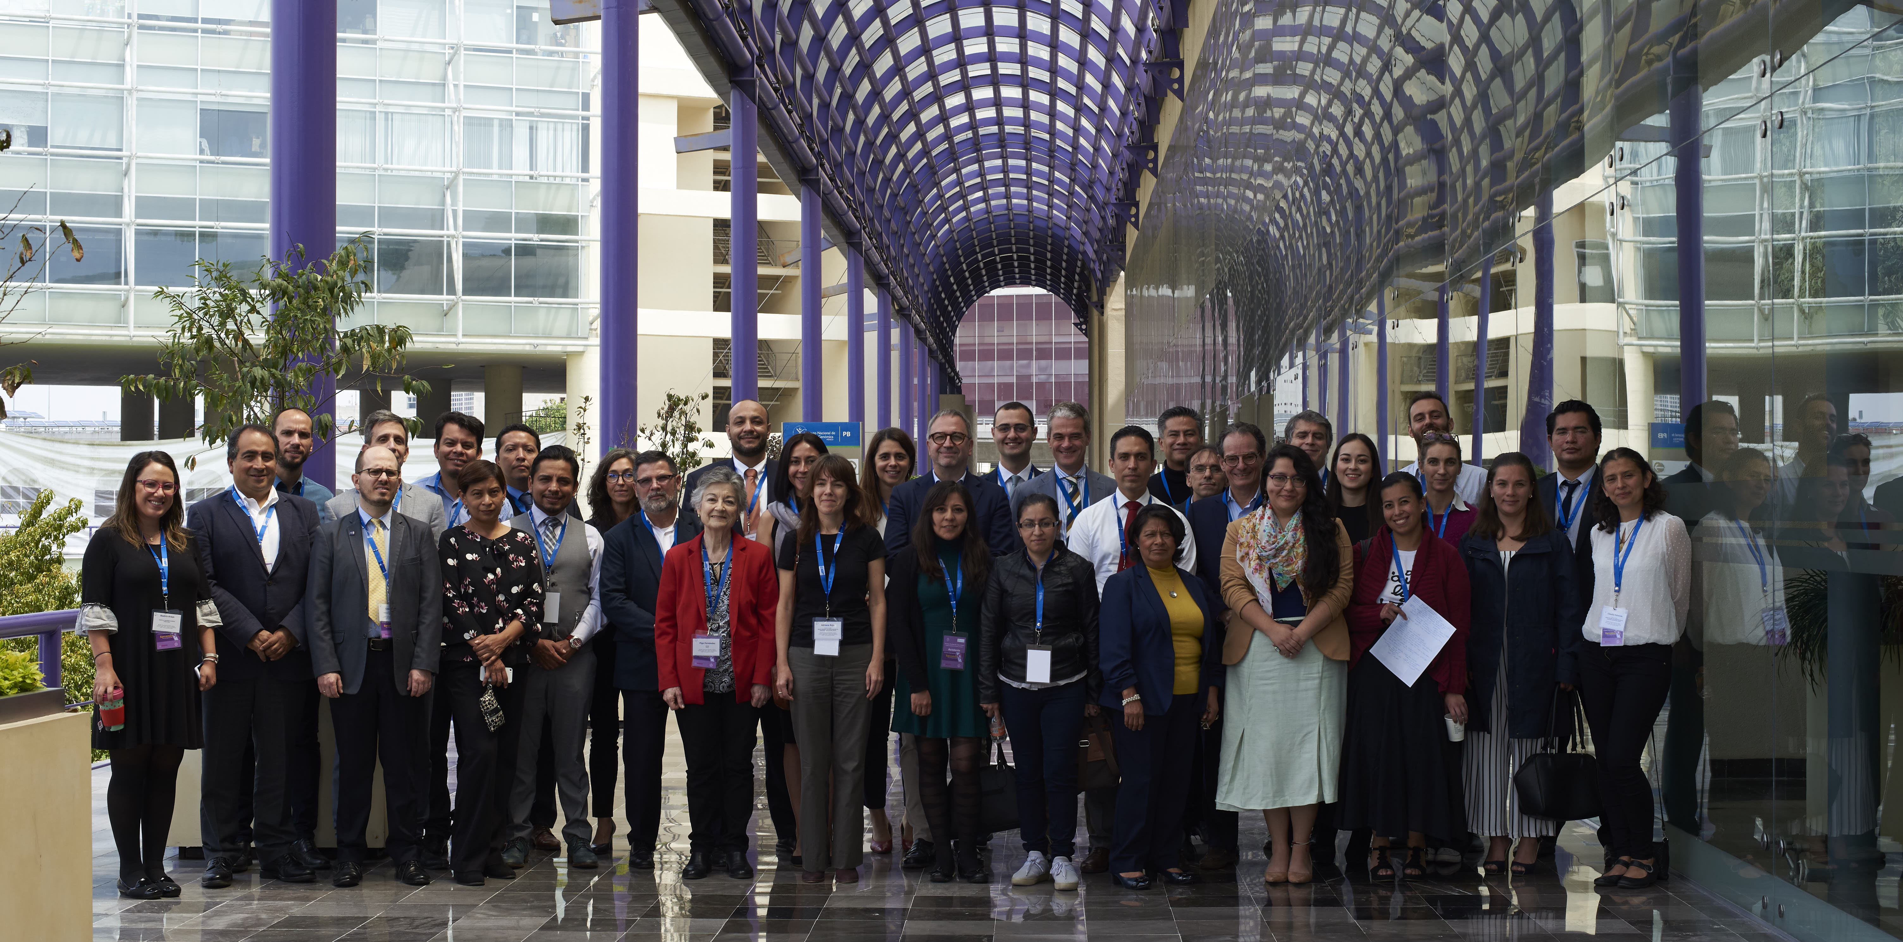
Seville 21-22 Feb 2019
San José 21 June 2019
Sao Paulo 17-18 May 2019
Virtual 03 Sept 2020
C de Mexico 19-21 Sep 2019
Lyon 9-10 Jan 2020

Slide 6
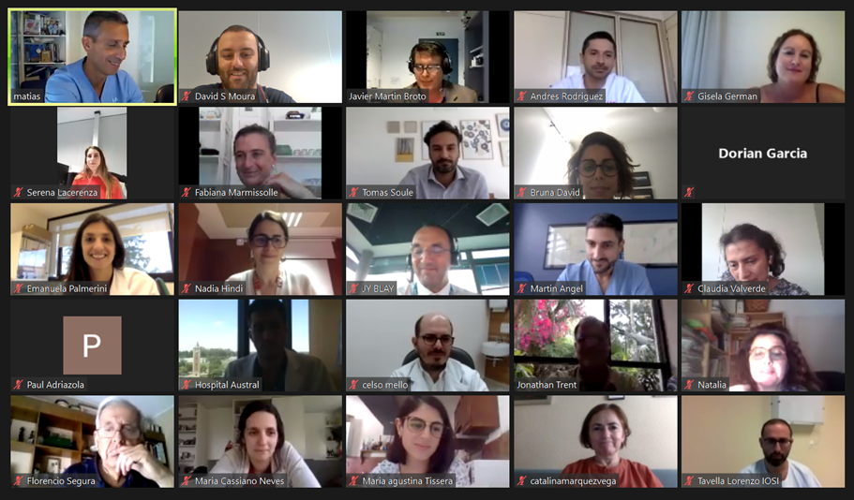

Slide 7
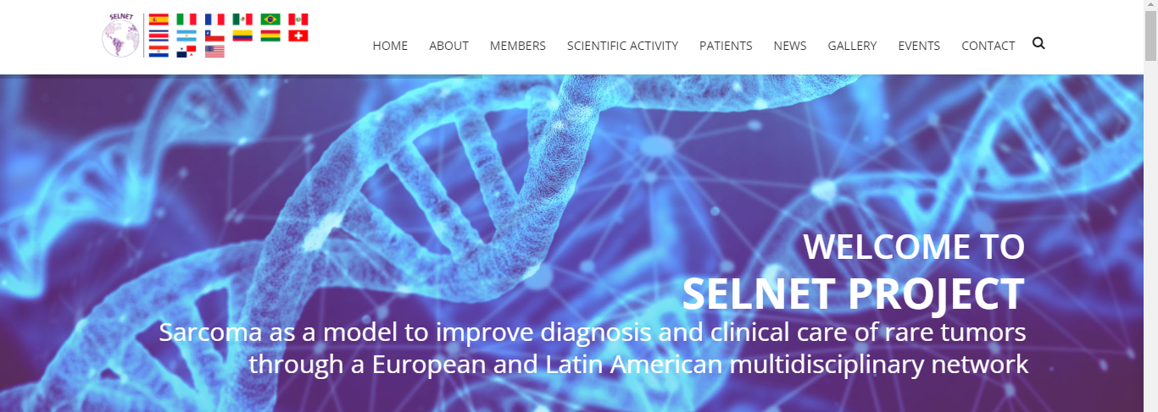
The WEBSITE is your tool…just USE IT

Slide 8
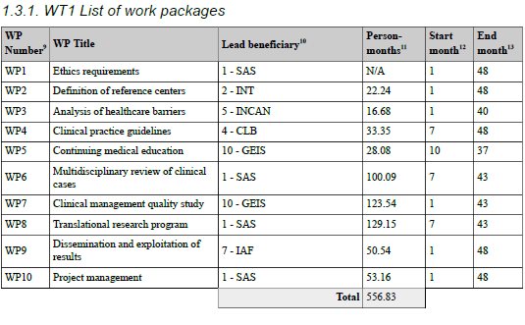
CHECKING THE WPs… Topics

Slide 9
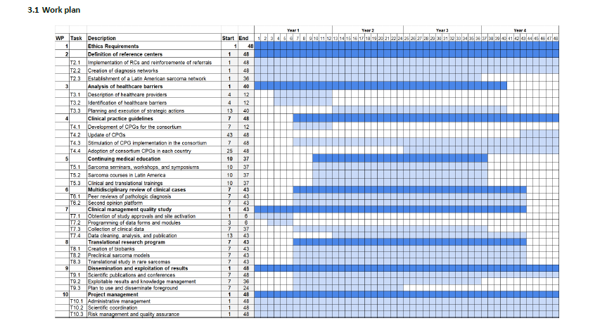
CHECKING THE WPs… Timing

Slide 10
CHECKING THE WPs…WP3
This analysis has been performed for reports but there is still pending a COMPLETE & DEEP investigation
This will be a useful tool to design how the REFERRAL of sarcoma patients might be organized
This will be a necessary tool to acknowledge about the INEQUITY
This will be a critical tool to dicuss how these barriers might be BROKEN in uncommon cancer
For going FORWARD a wider “HEALTHCARE BARRIER TASK FORCE” has been considered:
  Peruvian Public Health Expert
  SPAEN members
  Advocacy Groups
  Coordination Tean

Slide 11
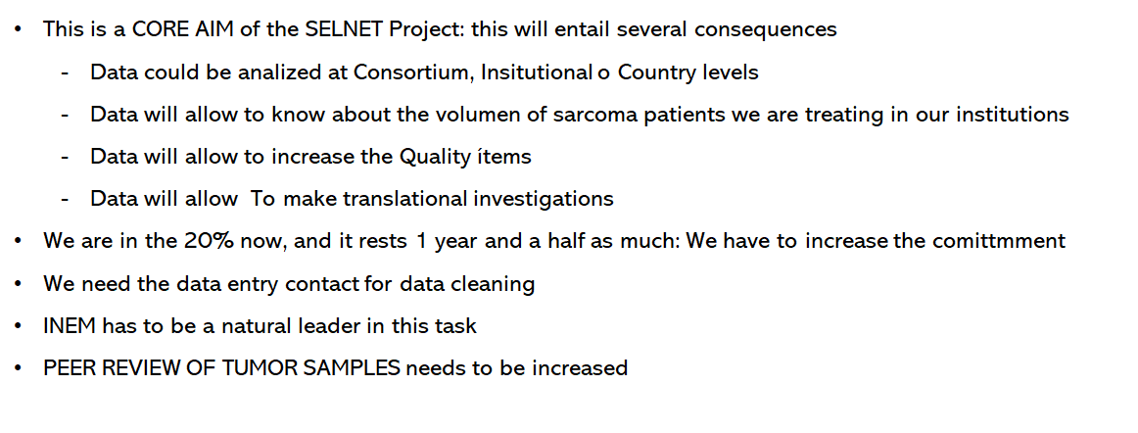
CHECKING THE WPs…WP6-7
OBSERVATIONAL STUDY: Still lacking 2/3

Slide 12
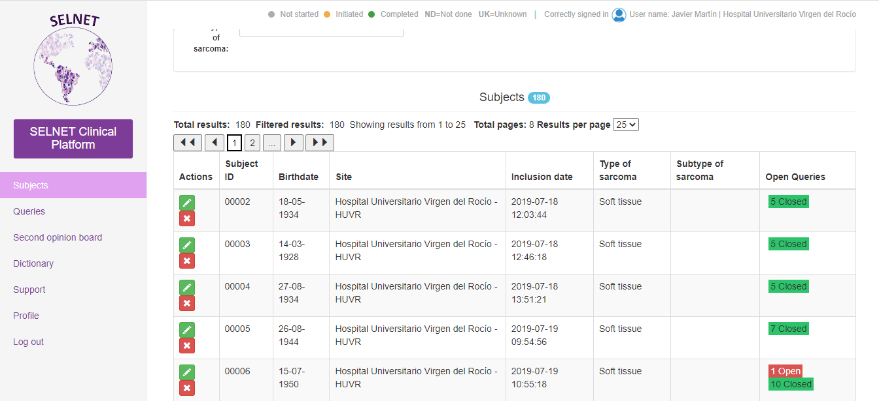
CHECKING THE WPs… Solving Queries

Slide 13



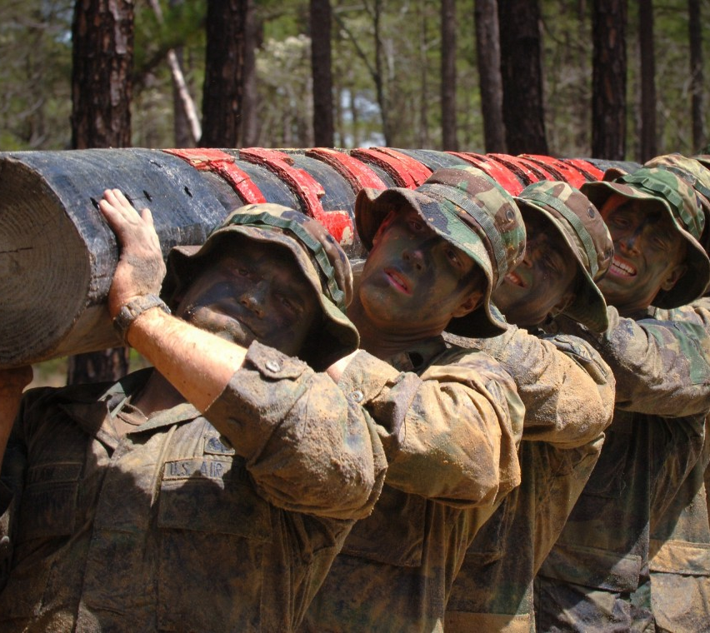
CHECKING THE WPs… Topics
Advantages Derived From SELNET Registry
Each Institution is owner of its own registered cases
This could represent a National Registry in some cases
The SELNET Registry will be the first big data for Sarcoma in LATAM
This will be a tool for checking Quality of Care ítems and its evolution over time
This will be a tool to measure the compliance for CPG and to measure outcome according to it
This will be useful to defend SELNET centers for conducting clinical trials
This will be helpful for academic papers based on clinical data from specific subtypes

Slide 14
CHECKING THE WPs 2 & 3
Congrats for the Lyon & Milan Teams
We need to follow with the NATIONAL ADOPTION PROCESSES of SELNET CPG
We need to advance in the Different MODELS of REFERRAL sarcoma patients by each Country
  The first level is the Professional discussion
  Patient Voice has to be incorporated
  Health managers have to be involved in this process

Slide 15
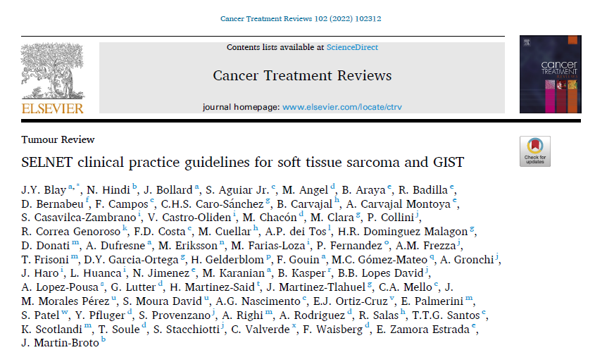
Publications
IF 12.11

Slide 16
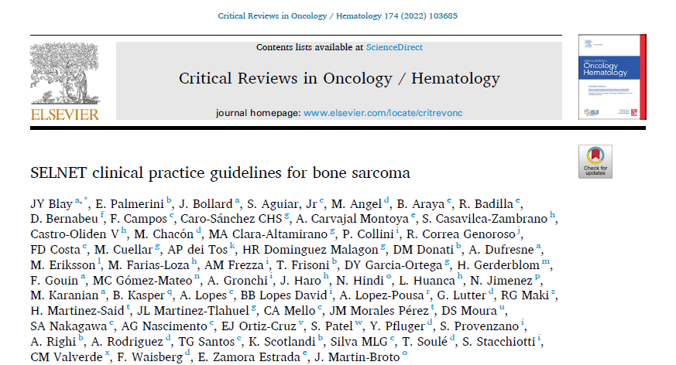
Publications
IF 6.3

Slide 17
CHECKING THE WP8
This is the most SCIENTIFIC PART of the current project
We can BRING NEW INSIGHTS in natural history, prognostic biomarkers, potential new targets in these entities
AC Camargo has submitted a new proposal for GRANT for DSRCT
There is an urgent need for ACCOMPLISHING THE NUMBERS by the end of this year (clinical data and blocks)
This will be our OWN FIRST SCIENTIFIC PRODUCTION AS A TEAM

Slide 18
SELNET WP8 TRANSLATIONAL RESEARCH
23/100
5/100
EMCh
DSRCT
Relevant to increase the knowledge on drivers
Relevant to discover prognostic biomarkers
Relevant to give insight on tumorigenesis
Based on Solidarity and Reciprocity
50/250
102/250
Angio
SFT

Slide 19
CHECKING THE WP6
The MDT CASES are working well, and substitutes the Platform for sharing cases
The PLATFORM might be activated at a National level to receive CONSULTING CASES
So far we present 5-6 cases every month
Consider the FAST TRACK way for pathology review
Consider the options for Clinical Trials
We need new Institutions will lead MDT meetings

Slide 20
NETWORKING IS VITAL IN SARCOMA
International Rare Cancer Initiative -IRCI is a joint initiative between NIH, Cancer Research UK, NCI and EORTC
COG
EURAMOS, EUROEWING Studies
Rhabdomyosarcoma Study Groups
Supranational Networks (EORTC, EURACAN, CONTICANET, TARPSWG, WSN, SELNET)
National Sarcoma Groups (SARC, GSF-GETO, ISG, SSG, BSG, GSG, GEIS, JSG, ASG)

Slide 21
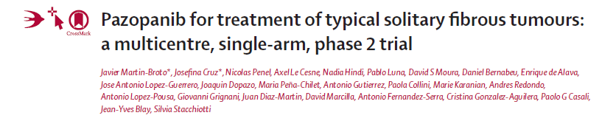

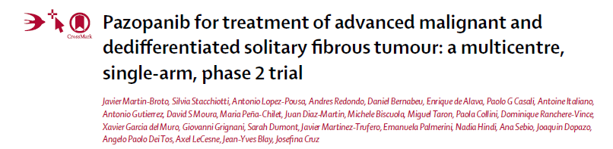


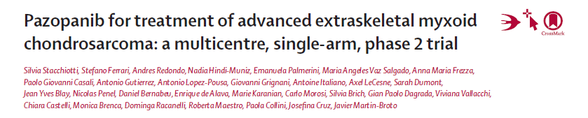
NETWORKING IS VITAL IN SARCOMA
Pazopanib as upfront line of antiangiogenic
Study Design:
TYPICAL SFT
CLOSED 34
GEIS-32
Simon 2-Stage phase II
Main endpoint: Response (Choi)
Pathologic Review & Radiological Assessment were Centralized
CT scans every 8 weeks
GEIS 32
MALIGNANT SFT
First Stage 12/23
Up to 31
EXTRASKELETAL MYXOID CHONDROSARCOMA
CLOSED 24
IDEA
GSK meeting
Kick off meeting
Data locked
Early 2013
October 2013
Sept 2014
June 2019

Slide 22
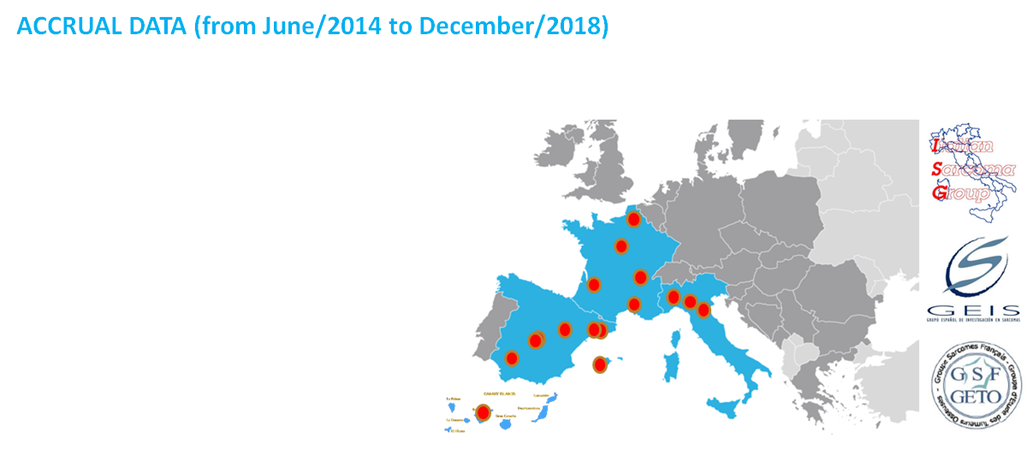
NETWORKING IS VITAL IN SARCOMA
Global CRO: GEIS/SOFPROMED
Monitoring at National Level
Central Pathology review pre Enrolment at national level
Central supranational Pathology review at the end
Central radiological assessment at the end
Translational at the end

Slide 23
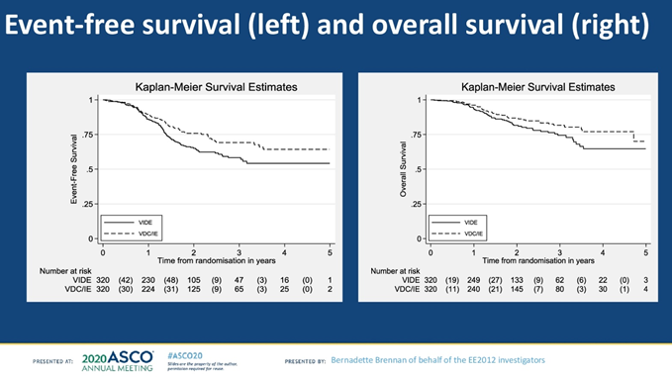
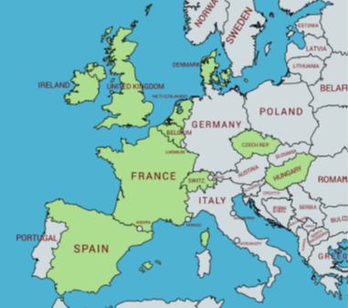
NETWORKING IS VITAL IN SARCOMA
EE12 VdC/IE vs VIDE/VAI
N= 640
Brennan et al; Jof Clin Oncol 38, no. 15_suppl (May 20, 2020) 11500-11500.

Slide 24
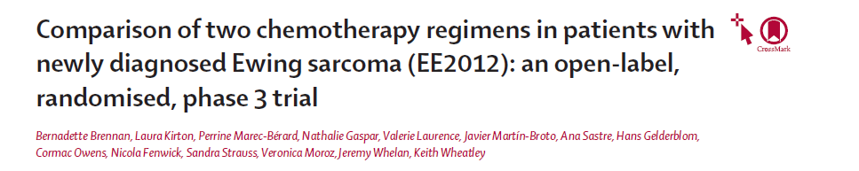
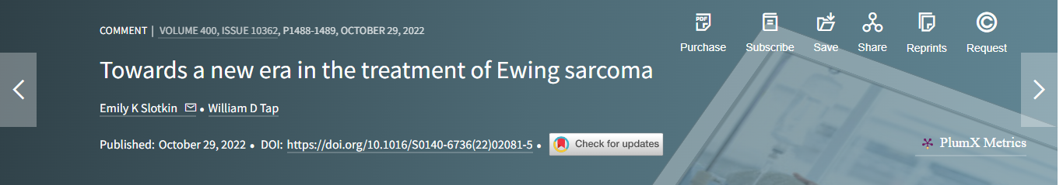
NETWORKING IS VITAL IN SARCOMA
Lancet 2022; 400: 1513–21
5 days ago

Slide 25



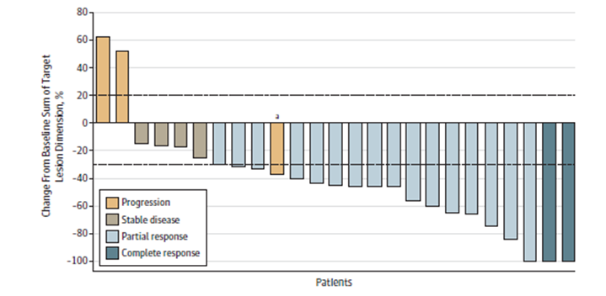
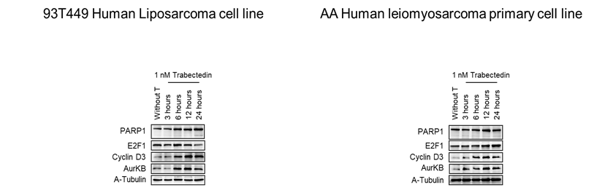
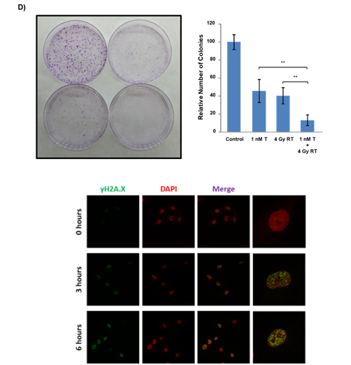
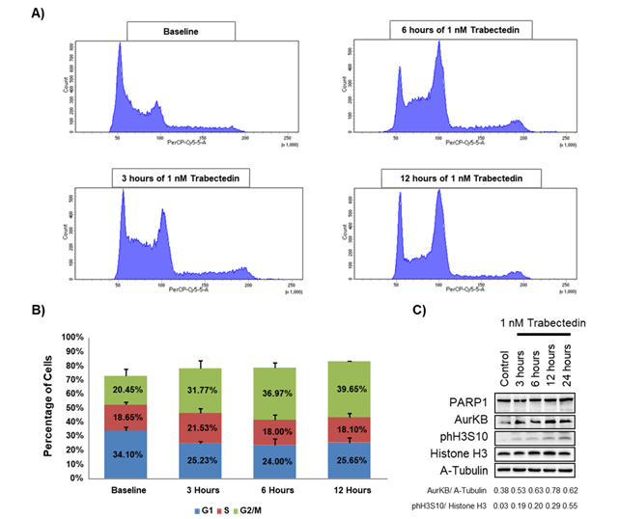
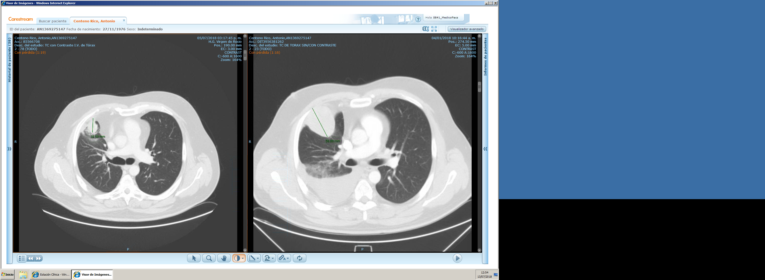
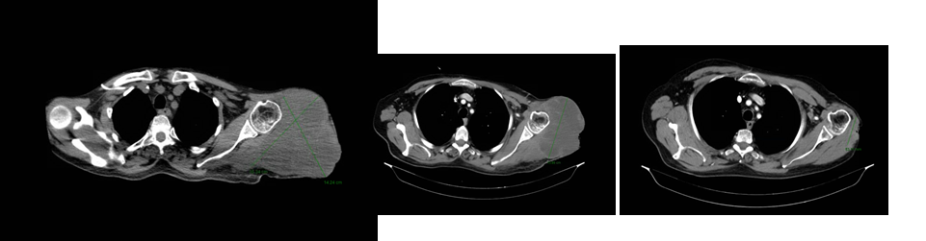
NETWORKING IS VITAL IN SARCOMA
Trabectedin & RT; A strong biological rational
4/JAN/2018
5/JUL/2018
JAMA Oncol 2020 Apr 1;6(4):535-541

Slide 26


NETWORKING IS VITAL IN SARCOMA
How to apply conventional CT designs to rare cancer community?
Complex designs with maximum utilities
IMMUNOSARC II TRIAL
Rationale
IMMUNOSARC I
Phase I
IMMUNOSARC I
Phase II
IMMUNOSARC II
Expansion coh
IMMUNOSARC II
New Cohorts
SUNITINIB + NIVOLUMAB
Chondro
EMCh
AngioS
SFT
ASPS
CCS
24
22
23
24
18
23

Slide 27
NETWORKING IS VITAL IN SARCOMA
How to apply conventional CT designs to rare cancer community?
Complex designs with maximum utilities
IMMUNOSARC II TRIAL
Rationale
IMMUNOSARC I
Phase I
IMMUNOSARC I
Phase II
IMMUNOSARC II
Expansion coh
IMMUNOSARC II
New cohorts
UPS & LMS
30
OST
Clinicaltrialsregister.eu Identifier: 2016-004040-10
ClinicalTrials.gov Identifier: NCT03277924
30

Slide 28
NETWORKING IS VITAL IN SARCOMA
Starting now the 83 GEIS Study
Advocacy Groups
Spaen, FMPJC, AEAS, GIST Sp, VYDA, ASARGA, APSATUR
International Collaborative projects: > 20 Studies
Collaborations
ISG, FSG, GSG, BSG, SSG, Netherlands, USA, Taiwan, EORTC, EE12 Consortium, WSN,
More than 30 Buesa Grants
More than 150 Abstracts in International Congresses
More than 100 Scientific Papers

Slide 29

EMPHASIZING MDT
Phisics
Engineering
Analytical Astronomy
Observational Astronomy
Geology

Slide 30
EMPHASIZING MDT
LOCAL
NATIONAL
INTERNATIONAL

Slide 31
EMPHASIZING MDT: GBSARC
NATIONAL COOPERATIVE GROUPS
LOCAL
TEACHING PROGAMS
CPG BUILT IN A MDT WAY
NATIONAL
NETWORKS FOR PATHOLOGY
INTERNATIONAL
MOLECULAR LAB
REFERRAL FOR LOCAL TREATMENTS

Slide 32
EMPHASIZING MDT
INTERNATIONAL
TEACHING PROGAMS
LOCAL
CLINICAL TRIALS
CPG BUILT IN A MDT WAY
TRANSLATIONAL RES
NETWORKS FOR PATHOLOGY
NATIONAL
MOLECULAR LAB
ULTRARARE TUMORS
INTERNATIONAL
REFERRAL FOR LOCAL TREATMENTS

Slide 33

Quo Vadis SELNET?
Cornerstone
Strategy
Consolidation
UE GRANT
LEGAL ENTITY
ORGANIZATION

Slide 34
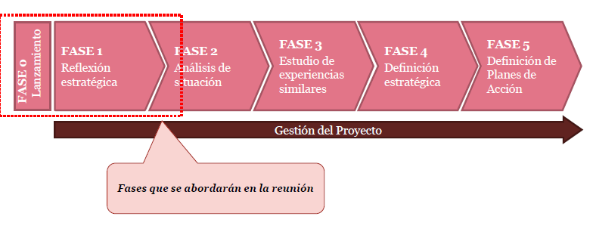
Quo Vadis SELNET?
GEIS STRATEGIC PLAN
Action plan
Self-Examination
Situation analyses
Strategic definition
Similar experiences
2011
2012

Slide 35



STRATEGIC PLAN
SARCOMA COOPERATIVE GROUPS (SCG): Scientific Association
SCG (most of them) have their own structure for Clinical Trials
Sub Committees by Pathology and Speciality
Research, Teaching and Clinical Assistance

Slide 36
REMARKS
We have to accomplish the SELNET objectives and ONLY ONE YEAR IS LEFT
We need leadership TO MOTIVATE AND ENCOURAGE OTHERS to participate
There is a time for PLANTING, and a time for HARVEST
MDT is a hallmark of Sarcoma Care and Research, LET’S EMPHASIZE IT
ACADEMIC TRIALS (investigator-driven) are crucial for rare tumors and we need to afford CLINICAL RESEARCH in SELNET
We need to decide if we are walking towards a CONSOLIDATION

