Slide 1
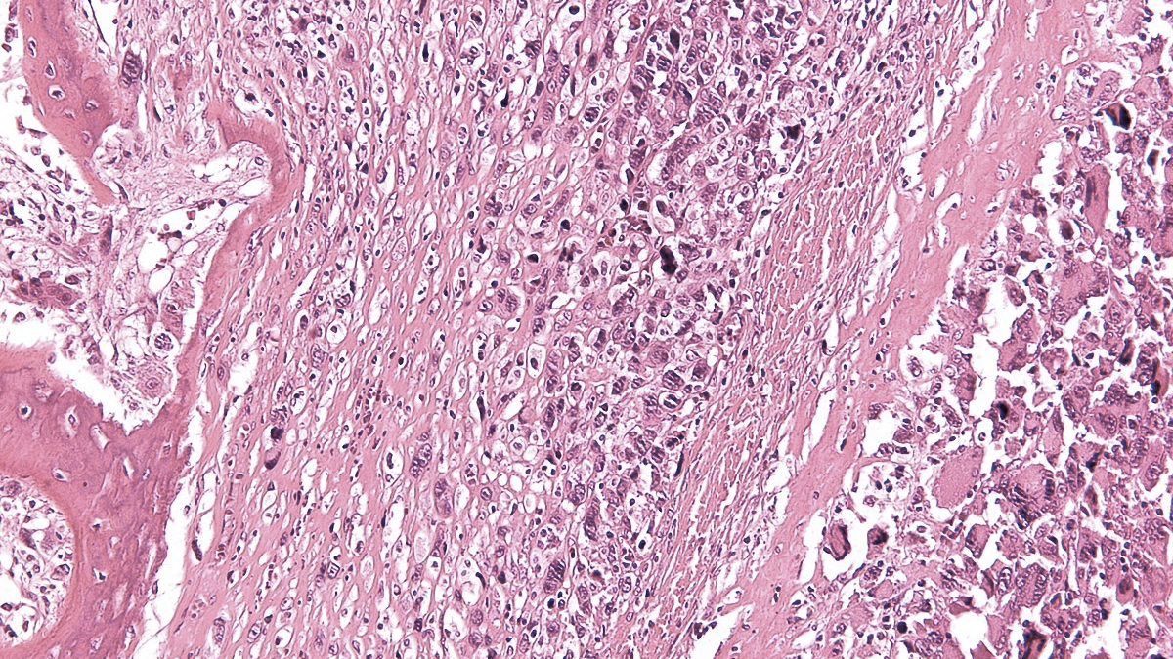
VIII SELNET
CONSORTIUM MEETING
WP2: Definition of reference centers
02nd-04th March 2023
Salvatore Provenzano,
Fondazione IRCCS
Istituto Nazionale dei Tumori, Milan, Italy

Slide 2
SELNET WP 2 / Definition of Reference Centers – INT, All
WorkPackage objectives:
1.1 To implement Reference Centers and reinforce sarcoma patient referral policies to them
1.2 To create national pathologic and molecular sarcoma diagnosis networks
1.3 To establish a Latin American sarcoma network to endorse improvement in sarcoma care, continuing medical education and research

Slide 3
SELNET WP 2 / Definition of Reference Centers – INT, All
2019: Definition of Sarcoma RCs criteria
Case volume
Multidisciplinarity
Facilities and Equipment
Research
Continuous Medical Education
Patient empowerment

Slide 4
SELNET WP 2 / Definition of Reference Centers – INT, All
2021 – 2022
A series of VCs with each LA partner
The importance of RCs and networking
Expertise, multidisciplinarity, research
The experiences in Europe
ERNs, NETSARC, RTR
RC criteria
Models of networking
Centralized VS hub-and-spoke
Managed VS non-managed
Problems/Solutions

Slide 5
SELNET WP 2 / Definition of Reference Centers – INT, All
Problems
Co-exhistence of different, irreconcialable, health systems (public/private)
Heterogeneity in delivery of care
Poor availability of certain facilities/equipment (e.g. molecular pathology)
Social, geographical and economical limitations to health migration
Lack of institutional procedure/support

Slide 6
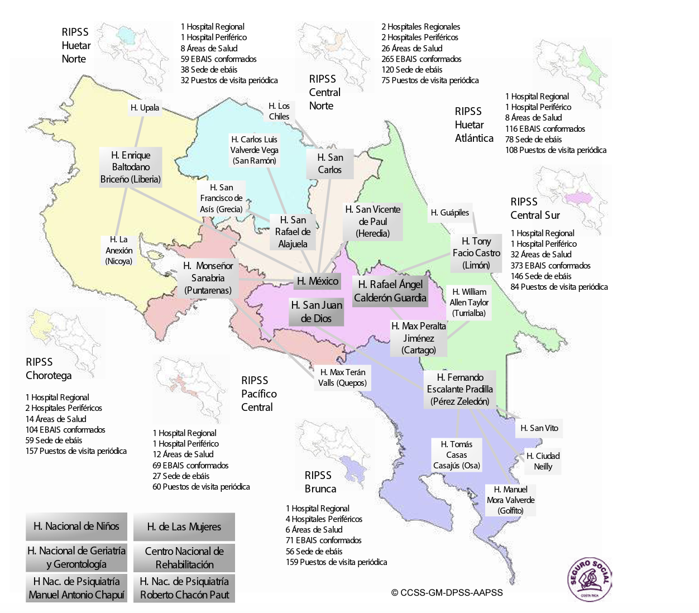
SELNET WP 2 / Definition of Reference Centers – INT, All
Each of the national hospital has the necessary expertise in sarcomas
Medical Oncologist
Orthopedist
Pathologist
Surgeon Oncologist
Radiation Oncologist
Infrastructure and other specialists needed for patients with sarcomas
Congratulations!!!

Slide 7
SELNET WP 2 / Definition of Reference Centers – INT, All
National Sarcoma Group
Multicenter Sarcoma Board
Research
Network of referral
Databases
Regular VCs
Virtual slide sharing?
Patients/Expertise
CPGs and RC criteria adoption
RC identification (Costa Rica)
Meetings
Patient empowerment
Trials
CME
Take charge of future institutional developments of referral centers
and sarcoma patient care in LACs

Slide 8
SELNET WP 2 / Definition of Reference Centers – INT, All
Congratulations!!!

Slide 9
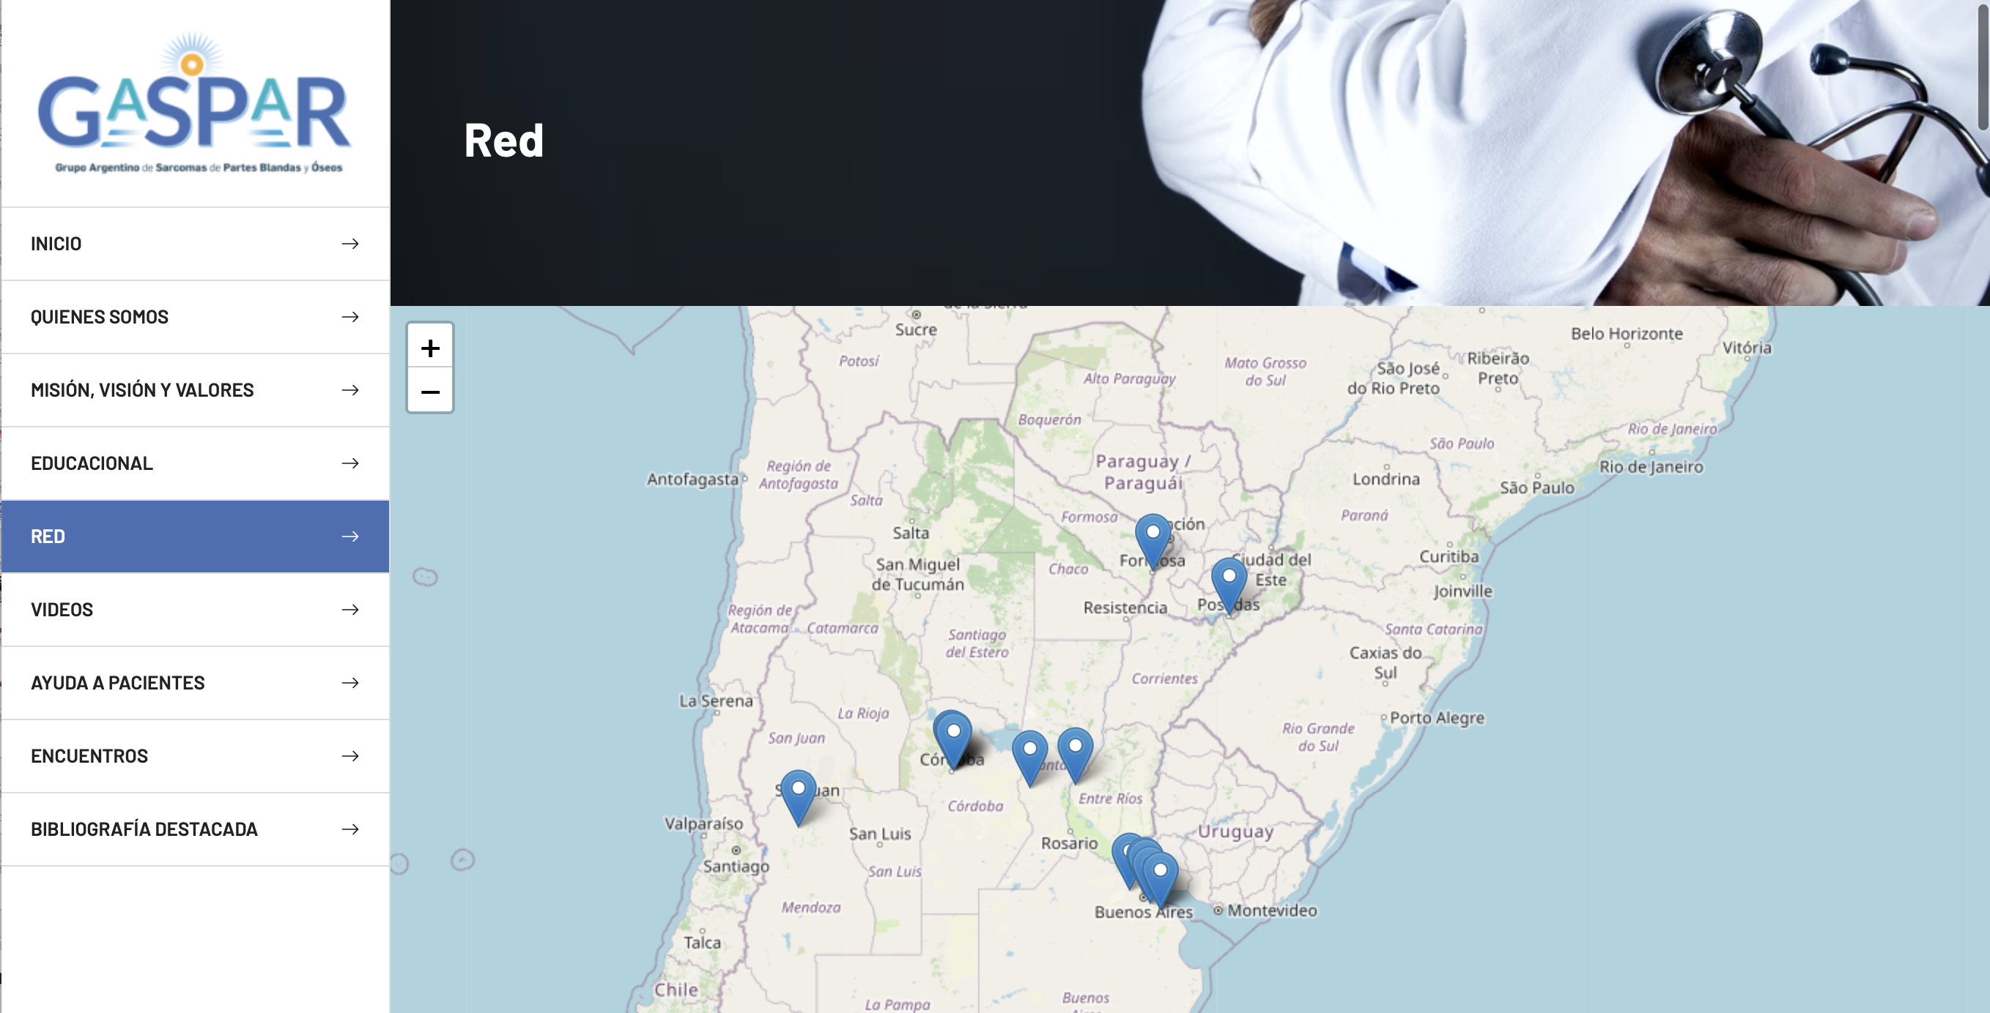
SELNET WP 2 / Definition of Reference Centers – INT, All
Congratulations!!!

Slide 10
SELNET WP 2 / Definition of Reference Centers – INT, All
Next steps
Surveys to be sent in the next weeks
Scan widely the activities ongoing in NSGs
To identify any weak points and special needs as to foster NSGs
Paper
Set adopted and common bases, recommendations for the future in LAC
Adapt RCs general criteria to each country
Spread the news
Create NSG brands

Slide 11
SELNET WP NUMBER/ NAME- PARTICIPANTS
Thank you
VIII SELNET CONSORTIUM MEETING (November 2022)

