Slide 1
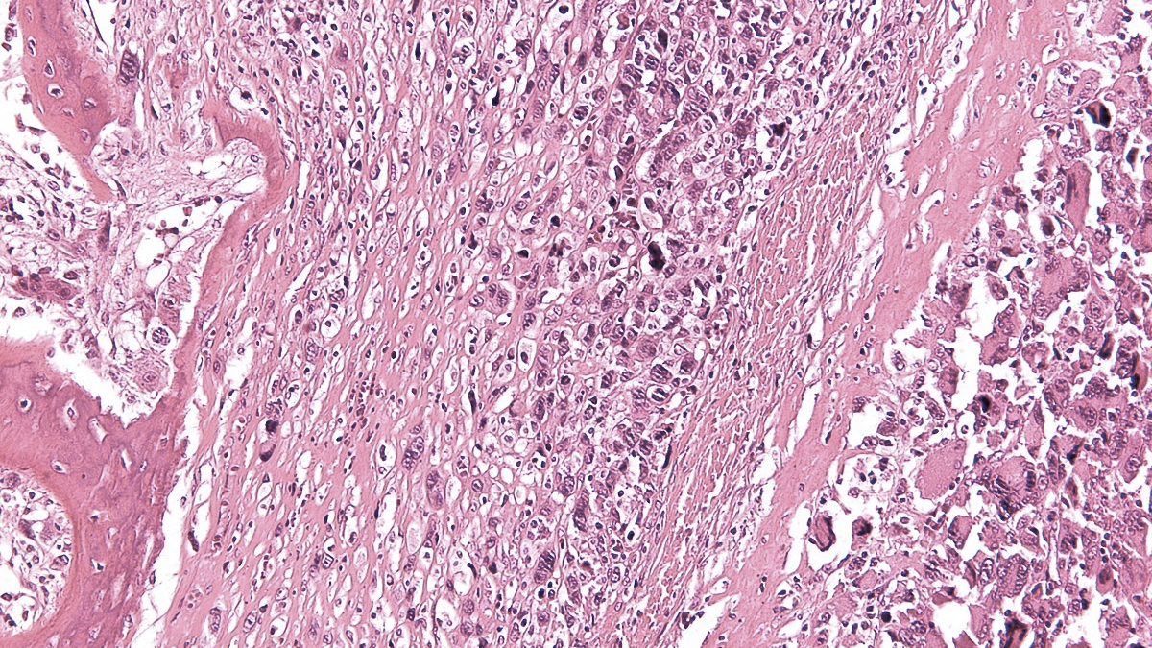

IX SELNET
CONSORTIUM MEETING
WP 1 and WP 10: Ethics requirements and Project Management
02nd-04th March 2023
Marta Martín-Ruiz,
IIS-FJD,
Madrid, Spain
Maceió, Brazil

Slide 2
SELNET
WP1: Ethics requirements - IIS-FJD
All the deliverables of this WP have been submitted and accepted
The Independent Ethics Advisory Board (EAB), composed by M Eriksson, H Gelderblom has F Waisberg has to review the Third Periodic Report and elaborate a Ethics Report 01/01/2022 to 01/12/2022.
Two site visit reports, one from Argentina and the other from Brazil.
Ensure compliance with Ethic Requirements for every partner.

Slide 3
SELNET timeline
Jan 2019
Dec 2022
Dec 2023
First Period
(Jan 2019- June 2020)
Second Period
(July 2020- Dec 2021)
Third Period
(Jan 2022-Dec 2022)
Fourth Period
(Jan 2023-Dec 2023)
TIME
AMM
AMM
AMM
P1 report
P2 report
P3
report
Final report
REPORTS
Feb 2019
August 2021
August 2022
PRE-funding (53.33%)*
P1 (15%)
P2 (15%)
P3 (16.67%)
FUNDS

Slide 4
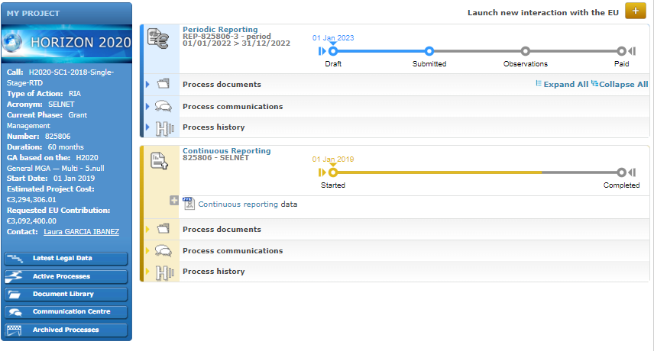
SELNET
WP10: PROJECT MANAGEMENT- IIS-FJD
Third Period Report:
Submitted on 27/02/2023. Check in the EU platform.
EVERY FUNDED PARTNER HAS TO FORESEE ITS OWN BUDGET FOR PERSONEL AND ITS DISTRIBUTION IN PERSON-MONTH
Every 6 months an update of the financial status has to be sent to the coordinator→ JUNE 2023. Financial and administrative Manager IIS-FJD: cristina.roldanm@quironsalud.es

Slide 5
SELNET
WP10: PROJECT MANAGEMENT- IIS-FJD
Planned PM
In the GA
Deviation

Slide 6
SELNET
WP10: PROJECT MANAGEMENT- IIS-FJD
 | TOTAL 1ST PERIOD | TOTAL 2ND PERIOD | TOTAL 3RD PERIOD | TOTAL | EU FUNDING GA | % | Remaining 4th period
PARTNER 1 IIS-FJD | - | 38.398,84 € | 182.856,79 € | 221.255,63 € | 567.270,06 € | 39,00% | 346.014,43 €
PARTNER 2 INT | 128.319,79 € | 253.149,85 € | 53.215,64 € | 434.685,28 € | 450.000,00 € | 96,60% | 15.314,72 €
PARTNER 3 IOR | 117.503,31 € | 171.350,89 € | 117.810,99 € | 406.665,19 € | 432.000,00 € | 94,14% | 25.334,81 €
PARTNER 4 CLB | 82.118,42 € | 145.218,84 € | 121.587,99 € | 348.925,25 € | 486.000,00 € | 71,80% | 137.074,75 €
PARTNER 5 INCAN | NA | NA | NA | - | NA | - | NA
PARTNER 6 ACC | NA | NA | NA | - | NA | - | NA
PARTNER 7 IAF | 66.898,81 € | 56.601,25 € | 47.952,35 € | 171.452,41 € | 194.400,00 € | 88,20% | 22.947,59 €
PARTNER 8 FUNDAEVI | 1.867,50 € | - | 71.256,86 € | 73.124,36 € | 180.000,00 € | 40,62% | 106.875,64 €
PARTNER 9 INEN | 26.163,99 € | 38.988,75 € | 31.209,20 € | 96.361,94 € | 176.400,00 € | 54,63% | 80.038,06 €
PARTNER 10 GEIS | 59.260,00 € | 44.266,61 € | 60.457,76 € | 163.984,37 € | 216.979,93 € | 75,58% | 52.995,56 €
PARTNER 11 SPAEN | 8.982,08 € | 2.025,00 € | 10.550,00 € | 21.557,08 € | 75.600,00 € | 28,51% | 54.042,92 €
TOTAL | 491.113,90 € | 750.000,03 € | 696.897,58 € | 1.938.011,51 € | 2.778.649,99 € | 69,75% | 840.638,48 €

Slide 7
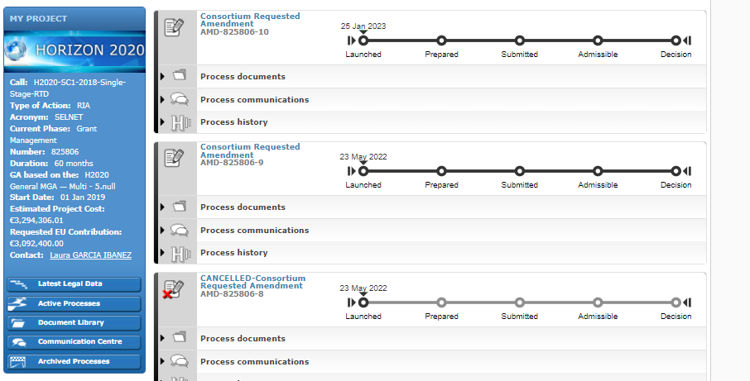
SELNET WP NUMBER/ NAME- PARTICIPANTS
AMENDMENT:
Increase the PM (IIS-FJD) for the last period.
Partner P6 Camargo center has applied to several national grants for external funding to perform the experiments detailed in the GA, but unfortunately they were not successful in these calls.
IIS-FJD will be transferred from our direct personnel costs to our other direct costs and be used to cover the translational research project in desmoplastic small round cell tumor, which is supervised by the P6.
Changes of Annex 1
Changes of Annex 2
See on the EU platform on the archived process or document library .

Slide 8
SELNET
WP10: PROJECT MANAGEMENT- IIS-FJD
Next deliverables dates!!
We are in great urgency to include more clinical cases to the Selnet database.
Deliverable | Current | Extension
D2.2 | 48 | 60
D2.3 | 48 | 60
D2.4 | 48 | 60
D4.2 | 48 | 60
D5.3 | 36 | 60
D6.1 | 43 | 57
D6.2 | 43 | 57
D7.3 | 43 | 55
D7.4 | 43 | 57
D8.1 | 43 | 55
D8.2 | 43 | 55
D8.3 | 43 | 60
D9.4 | 48 | 60
D10.4 | 48 | 60
D10.5 | 48 | 60
The Costa Rica MTA was approved. Register cases and send the tumor block.
Next deliverables
D6.1 : Pathologic peer review results report [57]
D6.2 : Second opinion activity report [57]
D7.3 : Report on locked database for STS, BS, and GIST cohorts [55]
D7.4 : Report on final results report for STS, BS, and GIST cohorts [57]
D8.1 : SELNET virtual biobank report [55]
D8.2 : Report on the international platform for preclinical research [55]
WP 7
WP 6
WP 8
Notes:
57 mean

Slide 9



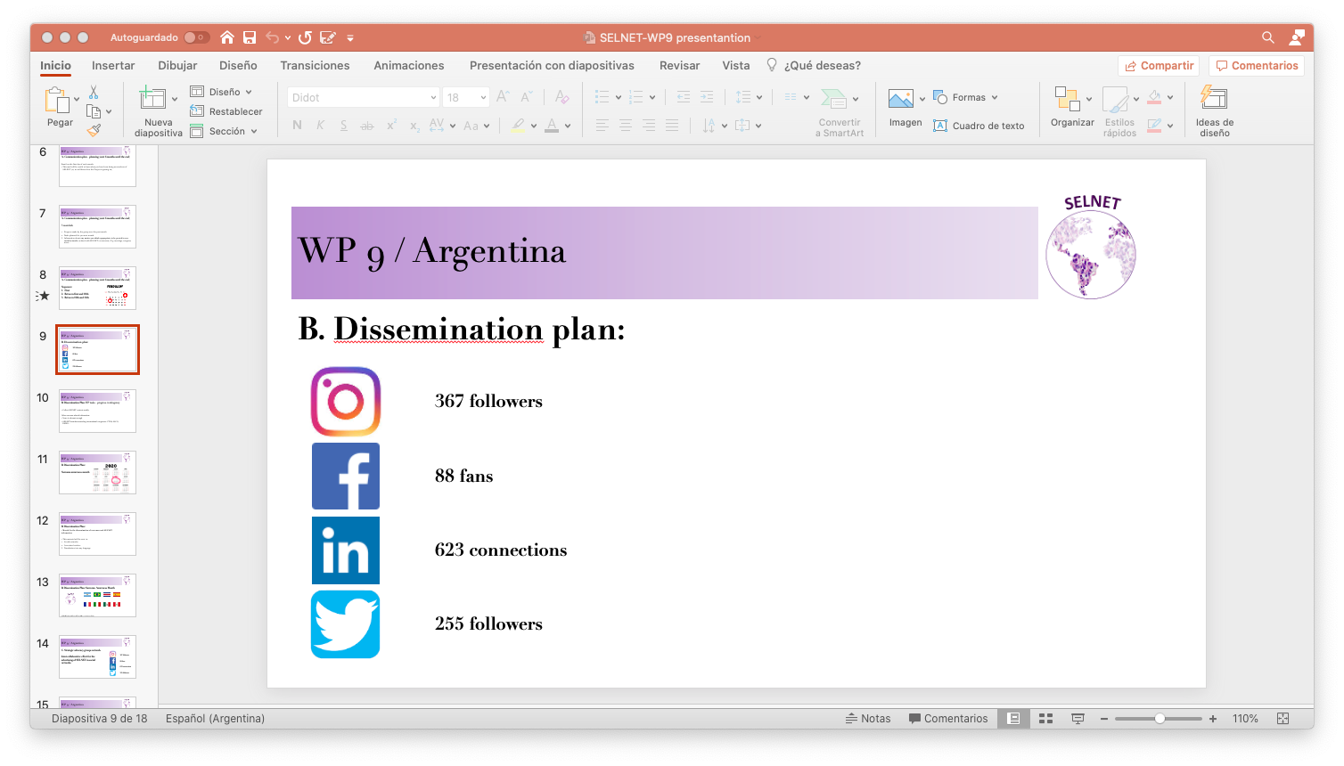

SELNET
WP10: PROJECT MANAGEMENT- IIS-FJD
Communication!
WP10 NEWS SELNET-WPs
@selnet_h2020
Sarcoma European & LatinAmerica Network
WP9 (IAF)
SOCIAL MEDIA
SELNET
@SelnetH2020
https://selnet-h2020.org/
NEXT CONSORTIUM MEETING IN ARGENTINA:
DATES, VANUE???

Slide 10

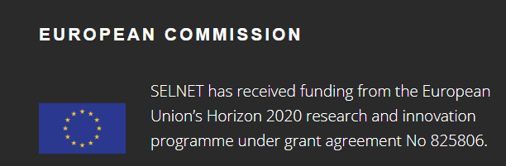
SELNET
WP10: PROJECT MANAGEMENT- IIS-FJD
Obrigada, gracias, merci, grazie, thank you!
Maceió, Brazil
Marta Martín Ruiz, PhD
Project Manager
SELNET coordination team
martamartinruiz@atbscar.org
IX SELNET CONSORTIUM MEETING (March 2023)

