Slide 1
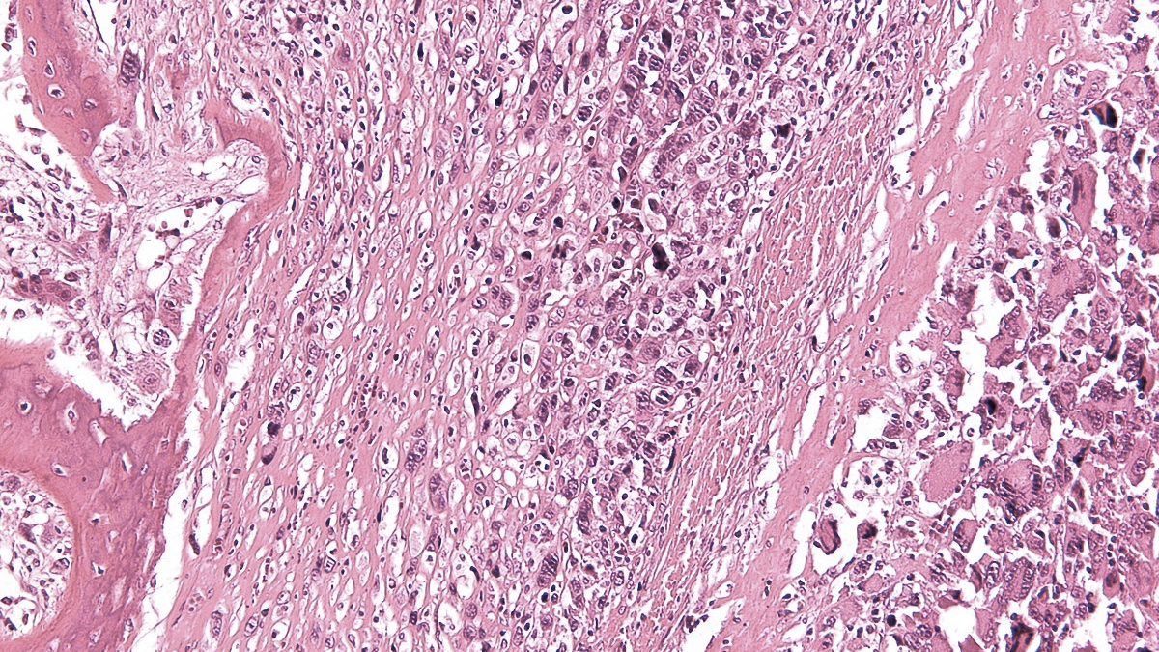
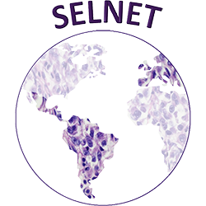
IX SELNET
CONSORTIUM MEETING
Healthcare barriers in Latam
02nd-04th March 2023
Matías Chacón, Fleming Institute, Buenos Aires, Argentina

Slide 2
Brief agenda
Number of cases in the region
Description of 7 countries National Health systems
Barriers
Tools from SELNET to improve care in sarcoma patients
Discussion

Slide 3
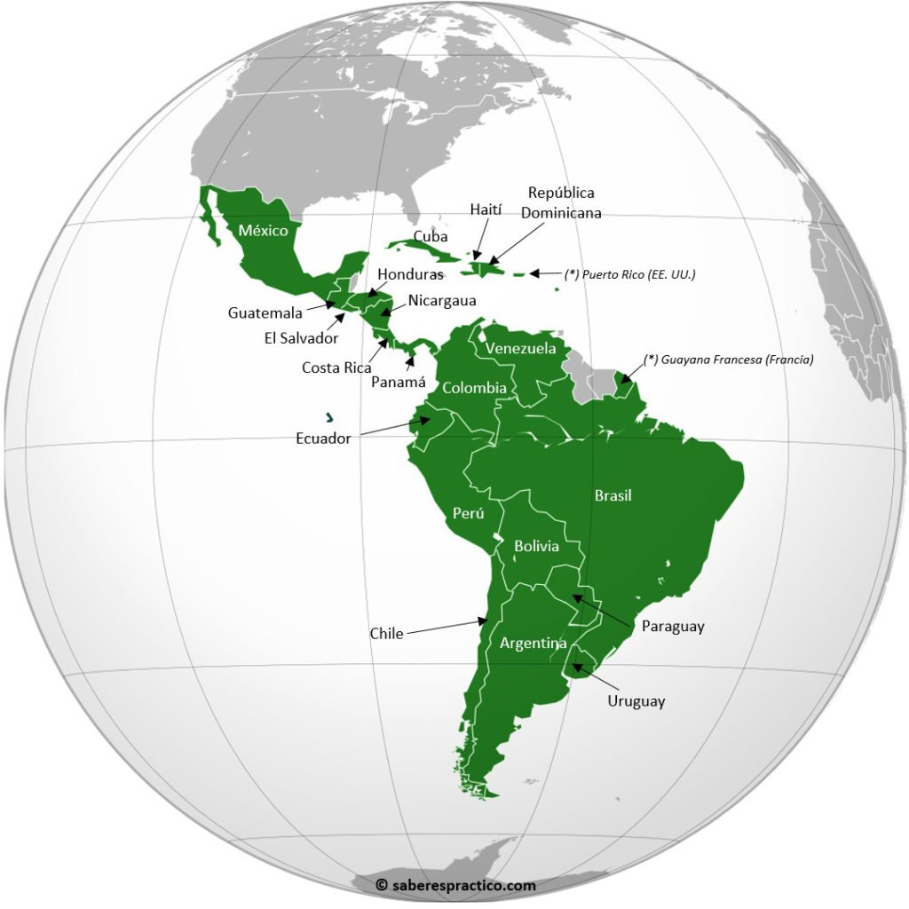
New cases of cancer/ year: 1.402.411
2
Cuba (11,300,000- 46.794 tumors)
Méjico (129,000,000- 195,500 tumors)
Republica Dominicana (10,900,000-19,800 tumors)
Guatemala (18,000,000-16.600 tumors)
Honduras (9,900,000- 10.600 tumors)
El Salvador (6,500,000-9600 tumors)
Nicaragua (6,600,000- 7.990 tumors)
Costa Rica ( 5,000,000-13.100 tumors)
Venezuela (28,000,000- 58.424 tumors)
Panamá (4,315,000-7.600 tumors)
4
Colombia (50,880,000-113.221 tumors)
Ecuador (11,300,000- 29.236 tumors)
1
Perú (32,900,000- 68.849 tumors)
Brasil (212,000,000- 592.212 tumors)
Chile (19,450,000- 54.227 tumors)
Paraguay (7,133,000-12.920 tumors)
Uruguay (3,500,000- 15.757 tumors)
3
Argentina (46,0000,000- 130.878 tumors)
IARC 2020
Matías Chacón

Slide 4
New cases of sarcomas/ year: 14.024
2
Cuba (11,300,000- 467 sarcomas)
Méjico (129,000,000- 1.955 sarcomas)
Republica Dominicana (10,900,000-198 sarcomas)
Guatemala (18,000,000- 166 sarcomas)
Honduras (9,900,000- 106 sarcomas)
El Salvador (6,500,000- 96 sarcomas)
Nicaragua (6,600,000- 80 sarcomas)
Costa Rica ( 5,000,000- 131 sarcomas)
Venezuela (28,000,000- 584 sarcomas)
Panamá (4,315,000- 76 sarcomas)
4
Colombia (50,880,000- 1132 sarcomas)
Ecuador (11,300,000- 293 sarcomas)
1
Perú (32,900,000- 688 sarcomas)
Brasil (212,000,000- 5.920 sarcomas)
Chile (19,450,000- 542 sarcomas)
Paraguay (7,133,000-130 sarcomas)
Uruguay (3,500,000- 15.7 sarcomas)
3
Argentina (46,0000,000- 1.380 sarcomas)
IARC 2020
Matías Chacón

Slide 5
Brief agenda
Number of cases in the region
Description of 7 countries National Health systems
Barriers
Tools from SELNET to improve care in sarcoma patients
Discussion

Slide 6
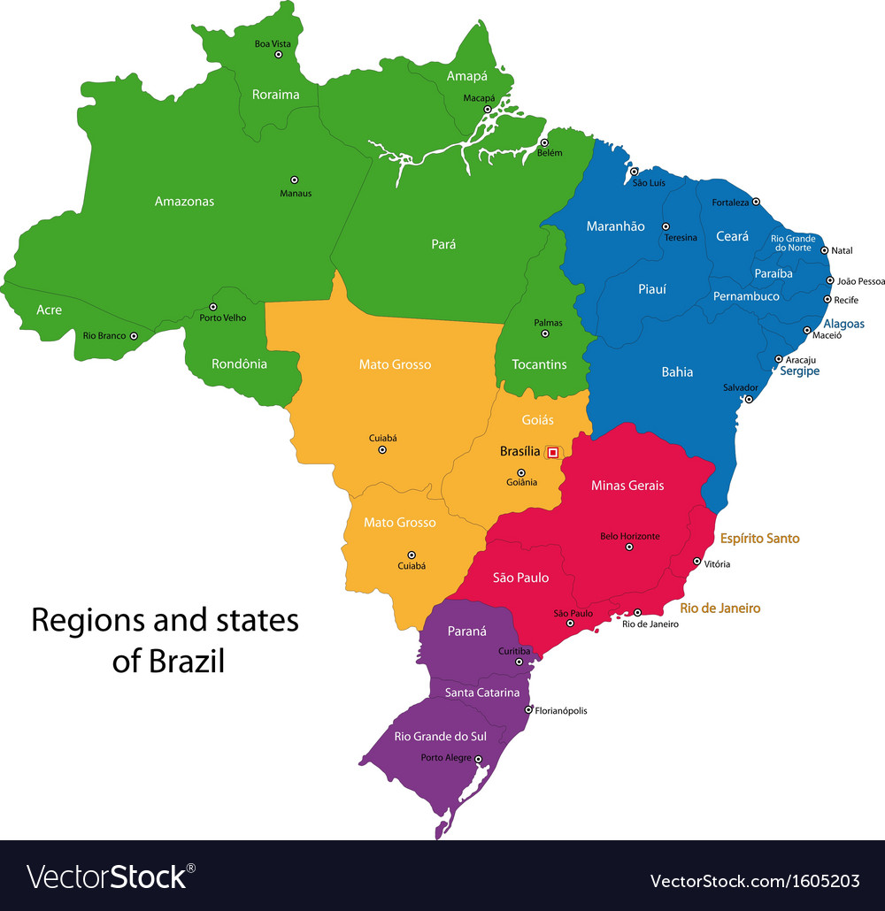
Brasil: National Health system 1
25% of the population: private health insurance service
75% of the population is NON
private health insurance service
·Public (Sistema Unico de Saude –SUS) that is universal for the whole population and the right to health care is guaranteed in the National Law and is financed and provided by the state (federal, state and municipal)
·Private (profit and non-profit [Foundations, for example])
·Private health insurance with various health plans
There are 317 cancer units designated by the Ministry of Healthy (UNACONs and CACONs).
Courtesy of C. Mello

Slide 7
Brasil: National Heath System 11
For those patients diagnosed with cancer, the first step is to consult with a primary care physician. This professional will refer the patient to the tertiary level and will attach all the documents such as the biopsy and other tests that were performed (imaging for example). Patients from the private health insurance system can follow the same process, without restriction.
It is recommended that the oncologic center should be the closest to the patient home
The Brazilian health system is universal BUT the distribution of resources is not equal throughout the states
Courtesy of C. Mello

Slide 8
Brasil: National Heath System 111
Inequity in several areas.
Socioeconomic disparities, availability of qualified professionals, and ability of states and cities to finance health services.
Most of the reference centers are located in large cities and most of them are in the south and southeast part of the country.
These centers receive patients from other regions and other states.
The distribution of funding is not uniform
There is a national law recommending that the cancer treatment should start no longer than 60 days after the pathological report
The National Institute of Cancer (INCA) is located in the city of Rio de Janeiro, and is a federal reference center. INCA works as an assistant of the ministry of health in establishing the national cancer program. Most of the reference centers have a training program for most of the oncology specialization.
Courtesy of C. Mello

Slide 9
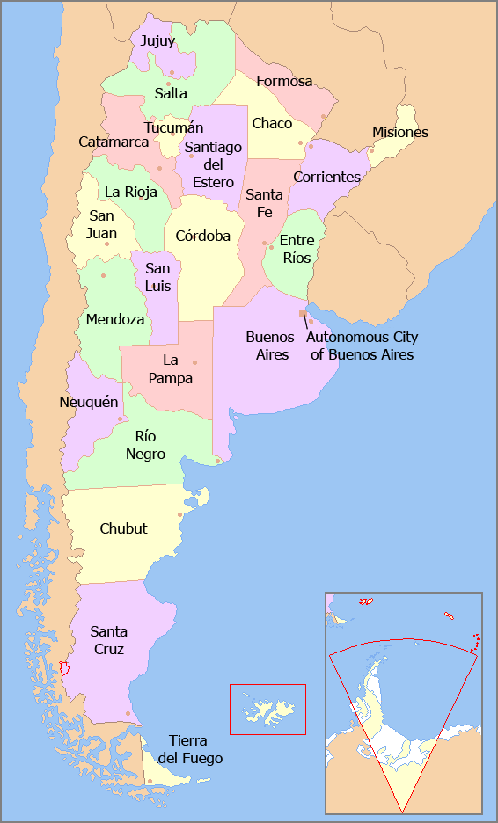
Argentina: National health system 1
Sector
Non private system
Social security or Obras Sociales (OS)
Private practice
PAMI
National Institute of Social Services for Retirees and Pensioners
Public system
Population
19.000.000
(43%)
5.900.000
(14%)
4.900.000
(11%)
14.300.000
(33%)
Who?
Formal sector
Family
Median and ”upper” class population
Retirees and pensioners
Non formal sector
Other marginal sector
Organizations
Union
(67%)
Provincial
(30%)
Federal (3%)
Private
Private Medical Insurances
PAMI
National Health ministery
Provinces Ministeries
Municip
Number of organizations
296
24
5
~100 companies
38 UGLs
Hospitals
Payer
Federal Gov (tax)
Employers
Employees Contribution
Premium Employers
Patient packet
Employees Contribution
Federa Govl
Provinces Gov
Municipal Gov
Players
OSECAC
OSPRERA
UP
OSUTHGRA
OSPE
IOMA
APROSS
IAPOS
OSBA
IPSST
IOSE
DIBA
DIBPFA
OSPJN
OSDE Galeno
SMG Medicus
OMINT H. Italiano
Adated Courtesy of J. Pujol

Slide 10
Argentina: National health system 11
Sector
Non private system
Social security or Obras Sociales (OS)
Private practice
PAMI
National Institute of Social Services for Retirees and Pensioners
Public system
Population
12.2 million
(67% OS)
6.8 Million
(30% OS)*
5.9 million
Affiliates
4.9 million
Beneficiaries
14.3 million
Pathways of inclusion
PMO – (Medical obligatory plan, law 23.660 - 2004)
SUR (HTA)
Pharma/Access Agreements
Pharma Agreements (IOMA, APROSS, OSEP and IPSST)
Pharma/Access Agreements
PMO – (Medical obligatory plan, law 23.660 - 2004)
Pharma agreements
"Framework" agreement with industry
- Treatment guidelines and protocols at the National / Provincial level
- Federal Health Plans
Refunding
Outpatient– 40% / 60%
Chronic – 70%
High cost – 100%
Outpatient – 40%
Chronic – 70%
High cost –92% to 100%
Out patient– 40%
Chronic – 70%
High cost – 100%
Outpatient / Chronic from 40% to 100%
High cost – 100%
Out patient/chronic – usually without coverage
High cost – 100%

Slide 11
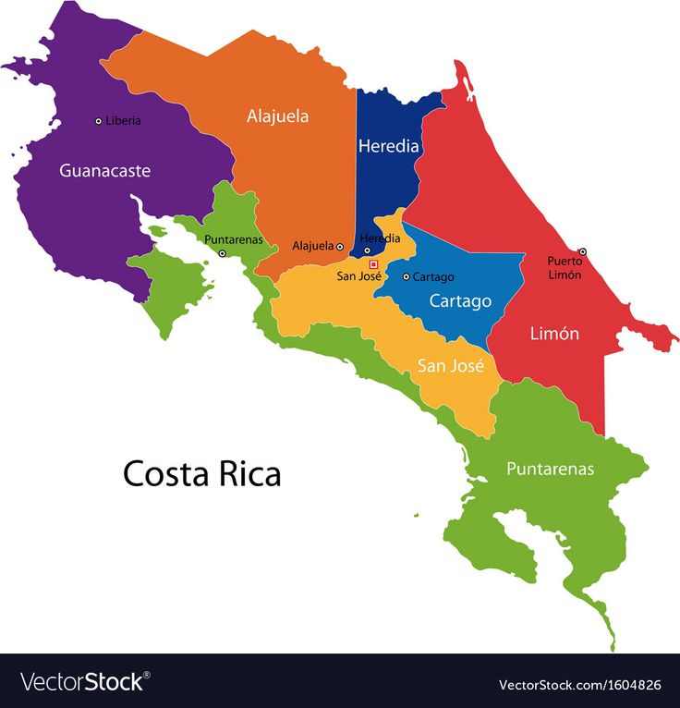
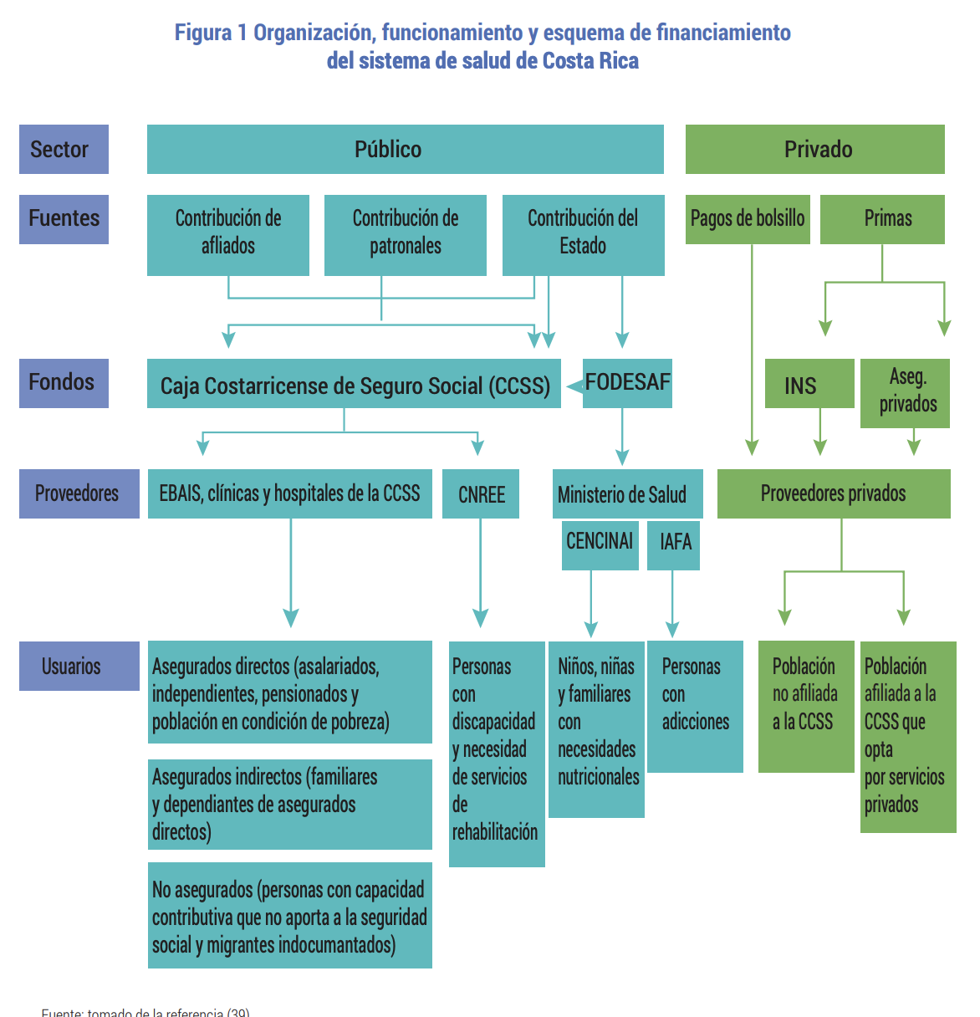
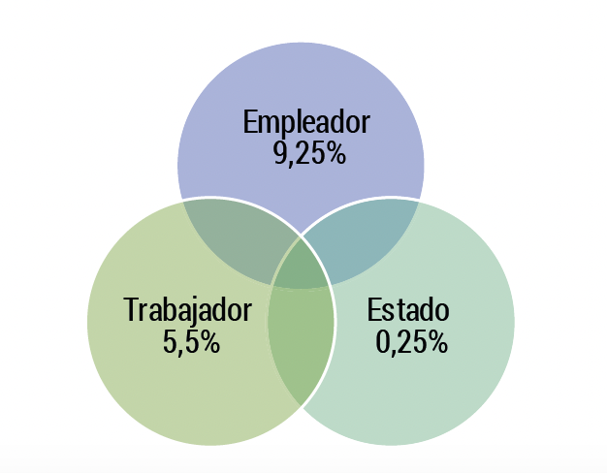
Costa Rica: National health system 1
%
%
The health system is managed by an autonomus institution that belongs to the State (Costa Rica Social Security Fund (CCSS)
The money go automatically from the salary of the state workers to the Costa Rica Social Security (fixed percentage)
Courtesy of N. Jimenez

Slide 12
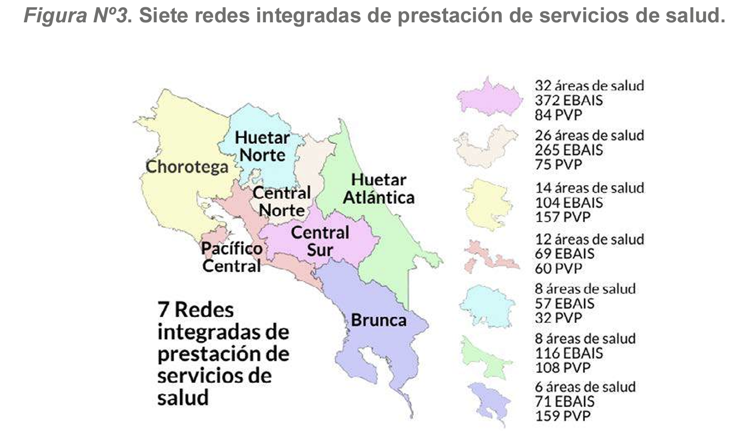
Costa Rica: National health system 11
EBAIS (Basic Teams of Comprehensive Health Care in Health) are the unit of human resources of the first line in the provision of health services of the CCSS, 1 general practitioner and a nurse
Next level, is the clinic that belongs to EBAIS, the clinic refers to the Peripheral Hospital and then this to the Regional Hospital and the Regional Hospital refers to the National General Hospital
There are 3 main national National Hospitals (class A: high complexity) and they are divided according to zones.
Courtesy of N. Jimenez

Slide 13
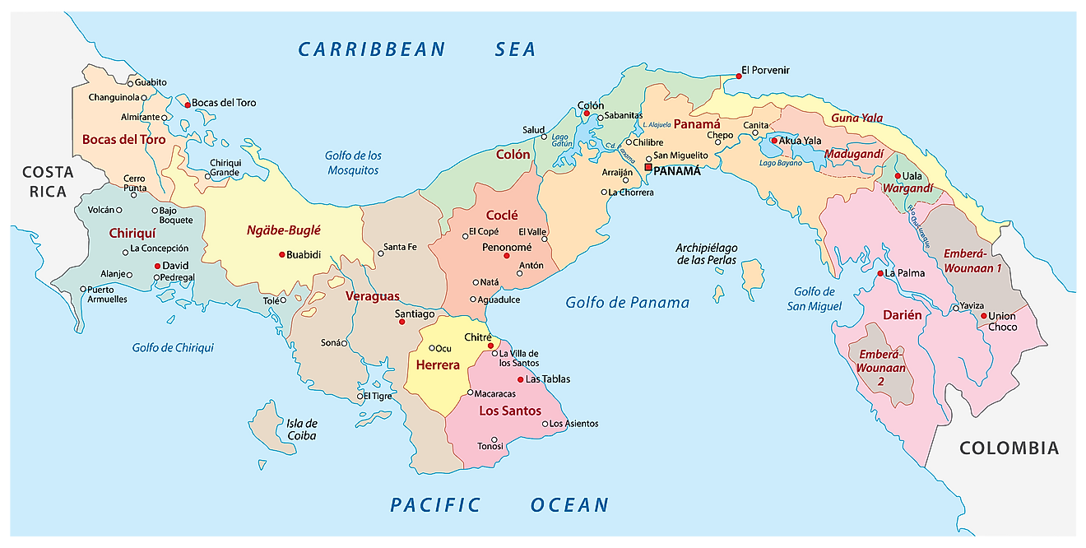
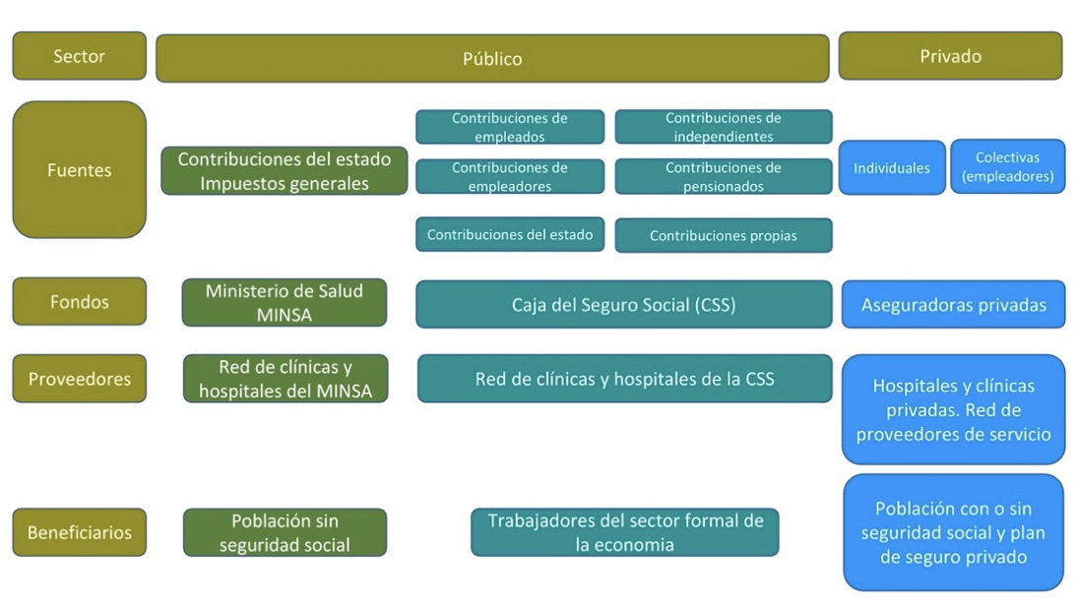
Panamá: National health system 1
%
%
Public health care is divided in 2 health systems segmented into two large Organizations:
1. The Ministry of Health (MINSA)
2. The Social Security Fund (CSS): entity of Public Law but autonomous from the State
The population under social security system in 2020 was 2,682,264 (62%)
Mixed systems of national care and in the system of the Ministery of Health (MINSA)
Courtesy of M Pacheco

Slide 14
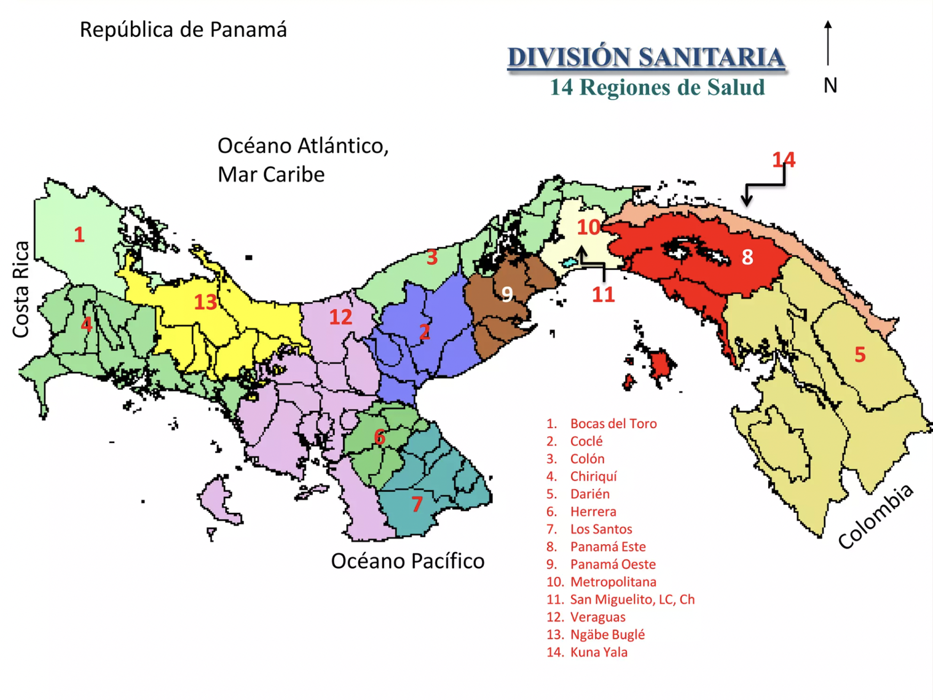
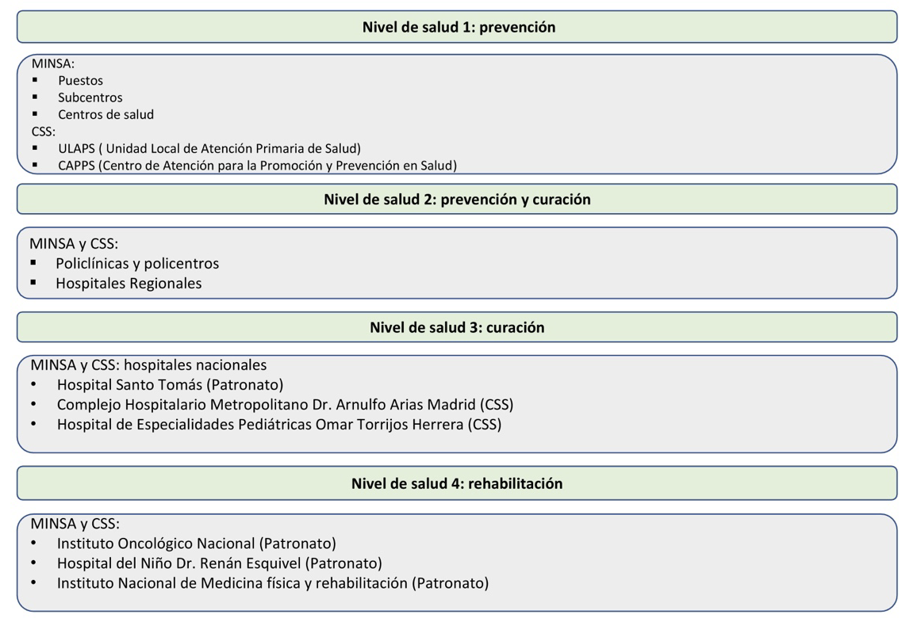
Panamá: National health system 11
Health Services Network of the Health System
902 public facilities (90% MINSA and 10% CSS)
Health regions
Both public health systems are divided into 14 health regions, organized by levels of complexity.
The parallel presence of both public systems is not coordinated or equitable
The duplication of health services providers is detrimental
Courtesy of M Pacheco

Slide 15
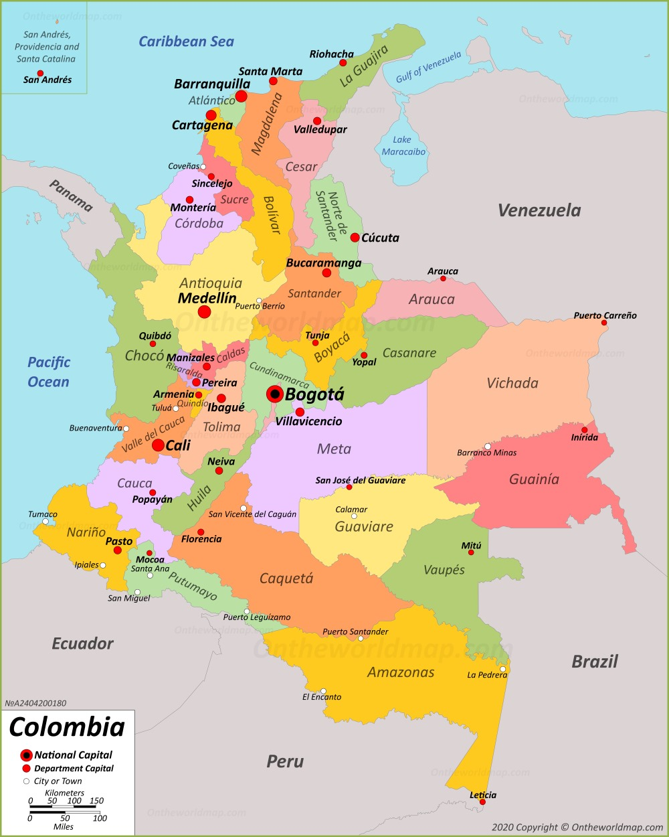
Colombia: National health system 1
Health System
The structure of the current health system has been in operation since 1991.
Health is defined as a fundamental right.
Financing and coverage
- Ministry of Social Protection has an Administrator of the Resources of the General System of Social Security in Health (ADRES)
- The General System of Social Security in Health (SGSSS) (Law in 1993) is formed by the Ministry of Health and Social Protection, insurers (Promotor Entities of health- EPS) public and private, responsible for enrolling and collecting contributions as well as guaranteeing the provision of the Health Benefits Plan, and the Health Providing Institutions (IPS) which are hospitals, clinics, laboratories and clinics.
There is also the special regimen for teachers, the Military Forces, the Colombian Petroleum Company (ECOPETROL) and some public universities.
48% of people are affiliated to the contributory regimen and almost 47% to the subsidized régimen, 4% the exceptions. The coverage achieved is 99.03%.
9% of the population in Colombia had a voluntary health plan. 3% a private insurance
MH
MSP
MSP
ADRES
SGSSS
EPS
Other
Courtesy of M. Zapata

Slide 16
Colombia: National health system 1
Benefit
The availability of cancer care centers is the first barrier to access to timely cancer treatments. Only a few cities have quality public hospitals with availability of comprehensive services for cancer care and because it has been an unattractive market for private providers, comprehensive cancer centers are densified in large cities, EPS are prohibited by law from having their own providers of high complexity, which also decreases the incentives to have a quality network outside large cities.
In Bogotá there is the only public hospital with the capacity for quality comprehensive care for patients with sarcomas and it is the National Cancer Institute
In Colombia there is only one specialization program in clinical oncology with the possibility of up to 4 graduates per year , there are also 3 hemato-oncology programs (1 in the city of Bogotá and 2 in Cali) with the possibility of up to 6 graduates per year; it is estimated around 250 oncologists throughout the country with concentration in large cities
There are no oncological pathology programs, 3 oncological surgery programs with a potential of 6 graduates per year and an orthopedic oncology program with the possibility of 1 graduate per year..
There is no center of excellence in Colombia certified in sarcomas
Access to therapies
The IETS is the National Agency for Health Technology Assessment of Colombia. It was created by Law 1438 of 2011 – reforming the SGSSS and other provisions – as a non-profit entity, of mixed and decentralized nature of the health sector. Specifically in cancer there is no established methodology or prioritization for the evaluation of technologies. There is no evaluation of drugs or technologies in sarcomas
The authorization for the marketing, payment by the health system and indications of medicines in Colombia is in charge of INVIMA (National Institute for Drug and Food Surveillance). This entity has neither advice nor integration with any scientific society, it does not have within its staff any person with oncological knowledge, so they do not respond to the needs of patients.
In December 2021, Colombia carried out the broadest inclusion of medicines in history in the Health Benefits Plan. Resolution 2292 updated the services and technologies financed through the Capitation Payment Unit (UPC),
According to the Ministry of Health and Social Protection, with regard to medicines, the active ingredients financed by the UPC were increased from 459 to 1059. Among the additions are antineoplastic and immunomodulatory agents for different types of cancer, few are approved for sarcomas (Doxorubicin/epirubicin, ifosfamide, cisplatin, methotrexate, pazopanib, trabectedin, cyclophosphamide).
One of the important limitations for the development of institutional or regional guidelines is the regulatory restriction to establish recommendations that cannot include medicines without INVIMA authorization. There may be drugs/procedures available in Colombia but if they do not have INVIMA registration to be used in sarcomas they can generate difficulties for access and the only way to access is through legal action
Courtesy of M. Zapata

Slide 17
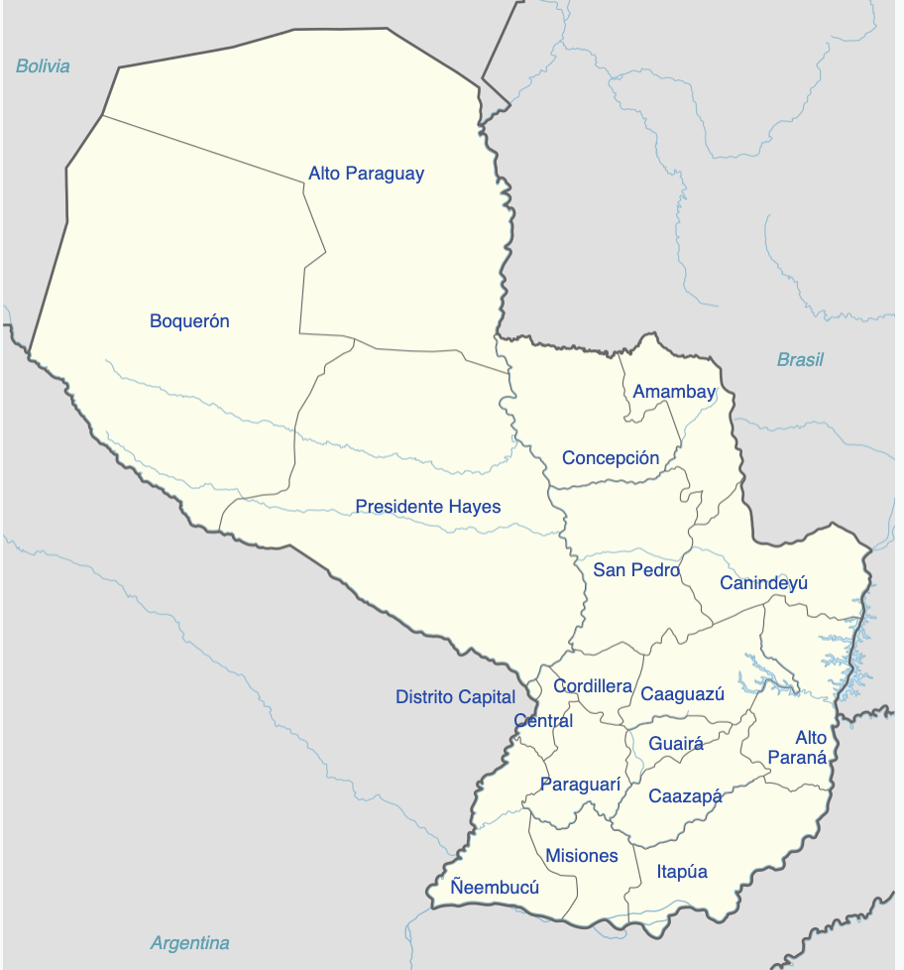
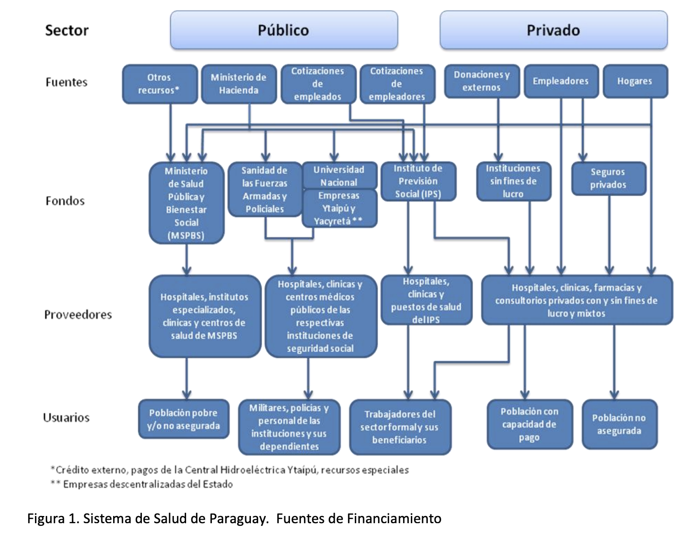
Paraguay: National health system
2 subsectors, public and private
-The public sector: Ministry of Public Health and Social Welfare (MSPyBS), the Social Security Institute (IPS), the Health of the Armed Forces and the Police, the National University of Asunción and the assistance services of two decentralized companies.
-The private sector: private insurers, for profit, non-profit and mixed providers.
-The MSPBS has the guiding and normative role for public and private actions in the health sector and develops functions to provide and funding.
-The IPS and the private sector play also a role to provide and financial
- MSPyBS (65% of the population)
- IPS (20%)
The Police Health and the Military Health (1%))
- Care is distributed in the Health Regions, operational-administrative units of the MSPyBS and a network of health services with health facilities from first to third level of care
Courtesy of ML Gonzalez Donna

Slide 18
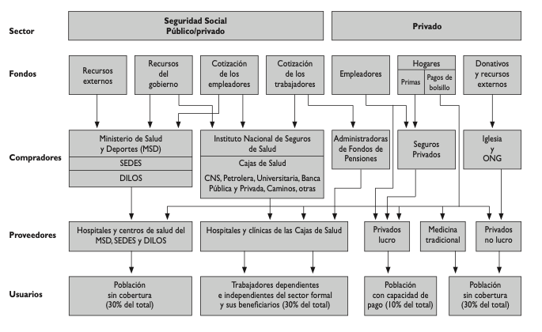
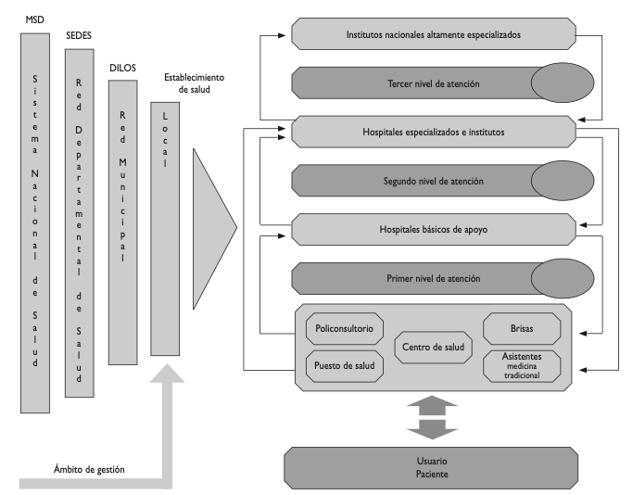
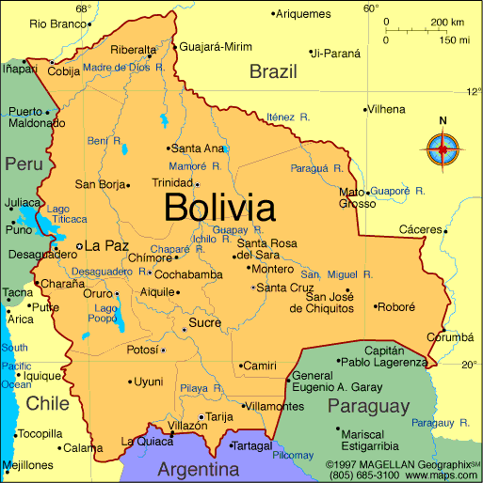
Bolivia: National health system 1
Health system:
1) Unified Health System (SUS) under the Ministry of Health that covers the general population that does not belong to any insurance.
2) Health Funds: National Health Fund, Oil Health Fund, Private Banking Health Fund, Roads and RA Health Fund, CORDES Health Fund, State Health Bank, COSSMIL, SINEC Comprehensive Health Insurance. (Salaried workers in private and public enterprises)
3) Social Health Insurance (SSU) University system workers and their families
4) Private Health Insurance
The health system, the national funds and university social security cover 85% of the population and the rest of the population has some private insurance.
National List of Essential Medicines (LINAME) insurances are based to pay cancer treatment, (updated every 2 years)
Limitations: Non validated by specialists
Private health insurance offers coverage based on NCCN and ESMO guidelines.
Courtesy of R. Limón

Slide 19
Brief agenda
Number of cases in the region
Description of 7 countries National Health systems
Barriers
Tools from SELNET to improve care in sarcoma patients
Discussion

Slide 20


Barriers and Windows of opportunity

Slide 21
Barriers and Windows of opportunity
Lack of registry data base
Lack of time
Lack of Laws
Lack of reference centers
Lack of interest
Lack of patients
Lack of MDT
Corruption
Inequities
Drugs
Radiation therapy
Education
Radiology technology
Pathologist
Pathology techniques
Time between those items
Molecular pathology
Ignorance
Complexity of the health system

Slide 22
- Lack of uniform access to Healthcare
- Lack of Officially Designated Sarcoma RC
- Lack of Referral Policies
- Limited resources for diagnosis (molecular pathology not covered)
- Limited resources for Sarcoma medical education
- Lack of robust, active and interconnected sarcoma cooperative group
Brasil: Barriers and opportunities
- Lack of uniform access to Healthcare
- Lack of Officially Designated Sarcoma RC
- Lack of Referral Policies
- Limited resources for diagnosis (molecular pathology not covered)
- Limited resources for Sarcoma medical education
- Lack of robust, active and interconnected sarcoma cooperative group
To improve Reference centers implementation (surgery, oncology, radiation and pathology).
Continous medical education
Courtesy of C. Mello

Slide 23
Argentina: Barriers
1- Large country with Socioeconomic disparities, non availability of qualified professionals
2- Location of reference centers
3- Lack of funding to investigate
4- Lack of interest in the general medical community
5- Less feasibilities than other tumor models to CT
6- Heterogenity of the health system
7- Access
8- Unestable economy
SELNET
Change authorities

Slide 24
Costa Rica: Barriers and opportunities
1-Lack of uniform access to health at the social security level. Disparity in quality of treatment
2-High number of sarcoma surgeries in centers without a multidisciplinary sarcoma specialists
3-Absence of referral policies to Sarcoma Functional Units with Multidisciplinary Teams in sarcoma.
4-Long times for imaging (mainly MRI which is key in sarcoma patients) or surgery in sarcoma patients
5-Long time to drug Access that are not on the official list of social security medicines
6-Lack of sarcoma database
7-Long waiting time for radiation therapy
7-Limitations in Training Programs for the Diagnosis and Treatment of Patients with Sarcoma
1-Lack of uniform access to health at the social security level. Disparity in quality of treatment
2-High number of sarcoma surgeries in centers without a multidisciplinary sarcoma specialists
3-Absence of referral policies to Sarcoma Functional Units with Multidisciplinary Teams in sarcoma.
4-Long times for imaging (mainly MRI which is key in sarcoma patients) or surgery in sarcoma patients
5-Long time to drug Access that are not on the official list of social security medicines
6-Lack of sarcoma database
7-Long waiting time for radiation therapy
7-Limitations in Training Programs for the Diagnosis and Treatment of Patients with Sarcoma
1- To Improve access to health in social security for patients with sarcomas through programs aimed at the first levels of care with sarcoma information
2- Creation of referral policies for centers with Sarcoma Functional Units
3- To improve access to drugs used in sarcoma with high clinical evidence
4- To create a database of sarcomas where diagnosis and outcomes could be evaluated
5-To develop training programs in the diagnosis and treatment of patients with sarcoma
Courtesy of N. Jimenez

Slide 25
Panamá: Barriers and opportunities
1. Fragmented health system with inequitable distribution of resources by region, which causes inadequate access to care depending on geographic area.
2. Late diagnosis
3. Limited medical experience and limited implementation of management guidelines in diagnosis, treatment and follow-up of sarcomas
4. Lack of human resources with specialization in management of sarcomas.
5. Lack of Multidisciplinary board in sarcomas.
6. Overload system, resulting in delayed diagnosis, referral and treatment.
7. Suboptimal reference system with long waiting times.
8. A single cancer center without resources for optimal multidisciplinary treatment of sarcomas.
9. High percentage of sarcoma surgeries performed by non specialised surgeries team.
10. Restricted access to new drugs approved for the management of sarcomas
11. Lack of national sarcoma registries
1. Fragmented health system with inequitable distribution of resources by region, which causes inadequate access to care depending on geographic area.
2. Late diagnosis
3. Limited medical experience and limited implementation of management guidelines in diagnosis, treatment and follow-up of sarcomas
4. Lack of human resources with specialization in management of sarcomas.
5. Lack of Multidisciplinary board in sarcomas.
6. Overload system, resulting in delayed diagnosis, referral and treatment.
7. Suboptimal reference system with long waiting times.
8. A single cancer center without resources for optimal multidisciplinary treatment of sarcomas.
9. High percentage of sarcoma surgeries performed by non specialised surgeries team.
10. Restricted access to new drugs approved for the management of sarcomas
11. Lack of national sarcoma registries
Courtesy of M Pacheco

Slide 26
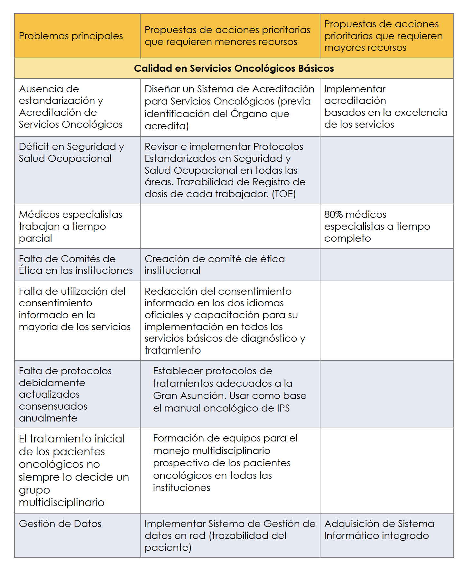
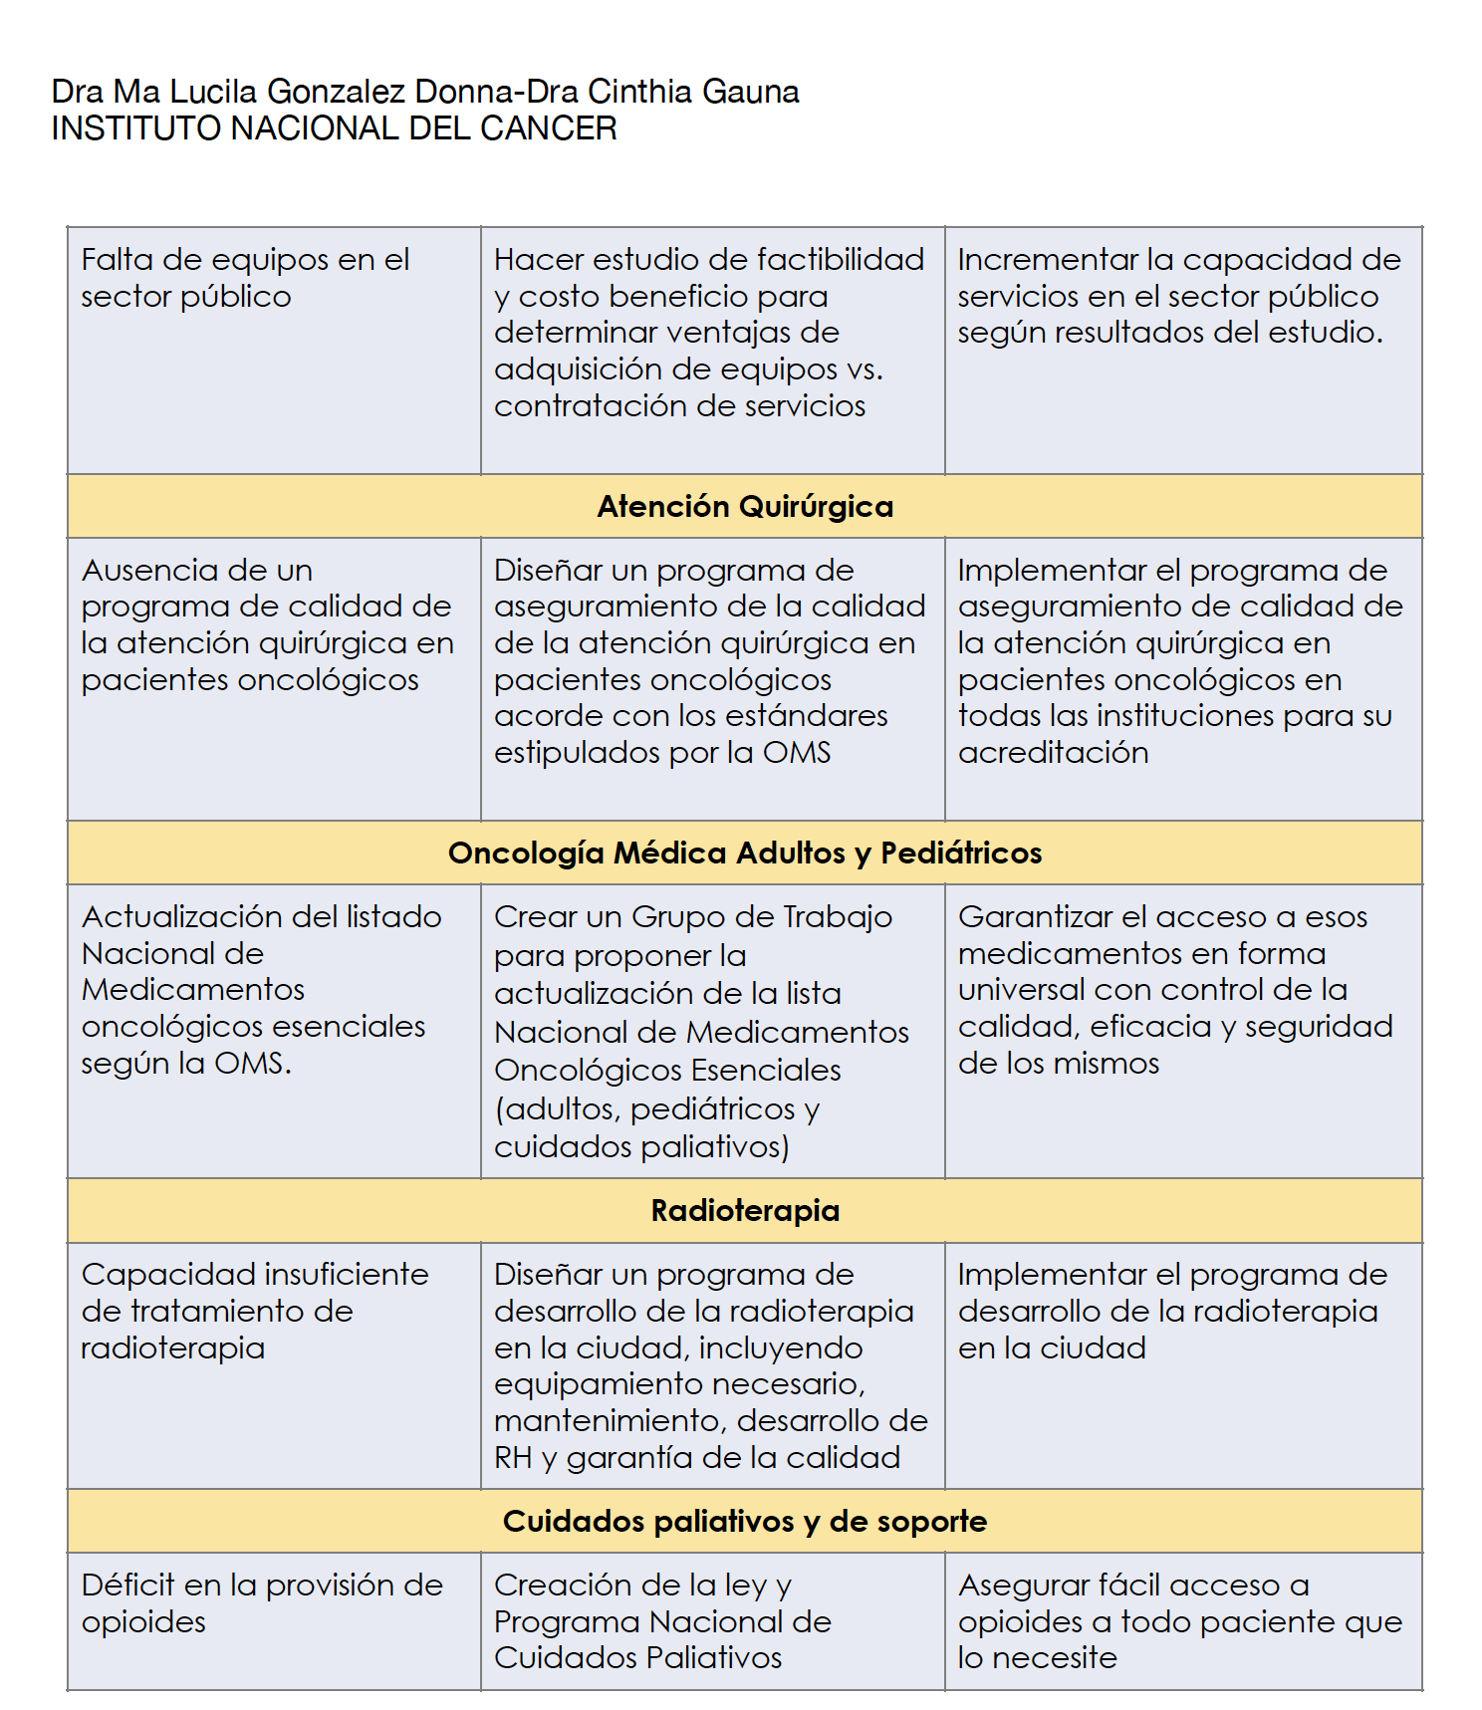
Paraguay: Barriers and opportunities
Cancer Care (data from CCCAN report) developed a list of the "Main problems identified" in each of these areas and the "Proposed priority actions" for cancer care
Courtesy of ML Gonzalez Donna

Slide 27
Bolivia: Barriers and opportunities
1. No data about isarcoma ncidence
2. Inadequate guidelines for the management
3. Lack of equipment for the diagnosis and treatment
4. Abscence of drugs for the management of sarcomas in the National List of Essential Medicines (LINAME).
5. Not uniform distribution of patients diagnosed with sarcomas.
6. Limited medical training for multidisciplinary managment of sarcoma patients
7. No access to molecular tests: NGS, cytogenetics, FISH
8. No resources for cancer research in general.
9. Lack of knolwledge of sarcoma in the population
10. Late referral of sarcoma patients
11. Non specialised pathologists
1. No data about isarcoma ncidence
2. Inadequate guidelines for the management
3. Lack of equipment for the diagnosis and treatment
4. Abscence of drugs for the management of sarcomas in the National List of Essential Medicines (LINAME).
5. Not uniform distribution of patients diagnosed with sarcomas.
6. Limited medical training for multidisciplinary management in diagnosis and treatment
7. No access to molecular tests: NGS, cytogenetics, FISH
8. No resources for cancer research in general.
9. Lack of knolwledge of sarcoma in the population
10. Late referral of sarcoma patients
11. Non specialised patohologists
1- The creation of the 1st multidisciplinary unit in the management of sarcomas (Surgical oncologists, traumatologists oncologists, radiotherapists, clinical oncologists, pathologists, radiologists)
2. 5-year sarcoma registriy is in process to evaluate epidemiology and incidence.
Courtesy of R. Limón

Slide 28
National health system: sarcoma reference center
There is no officially recognized Sarcoma Center by Governmental Agencies
There are traditional cancer centers that have a long history in the care of sarcomas

Slide 29
National health system: sarcoma reference center
Courtesy of N. Jimenez

Slide 30
Argentina: Access
Is really a matter of access to drugs?
My subjective Lights in terms of sarcoma drugs
Doxorubicin
Ifosfamide
Methotrexate
Cisplatin
DTIC
Cyclofosfamide
Vincristine
Topotecan
Docetaxel
Gemcitabine
Etoposide
Imatinib
Sunitinib
Paclitaxel
Mifarmutide
Regorafenib
Pazopanib
Bevacizumab
Temozolomide
Denosumab
Sorafenib
Liposomal Doxorubicin
Vinorelbine
Everolimus
Temsirolimus
Trabectedine
Eribuline
Mifarmutide
Regorafenib
Ripretinib
Crizotinib
Bevacizumab
Larotrectinib
Entrectinib
Pexidartinib
Selumetinib
Nirogacestat
Tazemetostat
Ceritinib
Brigatinib
Lorlatinib
Palbociclib
Not so difficult
Probably difficult
Very difficult or impossible

Slide 31







Argentina: High Cost drug Flow
Physician
Patient
Funder
Patient
Pharmacy
The patient must authorize the order: presents prescription, medical history, tests that support the diagnosis
The Social security system informs pharmacy that the patient will receive treatment and details the treatment scheme for its provision
Treatment is defined by the prescribing physician
Access
Drugstore
Prescription flow
Drug Flow
Authorization of the drug

Slide 32



Argentina: Public High Cost drug Flow
Public Hospital physician
Patient
National Drug Bank
Drug Bank Province
Access
Federal Plans/Programs (e.g. include Health, Immunization, HIV, Maternal and Child)
Treatment is defined by the prescribing physician
When the Federal Program does not have the drug available, the patient can claim it in the last instance, in the Ministery of Social Action
Ministery of Social Actions
In order for the patient to receive public coverage, he/she must:
Being treated in a public hospital
Prove that you do not have private coverage
Prove that you do not have the financial resources to pay for treatment
Once this is proven, the patient can receive the drug from the Drug Bank, Including Health, Social Development
Prescription flow
Drug Flow
Authorization of the drug

Slide 33
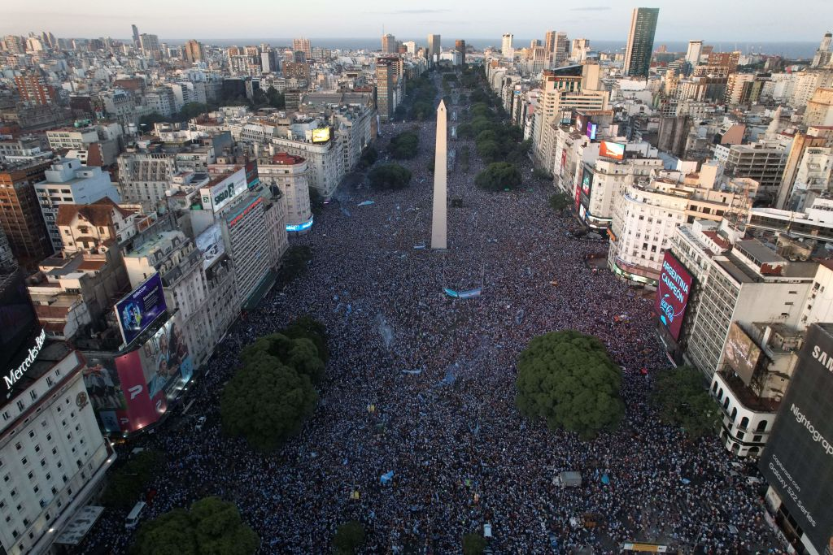
Argentina

Slide 34
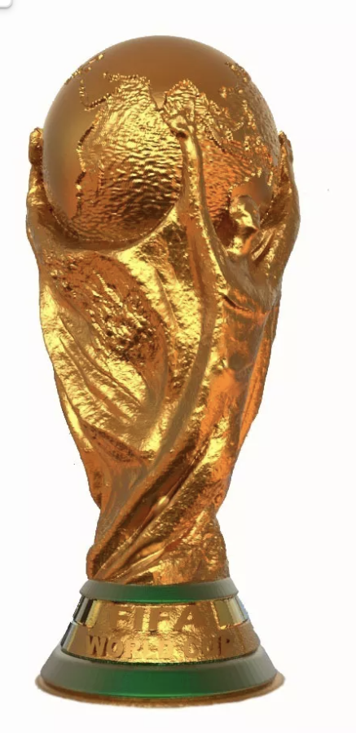

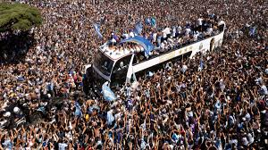
Argentina

Slide 35
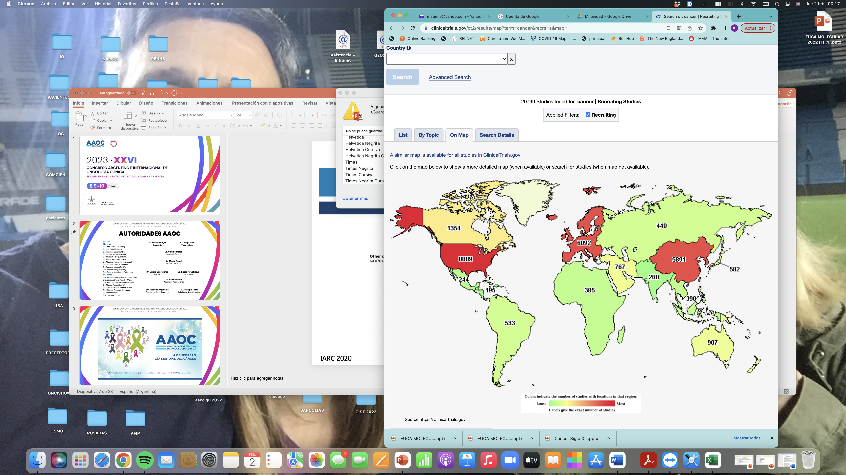
Access to Clinical trials in cancer: is the solution?
Febraury 2, 2023

Slide 36
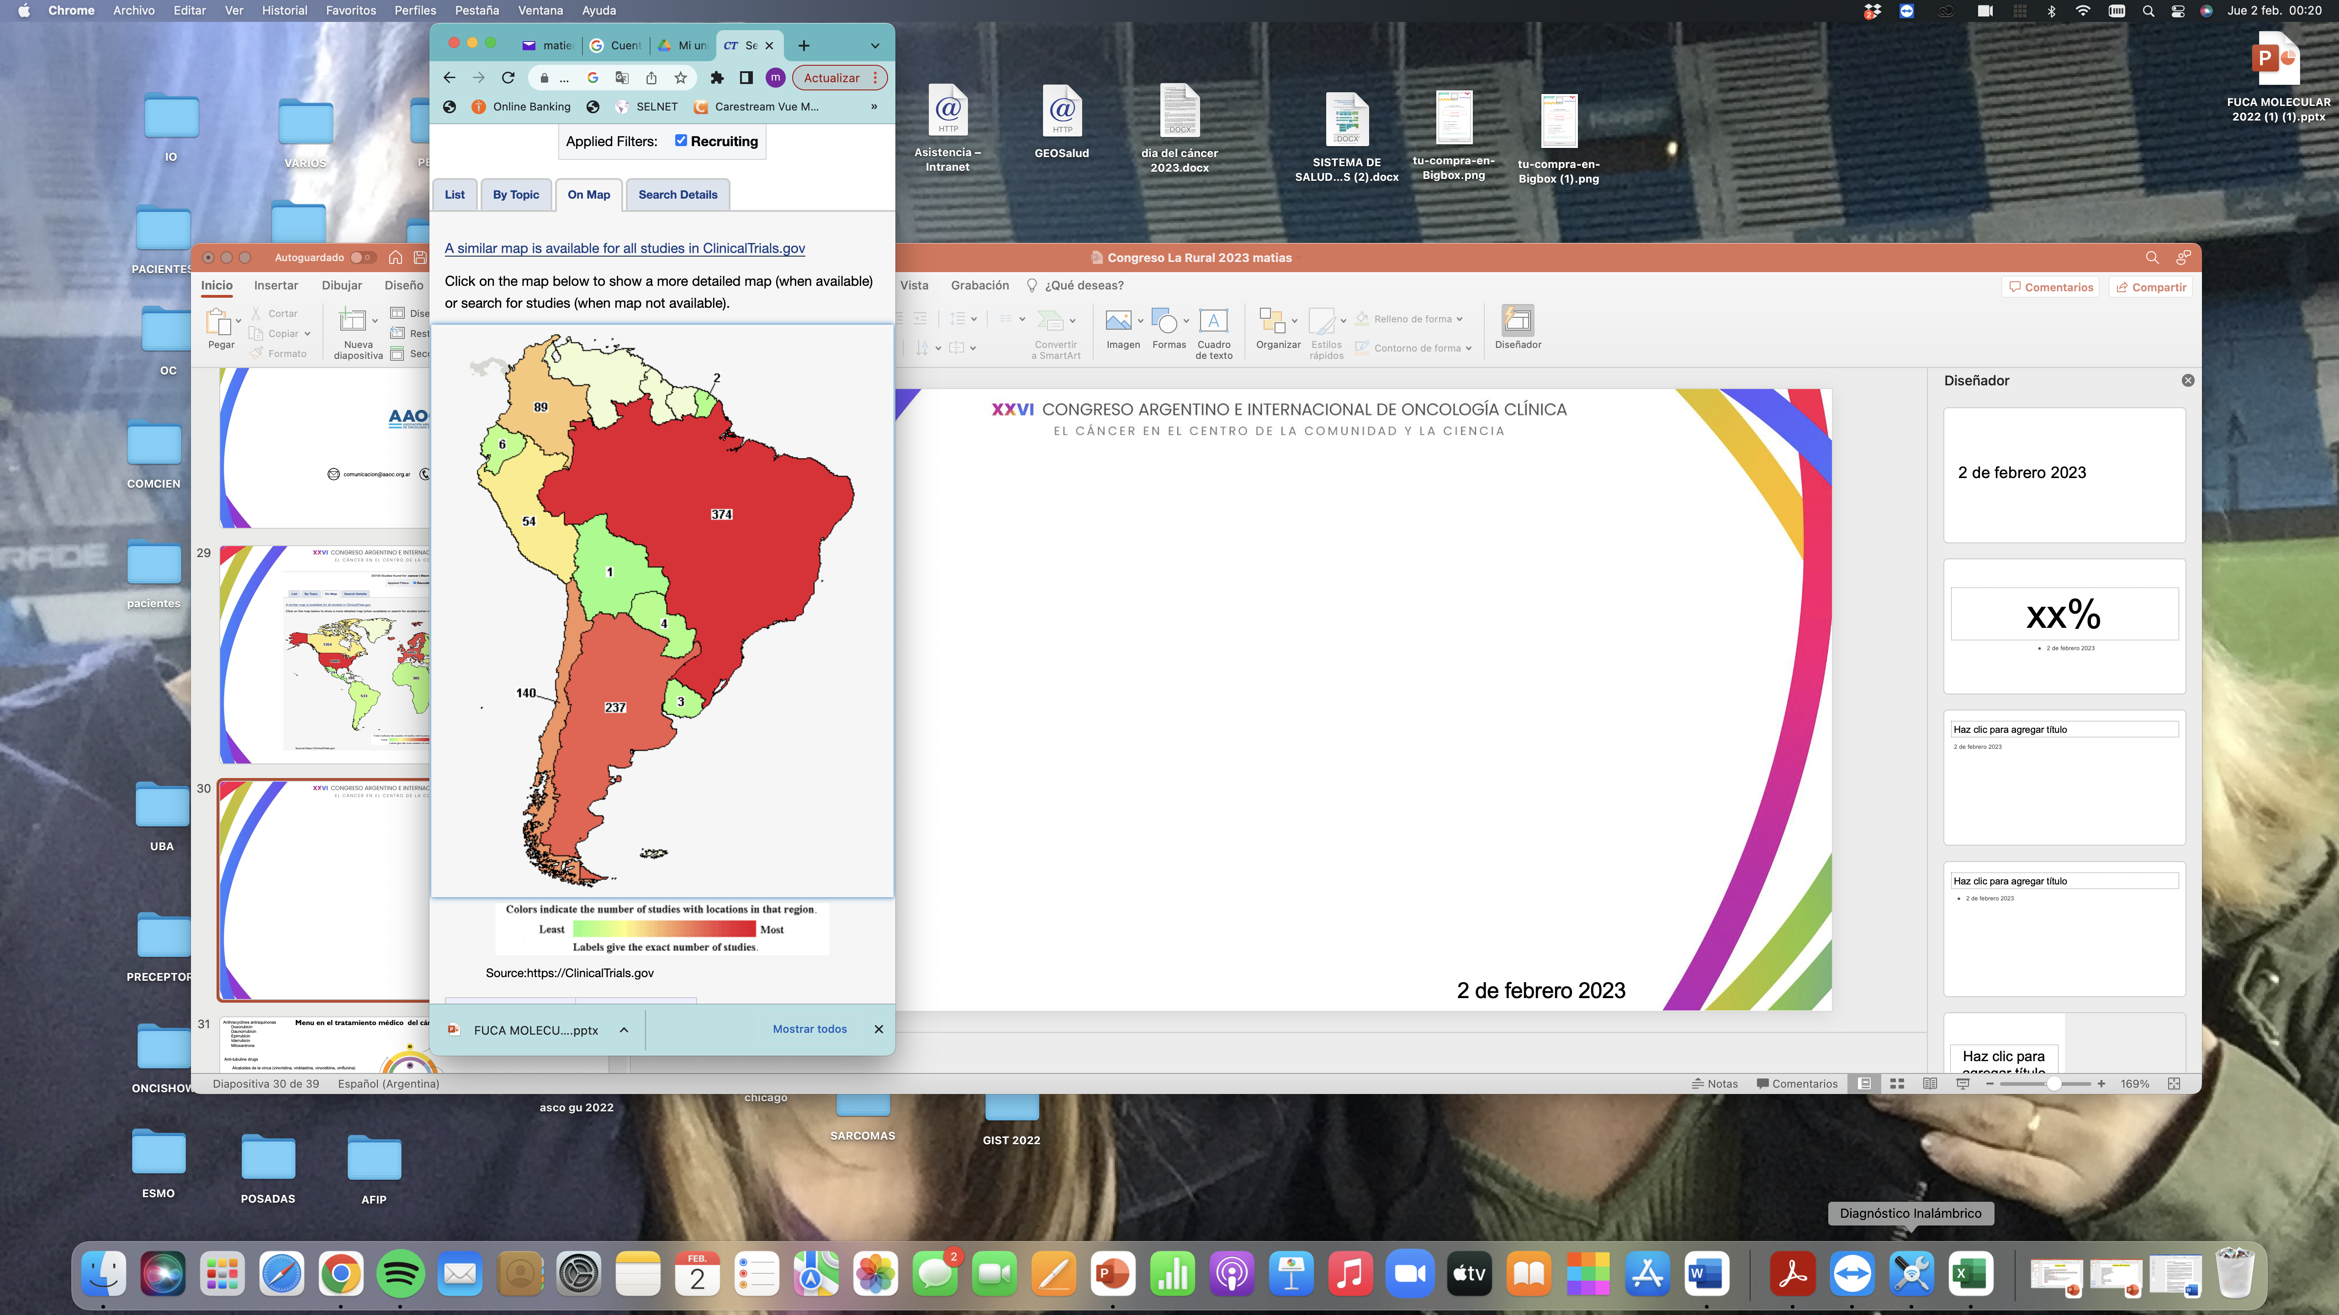
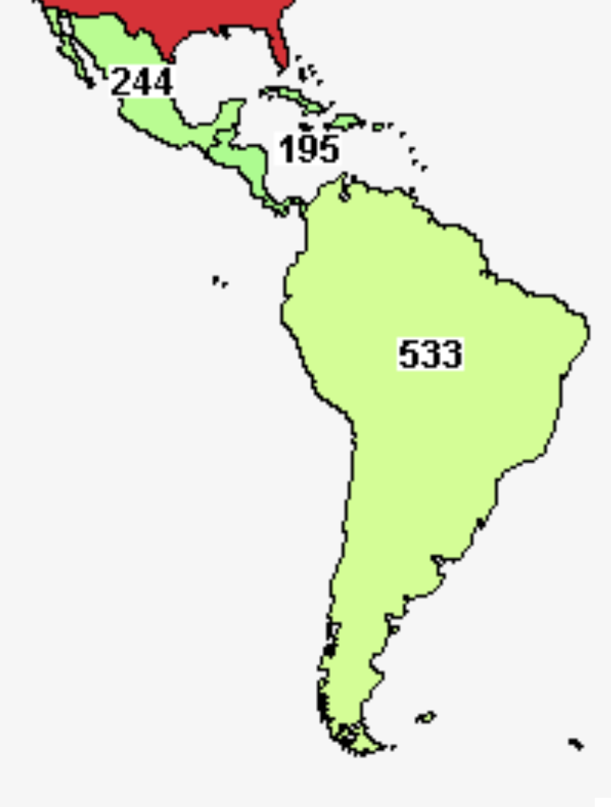
Access to Clinical trials in cancer: is the solution?
Febraury 2, 2023

Slide 37
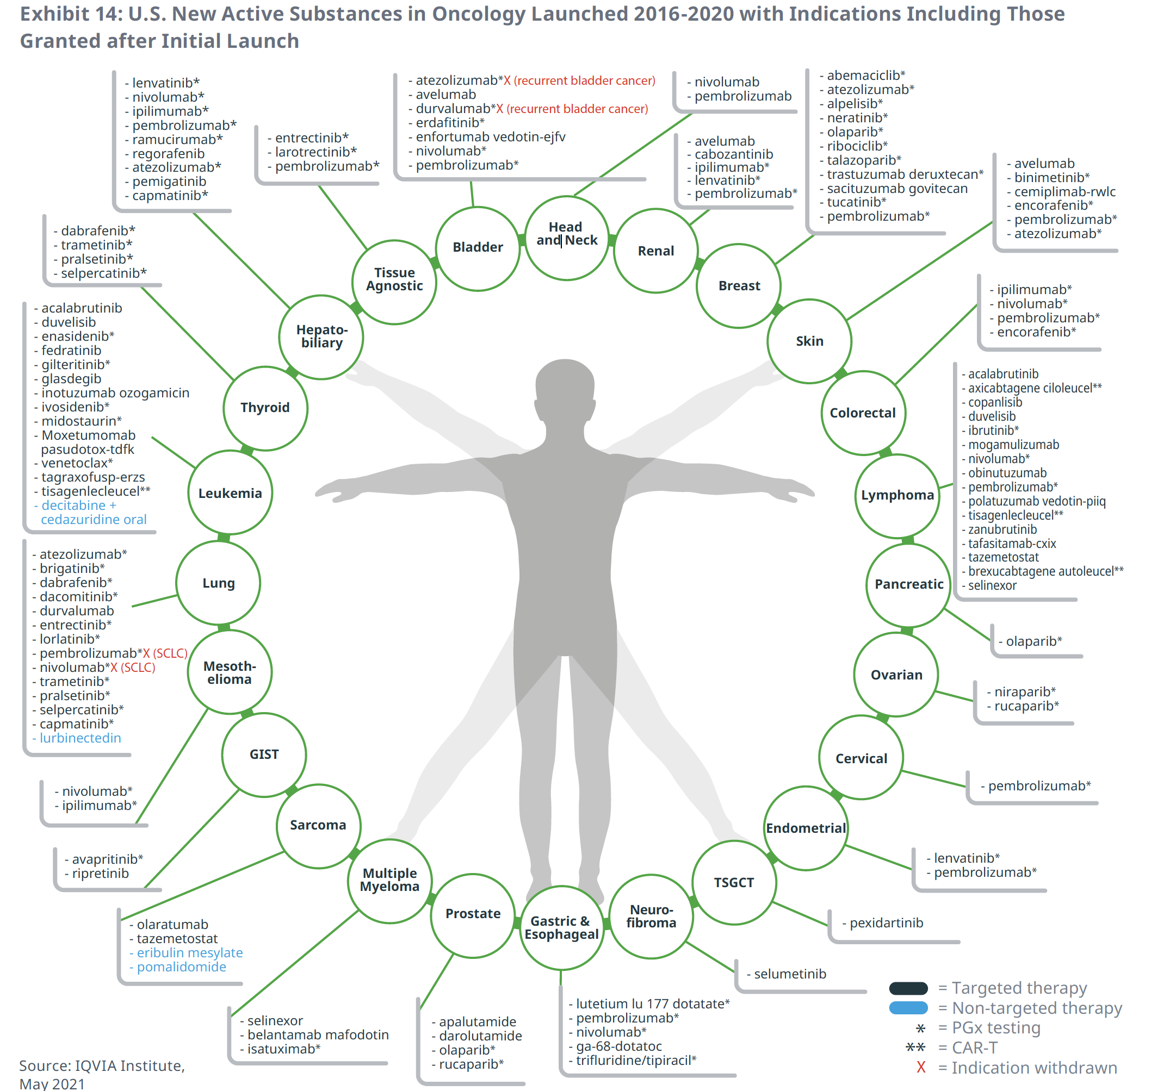
Approvals of drugs in cancer: how far is sarcoma to breast cancer?
Approvals of drugs in cancer
5
11
4
16
16
14
7
1

Slide 38
Brief agenda
Number of cases in the region
Description of 7 countries National Health systems
Barriers
Tools from SELNET to improve care in sarcoma patients
Discussion

Slide 39
Tools from SELNET to improve care in sarcoma patients
Modifiable Variables
Education
MDT
Guidelines
Reference centers
Local Data
Clinical trials
Access to diagnosis and treatment
Publications
Non-modifiable Variables
Health system
Inequities
Goverments
Population and territory
Low Incidence
Screening tools
Local economy

Slide 40
SELNET
Sarcoma as a model to improve diagnosis and clinical care of rare tumors through a European and Latin American multidisciplinary network
Appropriate management of sarcoma patients is hindered by the absence of referral policies to reference centers (RCs), incorrect or delayed diagnosis, non-adherence of therapies to clinical practice guidelines (CPGs), and lack of expertise by practitioners, which increases the risk of relapse and death.

