Slide 1
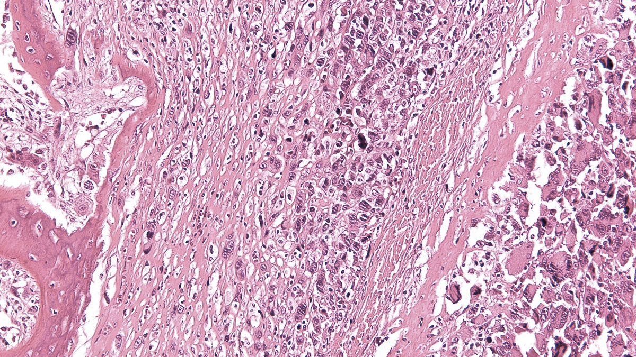
IX SELNET
CONSORTIUM MEETING
WP6: MULTIDISCIPLINARY REVIEW OF CLINICAL CASES
WP8: TRANSLATIONAL RESEARCH
DAVID S. MOURA
IIS-FUNDACION JIMENEZ DIAZ
MADRID, SPAIN

Slide 2
SELNET WP6: Multidisciplinary review of clinical cases- FIIS-FJD
OBJ 1: To perform peer reviews of pathologic diagnosis
OBJ 2: To conduct multidisciplinary tumor boards (MDT) to review clinical cases
WP 7
WP 6
WP 8

Slide 3
SELNET WP6: Multidisciplinary review of clinical cases- FIIS-FJD
OBSERVATIONAL STUDY (REGISTRY)
Approved in 42 centres across 15 countries!
34 centers fully activated (SIV) to include patients

Slide 4
SELNET WP6: Multidisciplinary review of clinical cases- FIIS-FJD
ONLINE REGISTRY (CRF)→ ACTIVE
PERIOD (amendment to increase range of years)
ALL sarcoma subtypes
TARGET: 5000- 6000 cases
Informed consent for data AND tissue. In retrospective cases might NOT be needed!!
Activation Month 7 (July 2019)→ prospective 48 months
Ask for Access to: support@sofpromed.com

Slide 5
 | CENTER | REGISTERED CASES | BLOCKS SENT
1 | IAF - INSTITUTO ALEXANDER FLEMING | 511 | 57
2 | INEN - NATIONAL INSTITUTE OF NEOPLASTIC DISEASES | 272 | 153
3 | INCan - INSTITUTO NACIONAL DE CANCEROLOGÍA | 230
4 | A.C. Camargo Cancer Center | 214
5 | HUVR – HOSPITAL UNIVERSITARIO VIRGEN DEL ROCIO | 180 | 74
6 | COIR- CENTRO ONCOLOGICO DE INTEGRACIÓN REGIONAL | 114 | 16
7 | IOR- RIZZOLI | 110 | 108
8 | INCP - Instituto Nacional del Cáncer de Paraguay | 102 | 57
9 | IREN - Instituto Regional de Enfermedades Neoplásicas Norte | 89
10 | IPSP - Instituto de Previsión Social de Paraguay | 70
11 | SSN - Swiss Sarcoma Network | 54
12 | HOPC - Hospital Oncológico Provincial Córdoba | 53 | 17
13 | HUC - Hospital Universitario Canarias | 35 | 26
14 | IOOB - Instituto Oncológico Oriente Boliviano | 27
15 | CLB – Centre Leon Berard | 21 | 59

Slide 6
 | CENTER | REGISTERED CASES | BLOCKS SENT
16 | CUCC - Centro Universitario Contra el Cancer UANL | 17
17 | IIS-FJD – FUNDACION JIMENEZ DIAZ | 16
18 | FHSV - Fundación Hospitalaria San Vicente de Paul | 14
19 | INT - IRCCS National Cancer Institute | 12
20 | HCSC - Hospital Clínico San Carlos | 12
21 | FALP – FUNDACION ARTURO LOPEZ PEREZ | 7 | 7
22 | HCUC – HOSPITAL CLINICO UNIVERSIDAD DE CHILE | 5
23 | HUD – HOSPITAL UNIVERSITARIO DONOSTIA | 4 | 4
24 | INCB - INSTITUTO NACIONAL DE CÁNCER DE BRASIL | 4
25 | ICAU - Instituto de Cancerología Las Américas Auna | 3
26 | CHMCSS - COMPLEJO HOSPITALARIO METROPOLITANO DE LA CAJA DE SEGURO SOCIAL | 3 | 2
27 | HNERM - HOSPITAL NACIONAL EDGARDO REBAGLIATI MARTINS | 2
28 | CCSS - Caja Costarricense de Seguro Social | 1
29 | HUA - Hospital Universitario Austral | 1
 | TOTAL | 2183 | 580

Slide 7
SELNET WP6/WP8:
OBJ 1: NUMBERS
Target 5000 cases: 500 new cases/month
STILL MUCH TO DO!!!!

Slide 8
SELNET WP6:
OBJ 1: PEER REVIEWS OF PATHOLOGIC DIAGNOSIS
Network of expert pathologist (WP2)
Central pathologic reviews ongoing
226 cases already shipped/ centrally reviewed
Angelo Paolo Dei Tos, Pathologist network coordinator – University of Padua, Italy.
Lucia Gonzalez– Institute Alexander Fleming, Argentina.
Martina Nesprias – General Hospital of Agudos Carlos G. Durand, Argentina.
Antonio Nascimento – A. C. Camargo Cancer Center, Brazil.
Felipe d’Almeida Costa – A. C. Camargo Cancer Center, Brazil.
Maurizio Donato Acuña – Rafael Ángel Calderón Guardia Hospital, Costa Rica.
Alberto Righi – Rizzoli Orthopedic Institute, Italy.
Paola Collini – IRCCS National Cancer Institute, Italy.
Marco Gambarotti- Rizzoli Orthopedic Institute, Italy.
Claudia Haydee Sarai Caro Sánchez – National Cancer Institute, Mexico.
Hugo Ricardo Domínguez Malagón – National Cancer Institute, Mexico.
Lourdes Huanca – National Cancer Institute of Peru, Peru.
Sandro Ángel Aníbal Casavilca Zambrano – INEN, Peru.
Cleofé Romagosa – Vall d’Hebron Universitary Hospital, Spain.
Rafael Ramos – Son Espases University Hospital, Spain.
José Merino- Fundación Jimenez Díaz Univesity Hospital, Spain

Slide 9
PATHOLOGY NETWORK:
222 cases were already reviewed.
First diagnosis | Second diagnosis
Myxoid liposarcoma | Hibernoma (molecular analysis NEGATIVE for myxoid liposarcoma)
Myxofibrosarcoma grade 3 | Leiomyosarcoma, grade 3
Liposarcoma grade 1 | Myxoid Liposarcoma high grade with molecular confirmation (rerraangement DDIT3)
Mixoid Lyposarcoma grade 1 | Myxofibrosarcoma grade 2 (molecular analysis NEGATIVE for myxoid liposarcoma)
GIST (DEDIFFERENTIATED?) | synovial sarcoma with molecular confirmation (SYT)

Slide 10
SELNET WP6 TAKE-HOME MESSAGES
Observational study approved in 42 centres
2183 registered cases → still far from TARGET 5000 registered cases
REGISTER YOUR CASES!!!!
IMPORTANT TO SEND BLOCKS to CITIUS III (deadline is March 31):
- Pathological review
- TRANSLATIONAL PROJECTS!
MDTs and second opinion platform are working very well - participate

Slide 11
SELNET Translational research (WP8)
WP 7
WP 6
WP 8
WP8 OBJ 1 To create SELNET biobank
WP8 OBJ 2 To establish pre-clinical sarcoma models for future research
WP8 OBJ 3 To conduct a translational study to explore potential biomarkers of response in rare sarcomas

Slide 12
SELNET WP8 – Translational research
TRANSLATIONAL STUDIES SCHEDULED
Type of Samples:
Paraffin tumor block at disease onset
Main goal:
To describe prognostic and/ or predictive biomarkers for anti-angiogenic agents and other treatments
Desmoplastic small-round-cell tumor
Angiosarcoma
Methods:
RNA expression analysis by RNA-Seq/ direct transcriptomics with HTG EdgeSeq technology
Validation of RNA-Seq gene expression results
Extraskeletal Myxoid Chondrosarcoma
Solitary Fibrous Tumor

Slide 13
SELNET WP8 – Translational research
(FEBRUARY, 2023)
FFPE Tumor blocks received | N
FFPE Tumor blocks received | 580
FFPE Tumor Blocks for translational studies | 314
FFPE Tumor blocks received | N=314 | AS | DSRCT | EMCh | SFT
Istituto Ortopedico Rizzoli | 87 | 19 | 0 | 21 | 47
Instituto Nacional de Enfermedades Neoplásicas | 50 | 13 | 0 | 3 | 34
Centre Leon Berard | 59 | 18 | 1 | 5 | 35
Instituto Alexander Fleming | 21 | 8 | 4 | 0 | 9
Hospital Universitario Virgen del Rocio | 69 | 10 | 4 | 0 | 55
Hospital Universitario Canarias | 26 | 0 | 1 | 0 | 25
Hospital Oncológico provincial de Córdoba | 2 | 0 | 0 | 0 | 2

Slide 14
SELNET WP8 – Translational research
Subtype | N=244 | Estimated numbers | Current state
Angiosarcoma | 68 | 250 | 27.2%
DSCRT | 10 | 100 | 10.0%
EMCh | 29 | 100 | 29.0%
SFT | 207 | 250 | 82.8%
45 CELAC
175 EU

Slide 15
IMPORTANT

Slide 16
David S. Moura: Sara Borrell postdoctoral fellowship funded by the National Institute of Health Carlos III (ISCIII) (CD20/00155).
nhindi@atbsarc.org
dmoura@atbsarc.org
martamartinruiz@atbsarc.org
THANK YOU
OBRIGADO
V SELNET VIRTUAL CONSORTIUM MEETING (NOV 2022)

