Slide 1
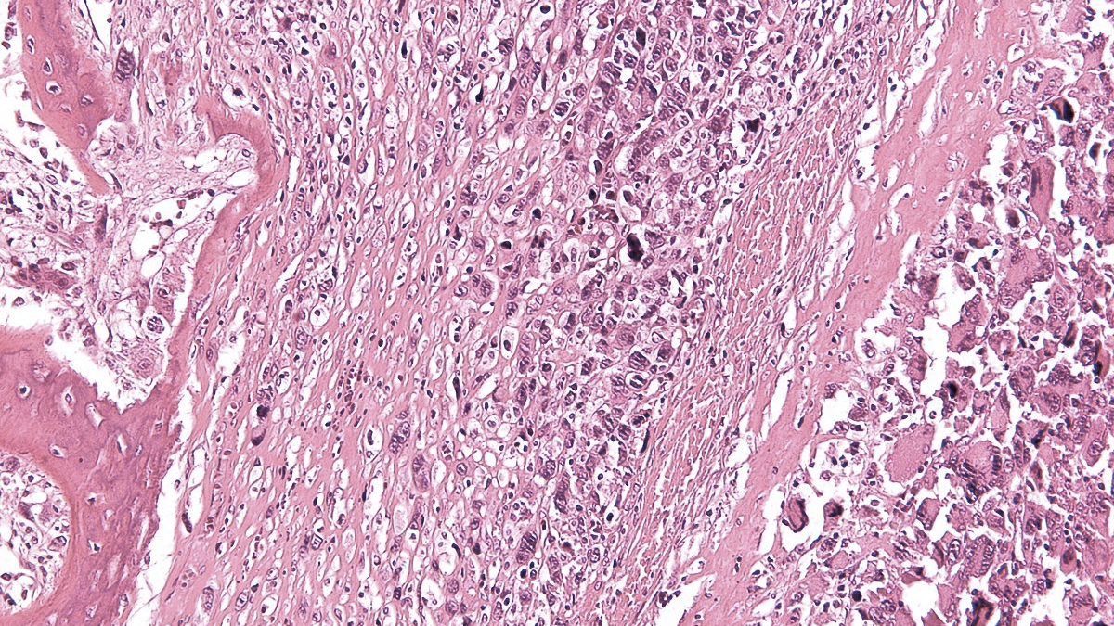
IX SELNET
CONSORTIUM MEETING
WK9 Dissemination and Exploitation
02nd-04th March 2023
Matías Chacón, Fleming Institute, Buenos Aires, Argentina

Slide 2
SELNET WP NUMBER/ NAME- PARTICIPANTS
WorkPackage tasks - objective

Slide 3
SELNET WP 9/ Communication, Dissemination and exploitation of results
Multidisciplinary Network of Clinical-Translational specialists in sarcomas
Reference centers
Guidelines
Health barriers
CME. Ethics
Improve diagnosis in sarcoma
Improve prognosis in sarcoma
Clinical and Pathological data
Bio-banks
Translation research program
Project
Tools
Final Objective
Spain
Italy
France
Mexico
Brazil
Argentina
Costa Rica
Peru
Germany
48 months

Slide 4
Research roadmaps
Research
communities
MS, EU
policymakers
Data
Policy recommendations
Publications
Reports
Software
(collaboration) platforms
Skills, knowledge
Project results
Prototypes
Pre-standards
Educational materials
Codes of conduct
Industry, innovators
Civic society, citizens
Adapted from Kirsti Ala-Mutka
European Commission H2020

Slide 5
SELNET WP 9/ Communication, Dissemination and exploitation of results
Informing about project
Informing about results
Project website
Making results available for use
Scientific publication
Newsletter
Sarcoma MDT
Training/MDT/webinars
Local and international congress
Sharing results on online repository (research data, reports)
Posts, Flyers, Alerts
sarcoma awareness month campaign
CPGs
Deliverables
Social media (Instagram, Twitter, Facebook, LinkedIn)
Academic webinars
Conference presentation
COMMUNICATION | DISSEMINATION | EXPLOITATION OF RESULTS
INTERNAL WP10 (Marta Martina Ruiz) WPs EXTERNAL Social Media National/International | MDT virtual board PATHOLOGY MEETINGS | Promote SELNET project Dissemination and adoption of CPGs
Last meeting in November/2022
Adapted from Kirsti Ala-Mutka
European Commission H2020
Present March/2023

Slide 6
SELNET WP 9/ Communication, Dissemination and exploitation of results
COMMUNICATION
SELENET COMUNICATION
Unidirectional
Patient registration on SELNET platform 30%
Consortium meeting 50%
Academicals webinar 10%
Financial report and deliverable report for the European commission 10%
Last 3 months
Bidirectional by email exchange
Webinars-meeting-conferences MDT board 50%
Date and time
Speakers and coordinators
Methodology to participate
Clinical case in Powerpoint
Request for information of SELNET platform 5%
Notes:
the approximate percentage of information by topic

Slide 7
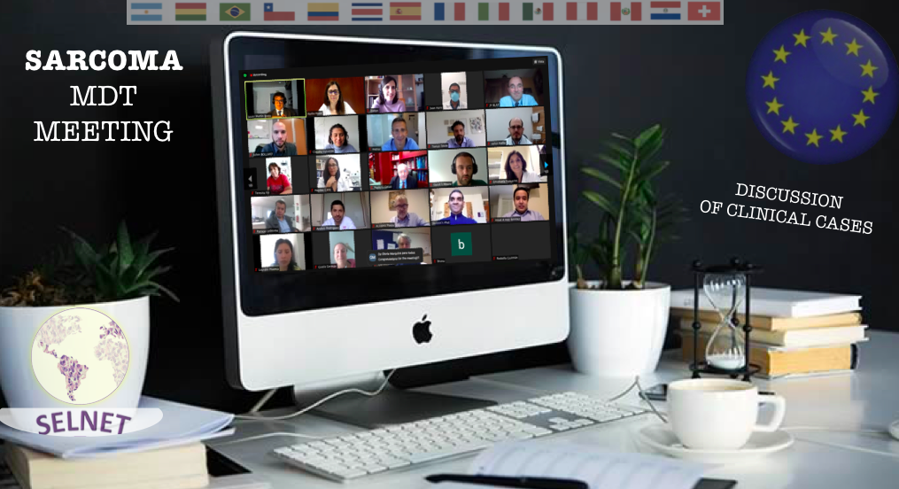
SELNET WP 9/ Communication, Dissemination and exploitation of results
DISSEMINATION
MDT 26th January IAF Argentina
MDT 20th December CBL France

Slide 8
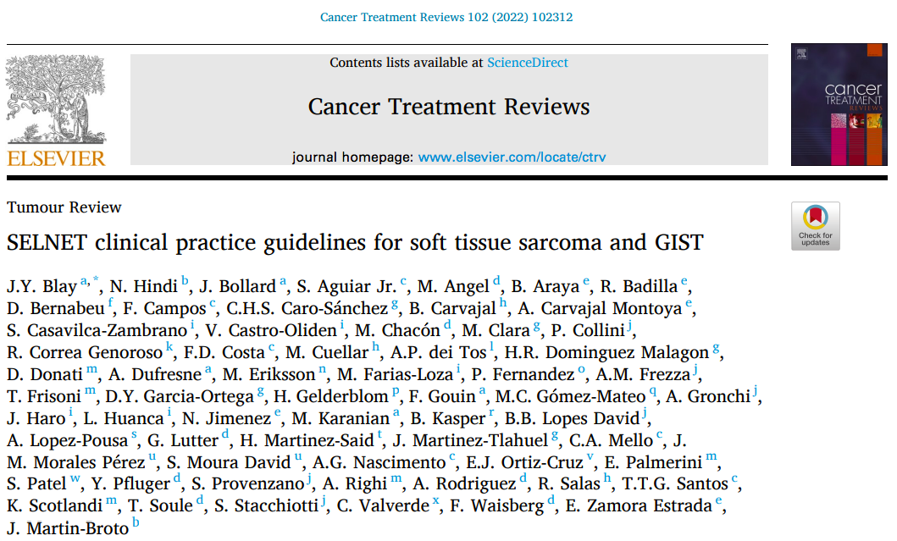
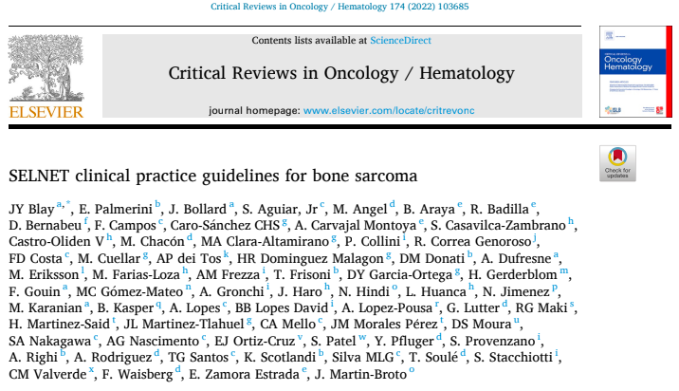
SELNET WP 9/ Communication, Dissemination and exploitation of results
1st january 2022
14th april 2022

Slide 9
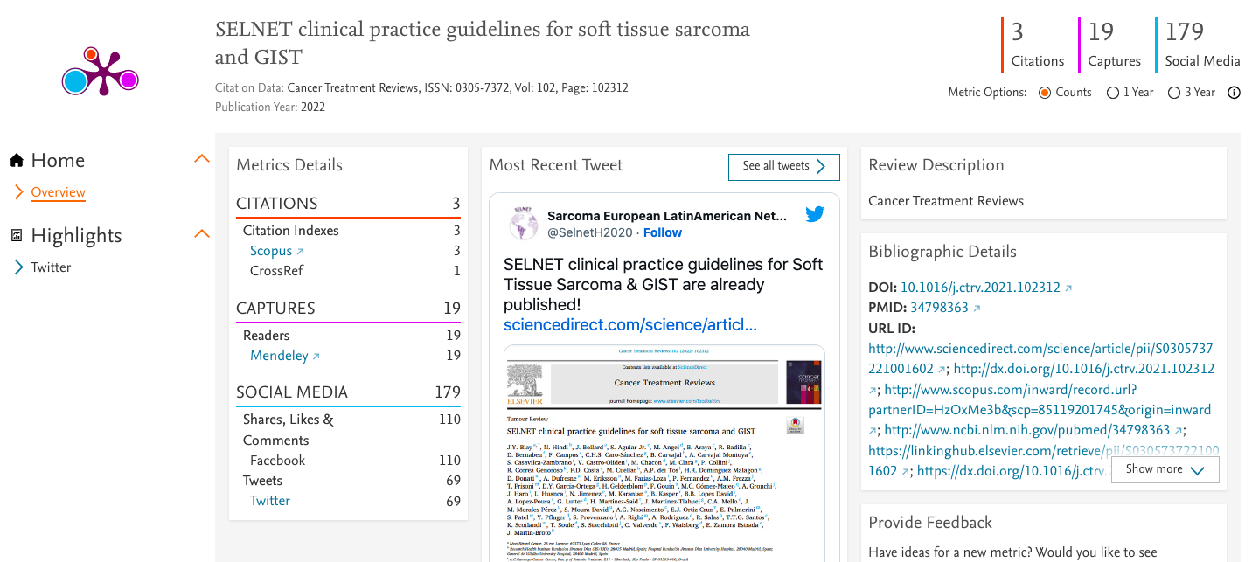
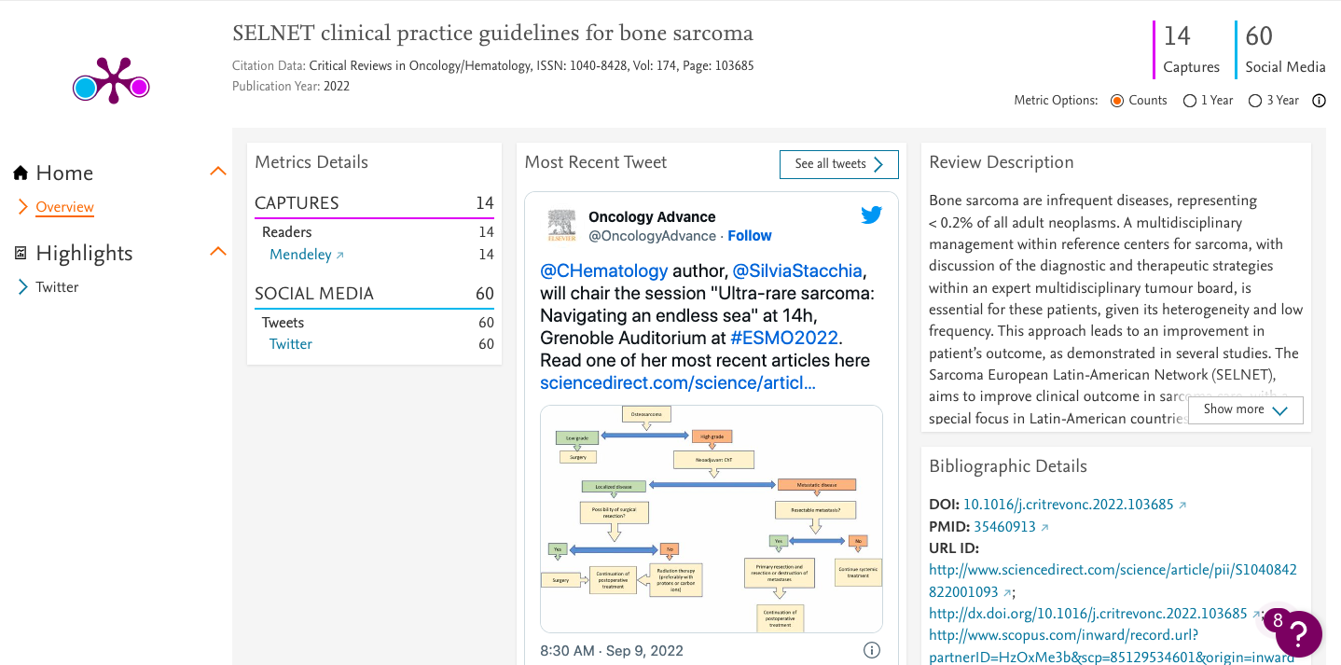
SELNET WP 9/ Communication, Dissemination and exploitation of results
1st january 2022
14th april 2022
Is time to move data and knwoledge beyond this sort of social media

Slide 10
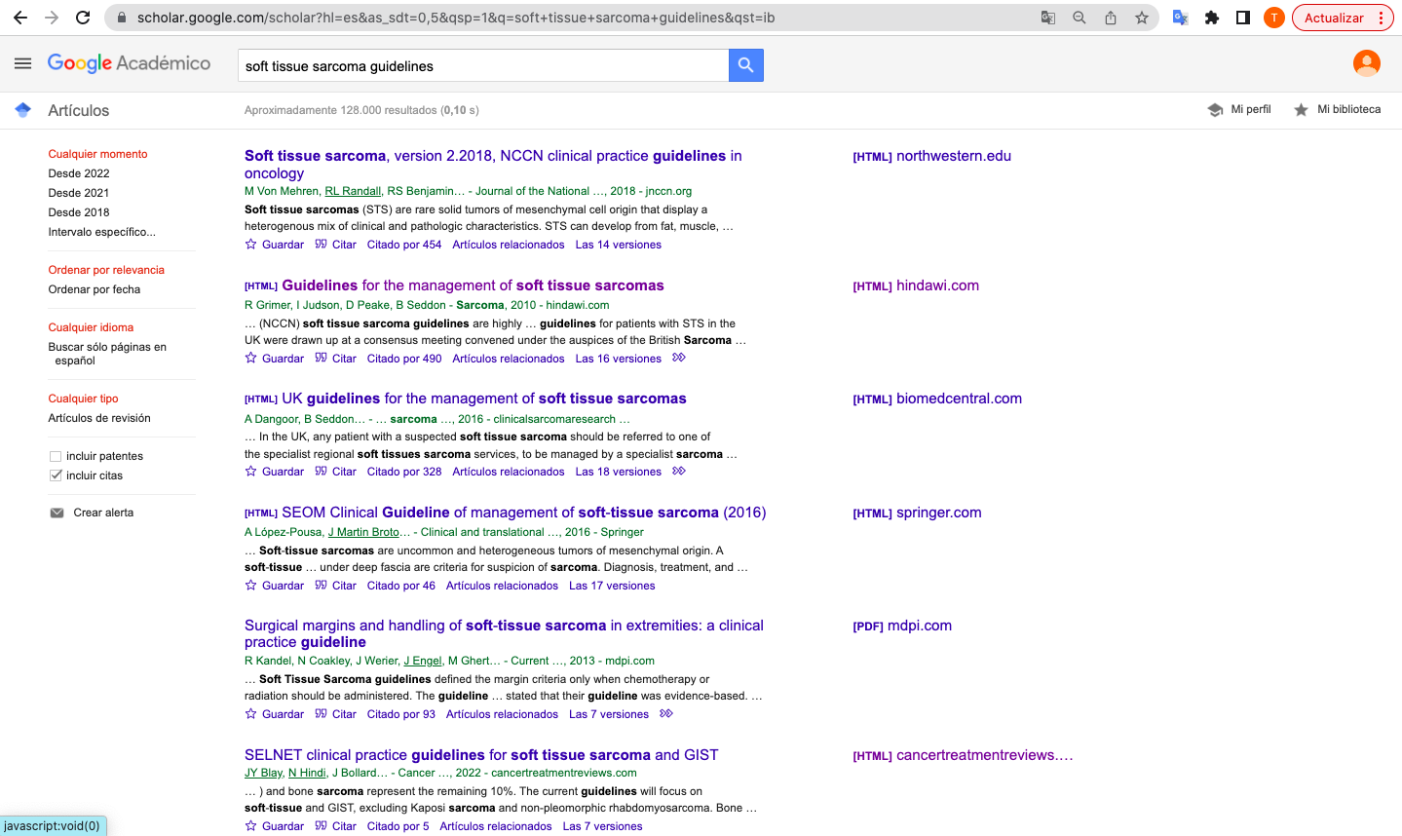
SELNET WP 9/ Communication, Dissemination and exploitation of results
Place #6 in terms of sarcoma guidelines

Slide 11
SELNET WP 9/ Communication, Dissemination and exploitation of results
EXPLOITATION OF RESULTS
 | WPs WP9 WP10 Website and ALERTs Increase participation in future own scientific publications: Retrospective studies Prospective real life studies Clinical Trial/ study proposals within SELNET Support request to European WPs to improve this

Slide 12
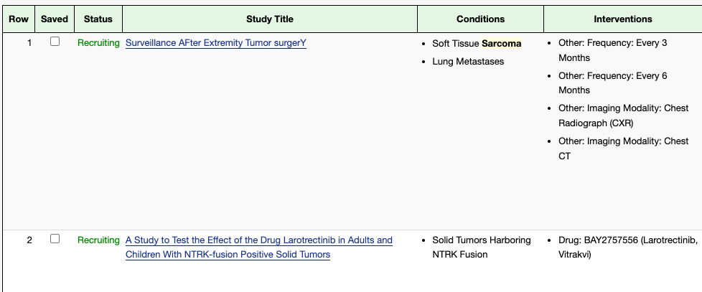
SELNET WP 9/ Communication, Dissemination and exploitation of results
Why SELNET is gone?
- Stakeholders
- Sarcoma patient groups
- Pharmaceutical companies

Slide 13
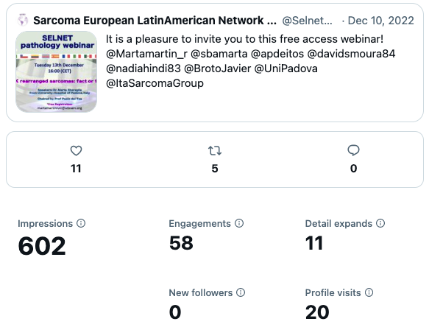
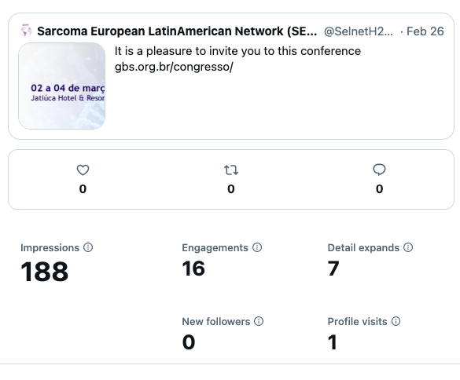
SELNET social network --> Sarcoma popularity
Last 3 months…
REALITY

Slide 14
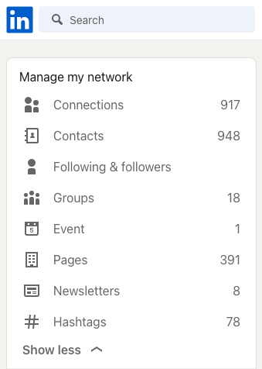
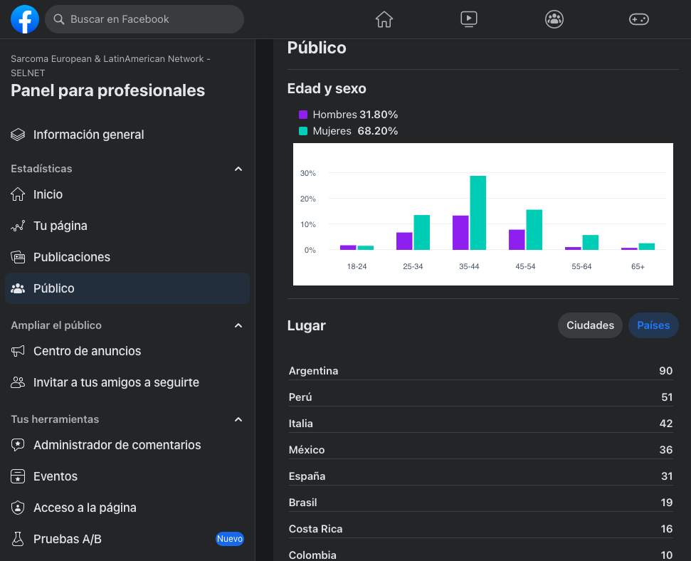
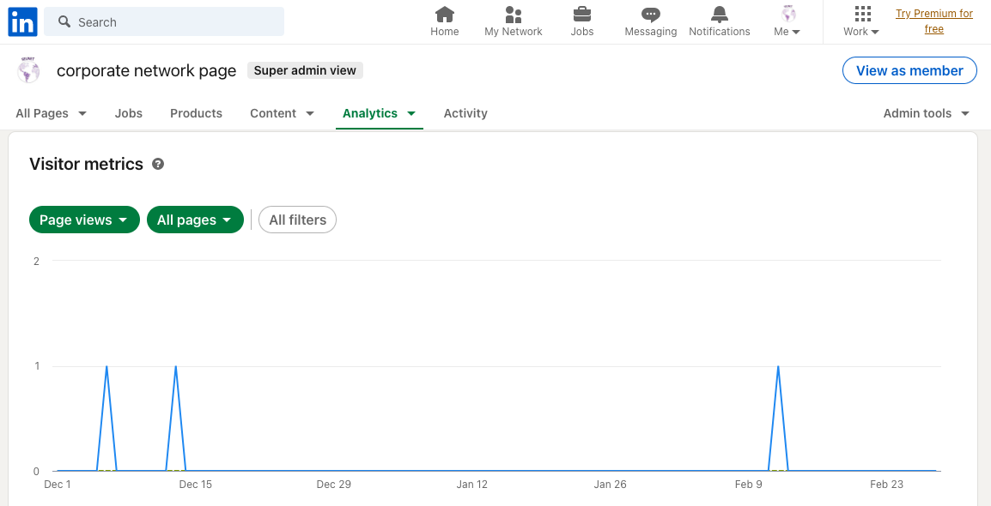
SELNET social network --> Sarcoma popularity
Last 3 months

Slide 15
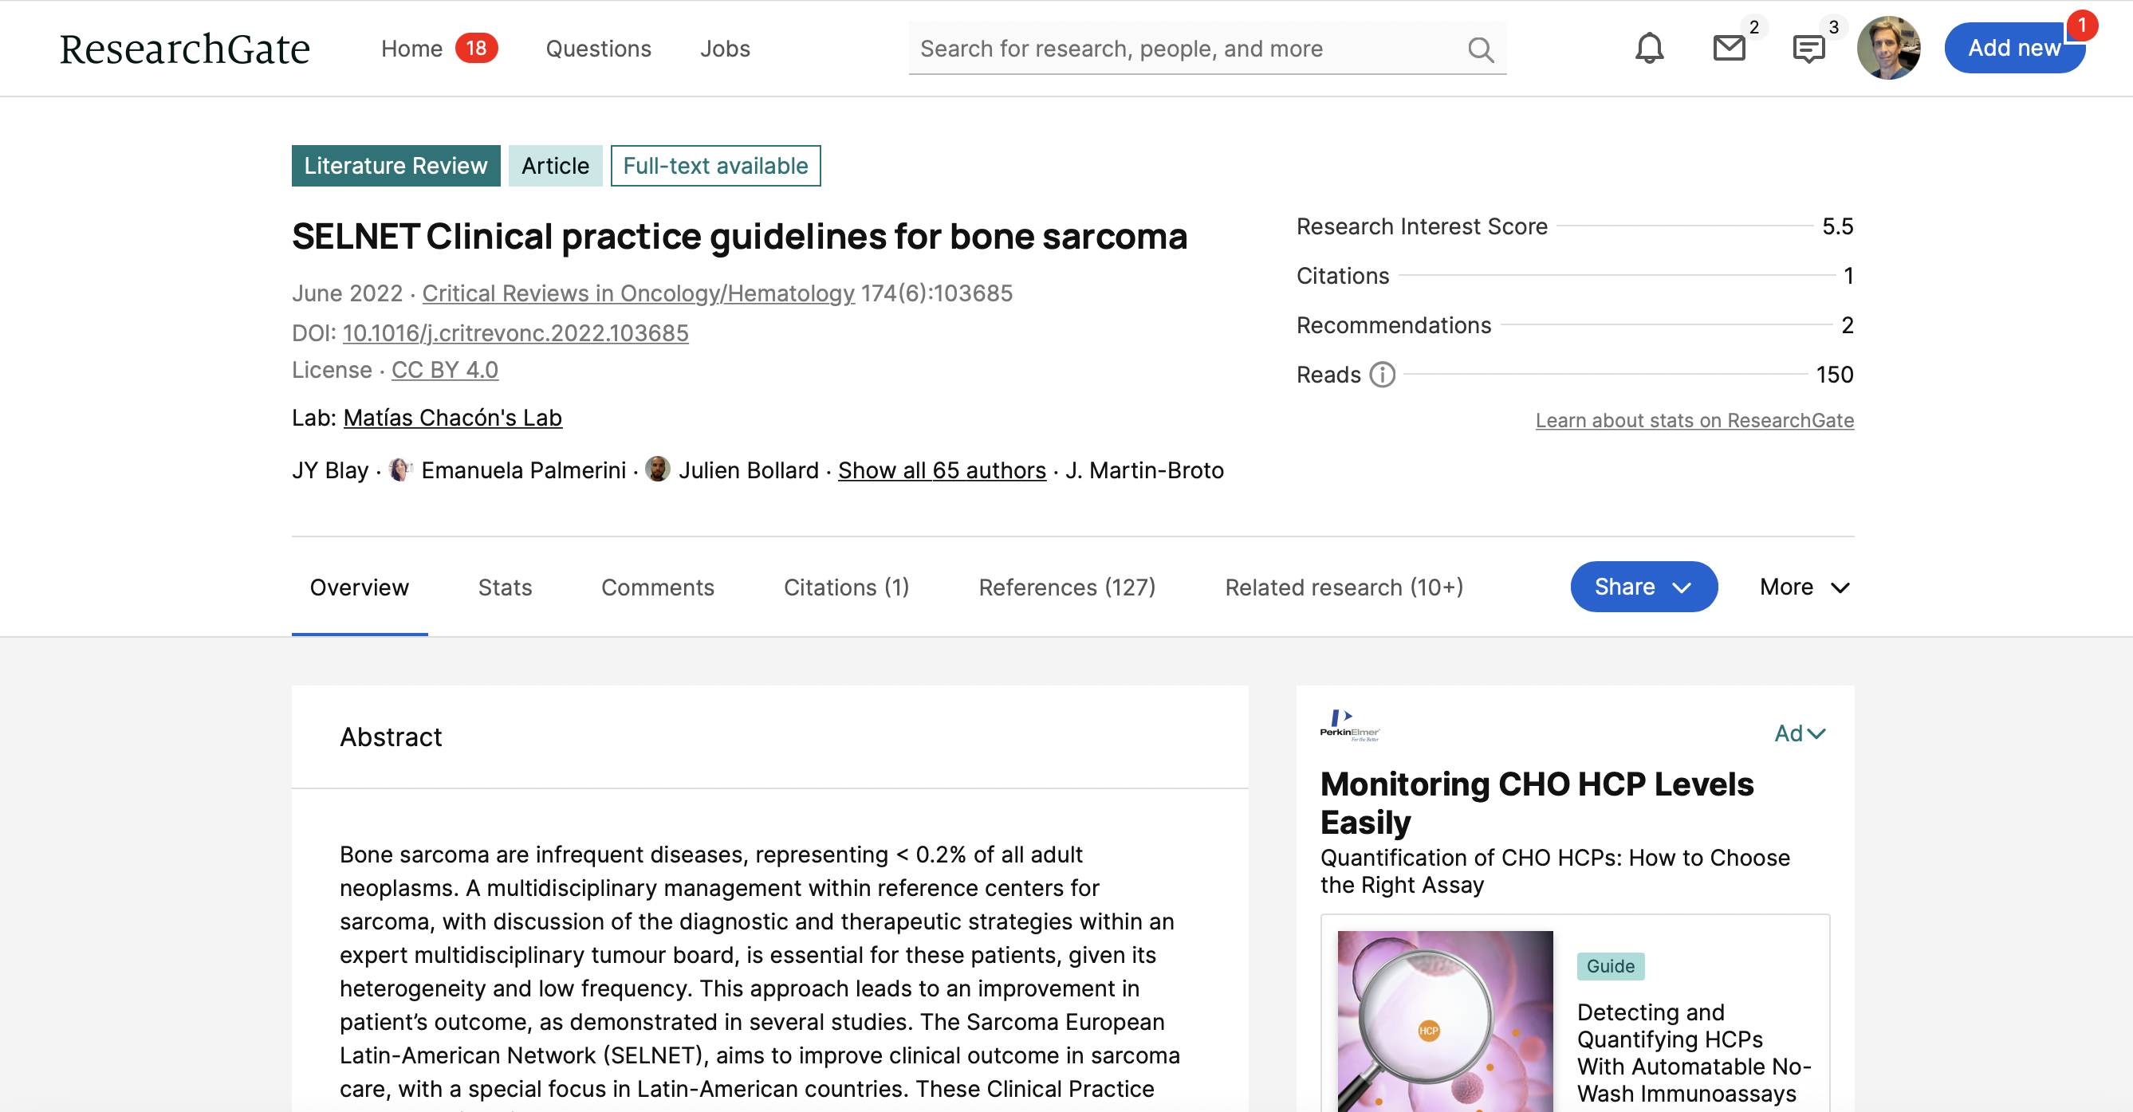
SELNET social network --> Sarcoma popularity

Slide 16
SELNET WP 9/
As part of the global work of the consortium
Deliverable
Update of the plan for exploitation and dissemination of result
ANNEX IV. PUBLICATIONS DURING SECOND PERIOD
- SELNET recommendations for COVID-19. Oct. 2020.
Clinical practice guidelines for bone sarcoma. Jun. 2022,
soft-tissue sarcoma and GIST. Nov. 2021.
Translational project publication:
A Novel NFIX-STAT6 Gene Fusion in Solitary Fibrous Tumor. Jul. 2021.
- Seven articles as guest editor in the Cancers journal with a special Issue entitled “New Therapeutic Advances in Rare Tumors”. Aug. 2020.

Slide 17
SELNET WP 9/
As part of the global work of the consortium
Deliverable

Slide 18
SELNET
Sarcoma as a model to improve diagnosis and clinical care of rare tumors through a European and Latin American multidisciplinary network
Appropriate management of sarcoma patients is hindered by the absence of referral policies to reference centers (RCs), incorrect or delayed diagnosis, non-adherence of therapies to clinical practice guidelines (CPGs), and lack of expertise by practitioners, which increases the risk of relapse and death.

Slide 19
SELNET WP9
WorkPackage tasks – planification (next 6 months until the end)
To be more agressibly looking for the attention of community, press and medical societies

Slide 20
Why does dissemination matter?
Dissemination
The public disclosure of the results by any appropriate means, including by scientific publications in any medium.*
Transfer of knowledge and results to the ones that can best make use of it
Maximizes the impact of research, enabling the value of results to be potentially wider than the original focus
Essential element of all good research practice
Prevents results becoming sticky and effectively lost
Strengthens and promotes the profile of the organisation
* Shortened from http://ec.europa.eu/research/participants/portal/desktop/en/support/reference_terms.html
Adapted from Kirsti Ala-Mutka
European Commission H2020

Slide 21
SELNET
Multidisciplinary Network of Clinical-Translational specialists in sarcomas
Reference centers
Guidelines
Health barriers
CME. Ethics
Improve diagnosis in sarcoma
Improve prognosis in sarcoma
Clinical and Pathological data
Bio-banks
Translation research program
Project
Tools
Final Objective
Spain
Italy
France
Mexico
Brazil
Argentina
Costa Rica
Peru
Germany
48 months

Slide 22
cOMMUNICATION plaN. tools
WEB site
Newsletter
Project factsheet, brochures
Social media (blogs, Twitter, Facebook, LinkedIn)
Press release

Slide 23
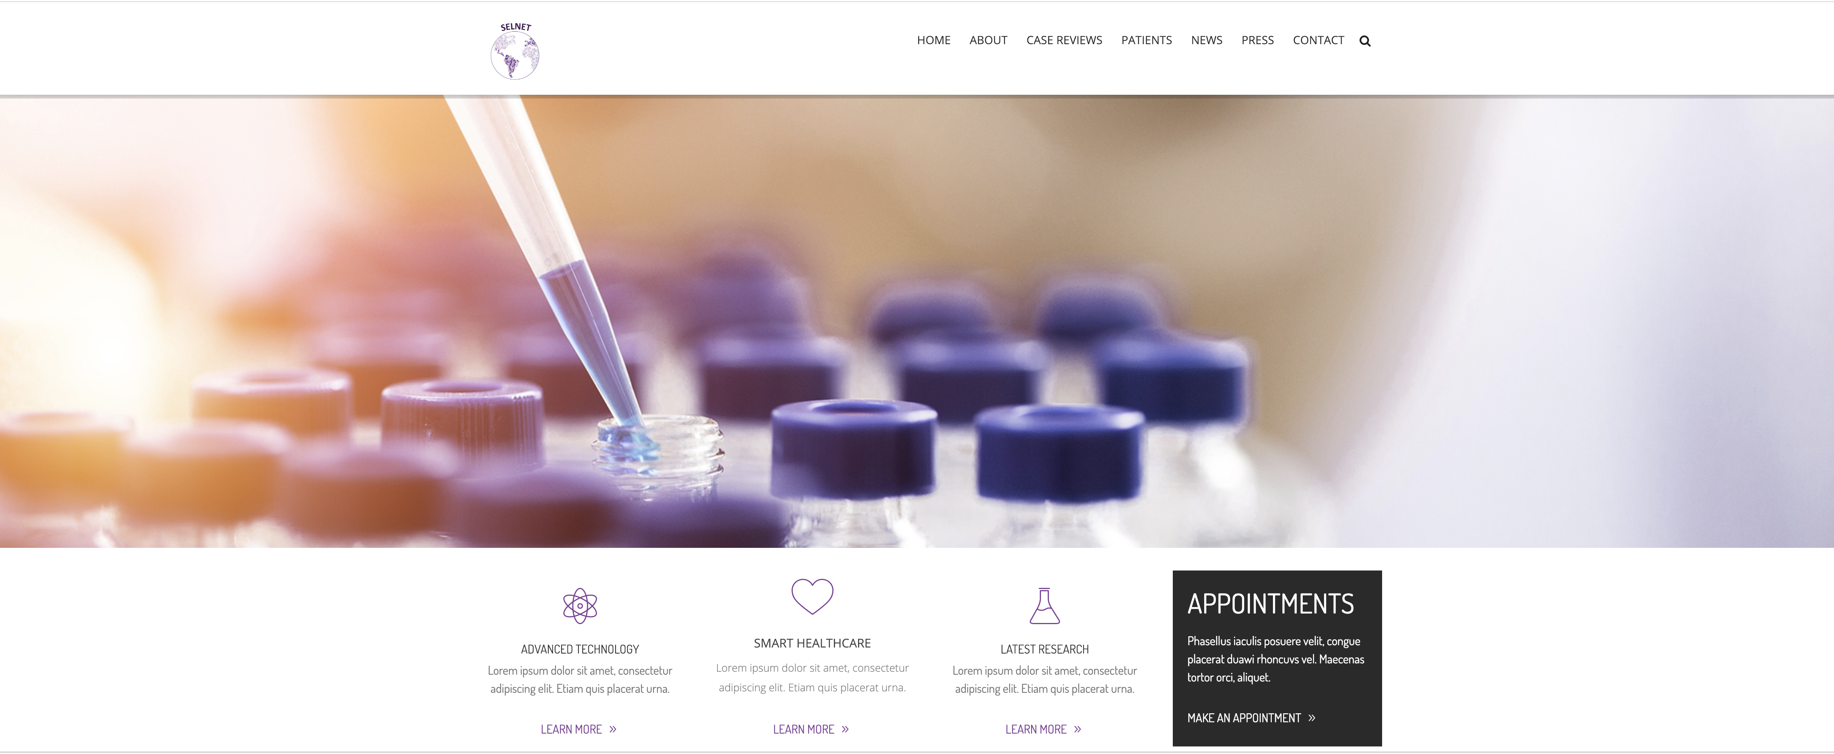
cOMMUNICATION plaN. tools
WEB site

Slide 24
cOMMUNICATION plan
tools

Slide 25
cOMMUNICATION plaN. tools
Videos, interviews
Articles in magazines
Exhibitions/guided visits
Conference presentation
Journal

Slide 26
DISSEMINATION plaN. Tools and target audiences
Oncology Societies
Surgical Societies
Pathological Societies
EU
CELAC
Advocacy Groups
Heath authorities
Companies
Private Institutions
Other especific contacts
Key contacts

Slide 27
DISSEMINATION plaN. KEY SARCOMA EVENTS and journals
GEIS’ Annual Symposium (Spain)
Italian Sarcoma Group Annual Meeting (Italy)
Journées du Groupe Sarcome (France)
CTOS
ESMO
ASCO
Mexican Annual Symposium on Sarcoma
Latam Meetings
Journal Surgical Oncology
Oncologist
Cancer Science
Immunology
Oncotarget
Journal of Clinical Oncology
European Journal of Cancer

Slide 28
dissemination plaN. tools
Do you consider to contact?
European Medical Groups of Sarcoma
GEIS (Grupo Español Investigación en Sarcomas)
ISG (Italian Sarcoma Group)
JSG -GETO( )
ASOCIACION ESPAÑOLA CONTRA EL CANCER | https://www.aecc.es/es/sobre-nosotros/quienes-somos | informacion@aecc.es
EUROPEAN CANCER ORGANISATION | https://www.ecco-org.eu/ | agnese.abolina@ecco-org.eu
EUROPEAN SOCIETY OF RADIOTHERAPY AND ONCOLOGY | https://www.estro.org/ | aleci@estro.org
CANCER CORE EUROPE | https://www.cancercoreeurope.eu/ | grant.office.gr@gmail.com
SARCOMA PATIENTS EURONET | https://www.sarcoma-patients.eu/en/ | info@sarcoma-patients.eu
SARCOMA UK | https://sarcoma.org.uk/ | info@sarcoma.org.uk
THE ROYAL MARSDEN NHS FUNDATION TRUST (SARCOMA UNIT) | https://www.royalmarsden.nhs.uk/our-consultants-units-and-wards/clinical-units/sarcoma-unit
THE LONDON SARCOMA SERVICE | http://www.londonsarcoma.org/ | ucl-tr.LondonSarcomaService@nhs.net
RARE CANCERS EUROPE | https://www.rarecancerseurope.org/ | rarecancerseurope@esmo.org
WORLD SARCOMA NETWORK | http://wsn.wpengine.com/
European Musculo-Skeletal Oncology Society E.M.S.O.S. | https://www.emsos.org/ | emsos2019@oic.it
EuropeanPaediatricSoft Tissue SarcomaStudy Group | https://www.epssgassociation.it/en/ | ulia.daragjati@unipd.it
Connective Tissue Oncology Society | https://www.ctos.org/Home.aspx | tos@ctos.org
British Sarcoma Group | http://www.britishsarcomagroup.org.uk/ | support@britishsarcomagroup.org.uk

Slide 29
dissemination plaN. tools
Do you consider to contact?
Other countries Cancer Societies
Asia
Asian Fund for Cancer Research (Hong Kong)
Cancer Aid and Research Foundation (India)
Foundation for Medical Research (FMR) (India)
Indonesian Cancer Foundation
Foundation for Promotion of Cancer Research (Japan)
Japanese Foundation for Cancer Research (JFCR) (Japan)
Kobayashi Foundation for Cancer Research (Japan)
Princess Takamatsu Cancer Research Fund (Japan)
National Cancer Center Research Institute (Japan)
Cancer Research Initiatives Foundation (CARIF) (Malaysia)
Philippine National Health Research System (PNHRS) (Philippines)
Singapore National Research Foundation (Singapore)
Agency for Science, Technology and Research (Singapore)
Australia
Australian Cancer Research Foundation (ACRF)
National Foundation for Medical Research and Innovation (NFMRI)
National Health and Medical Research Council (NHMRC)
Cancer Australia
Cancer Institute NSW
Cancer Council Western Australia
Cancer Council Queensland
Cancer Council Victoria
New Zealand
Cancer Society of New Zealand
Genesis Oncology Trust
Health Research Council of New Zealand
Royal Society of New Zealand Marsden Fund
Wellington Medical Research Foundation
North America: Canada
Canadian Cancer Research Alliance (CCRA)
Canadian Cancer Society Research Institute (CCSRI)
Canadian Institutes of Health Research
Canadian Research Information System
Cancer Research Society (CRS)
Institute of Cancer Research (ICR)
National Research Council Canada
Ontario Institute for Cancer Research (OICR, formerly OICR’s Cancer Research Fund (CRF)
ResearchNet Canada
)

Slide 30
dissemination plaN. tools
Do you consider to contact?
Other countries Cancer Societies
North America: US
American Association of Cancer Research
American Cancer Society
American Institute for Cancer Research
Association of American Cancer Institutes
Burroughs Wellcome Fund
Cancer Research Foundation
Congressionally Directed Medical Research Programs
Conquer Cancer Foundation
Damon Runyon Cancer Research Foundation
Gateway for Cancer Research
Livestrong Foundation
Oncology Nursing Society (ONS) Foundation
Robert Wood Johnson Foundation
Rising Tide Foundation
The Grantsmanship Center (TGCi)
The Max Foundation
The V Foundation for Cancer Research
U.S. Charity Navigator (search for cancer)
U.S. Federal Grantmaking Agencies
U.S. Foundation Directory Online (search for cancer)
U.S. National Science Foundation Index of Funding Opportunities
U.S. National Comprehensive Cancer Network (NCCN) Oncology Research Program
U.S. National Cancer Institute
U.S. NIAID's List of Foundations and Other Funding Sources (search for cáncer)

Slide 31
dissemination plaN. tools
Do you consider to contact?
CELAC Medical Oncology Societies
AAOC (Asociación Argentina de Oncología Clínica)
Sociedad Argentina de Cancerología
Asociacion oncólogos clínicos de Córdoba
Sociedad Chilena de oncologia medica
Sociedad Chilena de cancerología
Sociedad Chilena de Radioterapia oncologica
Sociedad Boliviana de oncología
Sociedad Boliviana de cancerología
FESCAS Federacion de sociedades de cancerología de Sudamerica
SBOC Sociedade Brasileira de Oncologia
SBC Sociedade Brasileira de Cancerología
SbeoNet Sociedade Brasileira de Enfermagem Oncológica
Sociedade Brasileira de Psico-Oncología
SOBRAFO Sociedade Brasileira de Farmaceuticos em omcologia
ACHO asociación Colombiana de Hematología y Oncología
Asociacion Colobiana de oncologia
ACHOP Asociacion Colombiana de hematologia y oncologia pediatrica
ACOMED Asociación Costarricense de Oncólogos Médicos
FLASCA Federacion Latinoamericana de sociedades contra el cancer
Sociedad cubana de cancerologia
SEO Sociedad Ecuatoriana de oncología
SOLCA Sociedad de lucha contra el cancer
Asociacion Salvadoreña para la prevencion del cancer
Sociedad Latinoamericana de oncología pediatrica
Sociedad Hondureña de oncología
SMEO sociedad Mexicana de oncología
Consejo Mexicano de Oncología
ANICO Asociacion Nicaraguense de oncologia
Sociedad Panameña de Oncología
SLACOM Sociedad Latinoamericana y del caribe de oncologia medica
SPOM Sociedad Paraguaya de oncología médica
Asociación de hematología y oncología de Puerto rico
Sociedad peruana de oncología
Sociedad Peruana de cancerología
Sociedad Dominicana de hematología y oncología
SOMPU Sociedad de oncología médica y pediátrica del Uruguay
Sociedad venezolana de oncología

Slide 32
dissemination plaN. tools
Do you consider to contact?
CELAC Surgical Societies and Meetings
Country | Society | Web | Contact | Meeting | Journal
Argentina | Asociación Argentina de Ortopedia y Traumatología | http://aaot.org.ar/ | informes@aaot.org.ar | anual | http://aaot.org.ar/
Colombia | Sociedad Colombiana de Cirugía Ortopédica y Traumatología | http://www.sccot.org.co/ | secretaria@sccot.org.com | anual | http://www.sccot.org.co/index.php/publicaciones/revista
Venezuela | Sociedad Venezolana de Cirugía Ortopédica y Traumatología | https://www.svcot.org.ve/ |  | anual
Ecuador | Sociedad Ecuatoriana de Ortopedia y Traumatologia | http://seotecuador.com/ | secretaria@seotecuador.com | anual
Panama | Sociedad Panameña de Ortopedia y Traumatología |  |  | anual
Mexico | Federación Mexicana De Colegios De Ortopedia Y Traumatología, A.C., Colegio Mexicano de ortopedia y Traumatologia | http://www.femecot.com/ | presidencia@femecot.com | anual | http://www.actaortopedicamexicana.com.mx/
Costa Rica | Asociación Costarricense de Ortopedia y Traumatología | https://www.ortopediacostarica.com | acotcostarica@gmail.com | anual
Honduras | Asociación de Cirugía Ortopédica y Traumatología de Honduras | https://www.facebook.com | shotnoroccidental@gmail.com | anual
Guatemala | Asociación Guatemalteca de Ortopedia y traumatologia | http://www.agot.gt/ | asociacionguateortoytrauma@gmail.com | anual

Slide 33
dissemination plaN. tools
Do you consider to contact?
CELAC Surgical Societies and Meetings
El Salvador | Asociacion Salvadoreña de Ortopedia y Traumatologia | http://asotelsalvador.org/ |  |  | Anual
Republica Dominicana | Sociedad Dominicana de Ortopedia Y Traumatologia | http://sdot.com.do/ | actividadesyeventossdot@sdot.com.do |  | Anual
Perú | Sociedad Peruana de Ortopedia y Traumatologia | http://spotrauma.org/ | spotperu@gmail.com, |  | Anual | http://www.spotrauma.org/?q=node/27
Brazil | Sociedad Brasileña de Ortopedi y Traumatología | https://www.sbotsp.org.br/ | atendimento@sbotsp.org.br |  | Anual | Revista SBOT-SP
Bolivia | Sociedad Boliviana de Ortopedia y Traumatología | http://sbolotbolivia.org/ |  |  | Anual
Paraguay | Sociedad Paraguaya de Ortopedia y Traumatología | https://www.spot.org.py/ |  | spot@sidus.com.py | Anual
Uruguay | Sociedad de Ortopedia y Traumatologia del Uruguay | http://www.sotu.org.uy/joomla |  |  | Anual
Chile | Sociedad Chilena de Ortopedi y Traumatología | https://www.schot.cl/ | schot@schot.cl | schot@schot.cl | Anual
Varios paises miembros | Sociedad Latinoamericana de Ortopedia y Traumatologia | https://www.slaot.org/index.php | slaot@slaot.org | slaot@slaot.org |  | https://revista.slaot.org/

Slide 34
dissemination plaN. tools
Do you consider to contact?
European Cancer Societies
Netherlands- Dutch Cancer Society (DCS), Nederlandse Organisatie voor Wetenschappelijk Onderzoek/Netherlands Organisation for Scientific Research (NWO)
Norway- Norges Forskningsråd/Research Council of Norway (RCN)
Poland- Narodowe Centrum Nauki/National Science Centre (NCN)
Portugal- Champalimaud Foundation (CF), Fundação para a Ciência e a Tecnologia/Foundation for Science and Technology (FCT)
Romania- Romanian Office for Science and Technology
Slovakia- Agentúra na podporu výskumu a vývoja/Slovak Research and Development Agency (APVV), Slovenská akadémia vied/Slovak Academy of Sciences (SAV)
Slovenia- Javna agencija za raziskovalno dejavnost Republike Slovenije/Slovenian Research Agency (ARRS)
Spain- Consejo Superior de Investigaciones Científicas/Spanish National Research Council (CSIC)
Sweden- Forskningsrådet för hälsa, arbetsliv och välfärd/Swedish Research Council for Health, Working Life and Welfare (FORTE), Vetenskapsrådet/Swedish Research Council (VR)
Switzerland- CTI, ISREC Foundation, Schweizerischer Nationalfonds/Fonds National Suisse/Swiss National Science Foundation (SNSF), State Secretariat for Education, Research and Innovation (SERI), Swiss Group for Clinical Cancer Research (SAKK)
Turkey- Türkiye Bilimsel ve Teknolojik Araştırma Kurumu,/Scientific and Technological Research Council of Turkey (TÜBİTAK)
United Kingdom- Biotechnology and Biological Sciences Council (BBSRC), Cancer Research UK, Cancer Research Technology , Cancer Research Wales ,Medical Research Foundation, Medical Research Council (MRC), National Cancer Research Institute (NCRI), National Institute for Health Research (NIHR), NCRI Grantsmanship Gateway (to identify sources of funding and to access expert advice on grant application development), Science and Technology Facilities Council (STFC), UK Cancer Foundations (list)

Slide 35
dissemination plaN. tools
Do you consider to contact?
European Cancer Societies
Austria- Fonds zur Förderung der Wissenschaftlichen Forschung/Austrian Science Fund (FWF)
Belgium- Fondation Contre le Cancer Fonds de la Recherche Scientifique/Fund for Scientific Research (FRS - FNRS), Fonds voor Wetenschappelijk Onderzoek - Vlaanderen/Research Foundation Flanders (FWO)
Bulgaria- The Bulgarian Academy of Sciences
Croatia- Hrvatska zaklada za znanost/Croatian Science Foundation (HRZZ)
Czech Republic- Grantová agentura Ceské republiky/Czech Science Foundation (GACR)
Denmark- Danish National Research Foundation, Det Frie Forskningsråd/Danish Council for Independent Research (DFF)
Estonia- Eesti Teadusagentuur/Estonian Research Council (ETAG)
Finland- Suomen Akatemia/Finlands Akademie/Academy of Finland (AKA)
France- Agence Nationale de la Recherche/French National Research Agency (ANR), Centre Nationale de la Recherche Scientifique/National Centre for Scientific Research (CNRS), European Cancer Centers Foundation,, Fondation ARC pour la recherche sur le cáncer, Institut National du Cancer (INCa), Fondation Jérôme Lejeune, Fondation Toulouse Cancer Santé, Institut National de la Santé et de la Recherche Médicale/French National Institute of Health and Medical Research (INSERM), UNICANCER
Germany- Deutsche Forschungsgemeinschaft/German Research Foundation (DFG), German Cancer Research Center (DKFZ), German Cancer Aid, Helmholtz-Association, Max-Planck-Gesellschaft/Max Planck Society (MPG), Wissenschaftsgemeinschaft Gottfried Wilhelm Leibniz/Leibniz Association (WGL)
Greece- Centre for Research and Technology-Hellas (CERTH), Foundation for Research and Technology-Hellas (FORTH), National Hellenic Research Foundation,
Hungary- Magyar Tudományos Akadémia/Hungarian Academy of Sciences (MTA), Országos Tudományos Kutatási Alapprogramok/Hungarian Scientific Research Fund (OTKA)
Iceland- Rannsóknamiðstöð Íslands/Iceland Centre for Research (Rannís)
Ireland- Health Research Board (HRB), Irish Research Council, Irish Cancer Society Research, Science Foundation Ireland (SFI)
Italy- Advanced Biomedical Research Foundation, Consiglio Nazionale delle Ricerche/National Research Council (CNR), European Centre for Nanomedicine (CEN Foundation), Fondazione IRCCS - Istituto Nazionale dei Tumori, Fondazione Umberto Veronesi (FUV), Italian Association for Cancer Research (AIRC), Italian Foundation for Cancer Reseach (FIRC), Italian Institute for Molecular Oncology (IFOM)
Latvia- Latvijas Zinatnes Padome/Latvian Science Council (LZP)
Lithuania- Lietuvos Mokslo Taryba/Research Council of Lithuania (LMT)
Luxembourg- Fondation Contre le Cancer, Fonds National de la Recherche/National Research Fund (FNR)
Malta- Action for Breast Cancer Foundation (ABCF)

Slide 36
dissemination plaN. tools
Do you consider to contact?
CELAC Pathologic Societies and Meetings
Country | Society
Argentina | Sociedad Argentina de Patologia
Colombia | Asociacion Colombiana de Patologia
Venezuela | Sociedad Venezolana de Anatomia Patologica
Ecuador
Panama
Mexico | Colegio y Asociación Mexicana de Patólogos, A.C. y Federacion de aantomia patologica de la Republica Mexicana (colegios nacionales adheridos) (congreso nacional y seminarios anuales)
Costa Rica | Asociacion de Patologos de Costa Rica
Honduras | Asociacion Hodureña de Anatomia Patologica
Nicaragua
Guatemala | Asociacion nacional de Patologios de Guatemala
El Salvador | Asociacion Salvadoreña de Patologia
Republica dominicana
Peru
Brazil | Associação dos Patologistas do Estado de São Paulo, Sociedade Brasileira de Patologia
Bolivia
Paraguay | Sociedad Paraguaya de Anatomia Patologica
Uruguay | Sociedad de Anatomia Patologica del Uruguay
Chile | Sociedad Chilena de Anatomia Patologica
Varios paises miembros | Sociedad Latinoamericana de Patologia
 | Sociedad Latinoamericana de Tumores Musculoesqueleticos
 | Academia Internacional de Patologia Division Argentina

Slide 37
dissemination plaN. tools
Do you consider to contact?
Sarcoma and cancer advocacy groups
Asociación Española de Afectados por Sarcomas (AEAS)
Fundación la sonrisa de Alex por la investigación y el tratamiento del sarcoma de Ewing
VYDA
FUCA (Fundación Cáncer)
Fundación Mari Paz Jimenez Casado
Fundación de investigacion oncológica FERO
Fundación Fero
Fundación Maria Garcia Estrada
Fundación SALES
Fundación Natalí Dafne Flexer de ayuda al niño con cáncer Ayuda a niños con cáncer de todo el país. CABA, Argentina
Fundacion Ayudale
Fundación Creando Lazos
ONG no estás solo
Gist Argentina
Alianza GIST
Fundación Ignacio MC Peralta Tanco
Fundación Maria Cecilia
Jano para todos
Asociación Civil Soles Catamarca
Fundación PULCCI
Fundacion F.A.E.H.E.R.
Fundación Crisálida
Fundación Arco Iris
Fundación Fermin Morales
Asociación Luci
Fundación FUNDAVITA
Asociación traspasar – Mercedes Carrion
Asociación de Jóvenes por la lucha contra el Cáncer Infantil
Asociacion Civil Creación
Asociación APANC
Fundación sendero
Fundación Anyarc
Fundación Hope
FundaME . Fundacion Maria Echenique de ayuda al niño con cáncer
Fundación Anna Vázquez para la lucha contra el cáncer cerebral infantil
Fundación ángeles
Fundación FAOHP (fundación ayuda onco hematologica pediatrica)
CENAIH (centro de apoyo integral hemato-oncológico)
Aldea de amor
Fundación santafesina Virgen de Lujan
Fundación Mateo Esquivo
Fundación Maria Graciela Maidana
FACEC Fundacion Argentina contra el Cancer
MACMA
Fundación GIST Mexico
Fundación Boliviana de lucha contra el cáncer
Fundación Tiempo de vivir CABA, Argentina
Fundación hondureña para el niño con cáncer
Liga Puertoriqueña contra el cáncer

Slide 38
dissemination plaN. tools
We need more publications?
Impact Factors from Relevant Journals
Impact factor
# References/publications
# RANKING
1 CA-A CANCER JOURNAL FOR CLINICIANS | 244,585
2 NEW ENGLAND JOURNAL OF MEDICINE | 79.258
3 LANCET | 53.254
7 JAMA-JOURNAL OF THE AMERICAN MEDICAL ASSOCIATION | 47.661
9 NATURE REVIEWS CANCER | 42.784
17 LANCET ONCOLOGY | 36.418
34 JOURNAL OF CLINICAL ONCOLOGY | 26.303
39 Nature Reviews Clinical Oncology | 24.653
43 Cancer Discovery | 24.373
49 BMJ-British Medical Journal | 23.259
50 CANCER CELL | 22.844
64 JAMA Oncology | 20.871
138 ANNALS OF ONCOLOGY | 13,926
209 JNCI-Journal of the National Cancer Institute | 11.238
226 Journal of Thoracic Oncology | 10.336
233 CLINICAL CANCER RESEARCH | 10.199
234 SEMINARS IN CANCER BIOLOGY | 10.198
263 NEURO-ONCOLOGY | 9.384
278 Cancer Immunology Research | 9.188
283 CANCER RESEARCH | 9.130
341 BIOCHIMICA ET BIOPHYSICA ACTA-REVIEWS ON CANCER | 8.220
348 CANCER TREATMENT REVIEWS | 8.122
371 Molecular Cancer | 7.776
400 INTERNATIONAL JOURNAL OF CANCER | 7.360
426 EUROPEAN JOURNAL OF CANCER | 7.191
501 CANCER | 6.537
512 CANCER LETTERS 6.491 | 6.491
519 Journal of the National Comprehensive Cancer Network | 6471
587 CANCER AND METASTASIS REVIEWS | 6.081
621 BRITISH JOURNAL OF CANCER | 5.922
697 INTERNATIONAL JOURNAL OF RADIATION ONCOLOGY BIOLOGY PHYSICS | 5.554
749 MOLECULAR CANCER THERAPEUTICS | 5.365
760 ENDOCRINE-RELATED CANCER | 5.331
762 Cancers | 5.326
768 ONCOLOGIST | 5.306
778 Molecular Oncology | 5.264
856 Gastric Cancer | 5.045
892 RADIOTHERAPY AND ONCOLOGY | 4942
982 Seminars in oncology | 4942
1048 GYNECOLOGIC ONCOLOGY | 4540
1078 CRITICAL REVIEWS IN ONCOLOGY HEMATOLOGY | 4.495
1521 ANNALS OF SURGICAL ONCOLOGY | 3.857
1708 CURRENT OPINION IN ONCOLOGY | 3.653
1761 BREAST CANCER RESEARCH AND TREATMENT | 3605
1843 CANCER JOURNAL | 3.519
2366 MELANOMA RESEARCH | 3.135
2309 Surgical Oncology Clinics of North America | 3.122
2391 Current Oncology Reports | 3.778

Slide 39
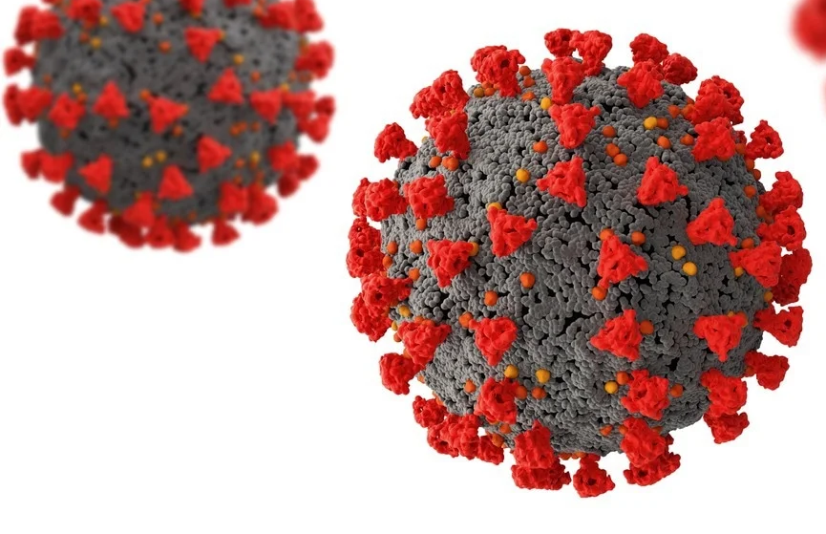
SELNET Deliverables. WP 9
Interim report on dissemination activities
Final dissemination report
DAY 1
DAY 60
MONTH 6
M12
M18
M24
M30
M36
M42
M 48
Communication Plan
Plan for Using and Disseminating Foreground

Slide 41
SELNET WP 9. Fleming Institute from Argentina
Thank you
VII SELNET CONSORTIUM MEETING (April 2022)

