Slide 1
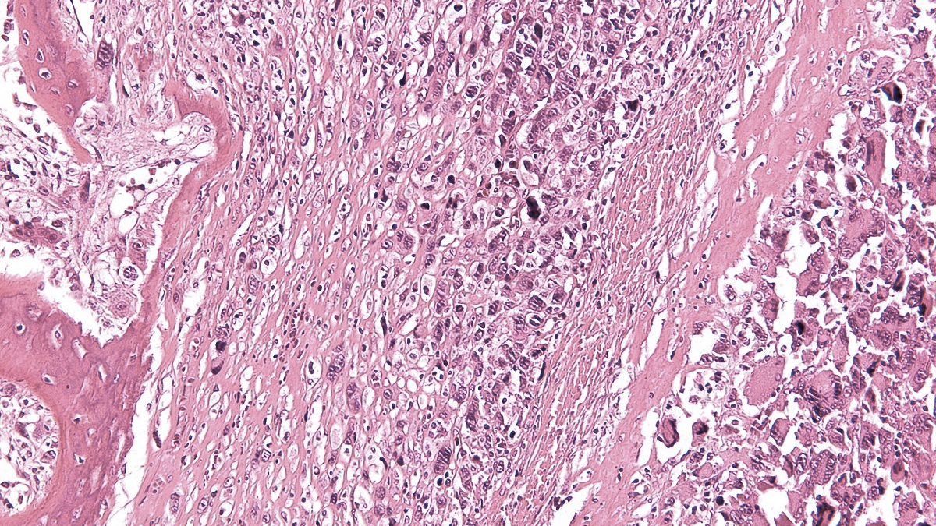
X SELNET
CONSORTIUM MEETING
08th-10th November 2023
WP6: MULTIDISCIPLINARY REVIEW OF CLINICAL CASES
NADIA HINDI MUÑIZ
FUNDACIÓN JIMENEZ DIAZ UNIVERSITY HOSPITAL
MADRID, SPAIN

Slide 2
SELNET WP6: Multidisciplinary review of clinical cases- FIIS-FJD
OBJ 1: To perform peer reviews of pathologic diagnosis
OBJ 2: To conduct multidisciplinary tumor boards (MDT) to review clinical cases
WP 7
WP 6
WP 8

Slide 3
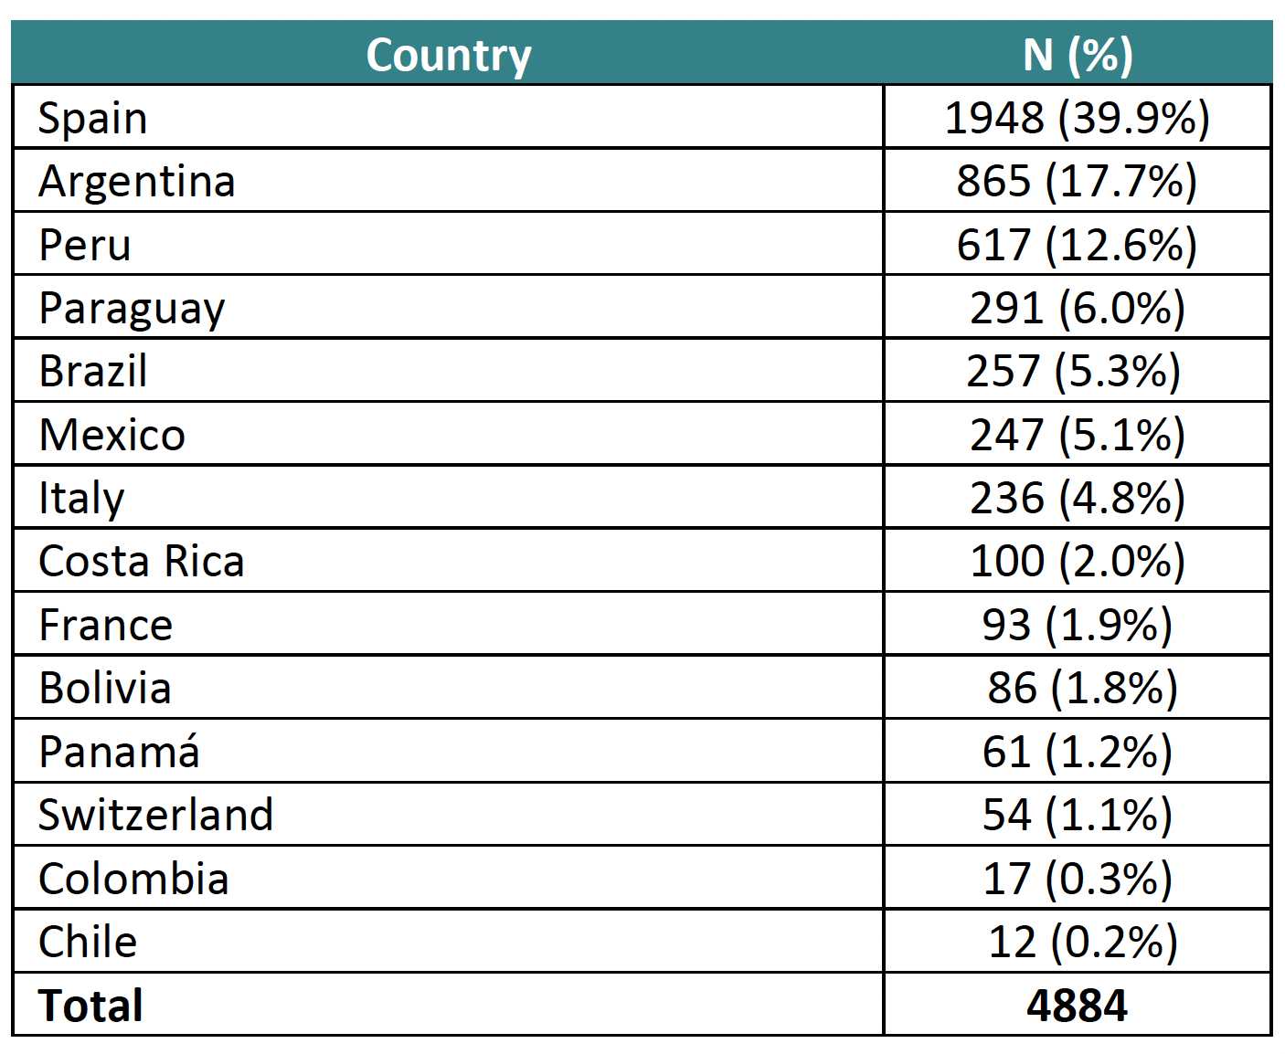
SELNET WP6: Multidisciplinary review of clinical cases- FIIS-FJD
OBSERVATIONAL STUDY (REGISTRY)
Approved in 39 centres in 14 countries
Costa Rica finally was approved in 2022!
32 centers included patients

Slide 4
SELNET REGISTRY: ADVANTAGES
Each Institution is owner of its own registered cases
This could represent a National Registry in some cases
The SELNET Registry is the first big data for Sarcoma in LATAM
This registry is a tool for checking Quality of Care items and its evolution over time
It is a tool to measure the compliance for CPG and to measure outcome according to it
It is useful to defend SELNET centers for conducting clinical trials
This will be helpful for academic papers based on clinical data from specific subtypes

Slide 5
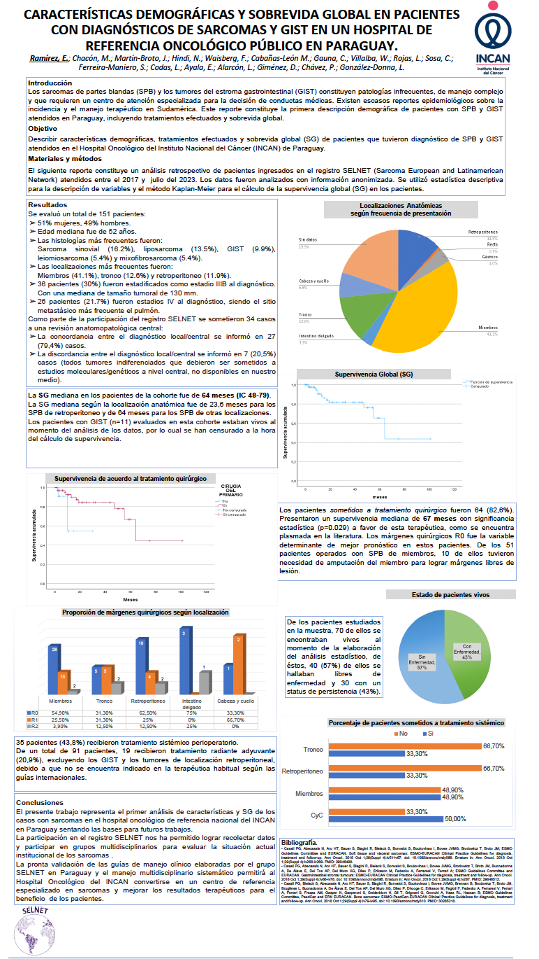
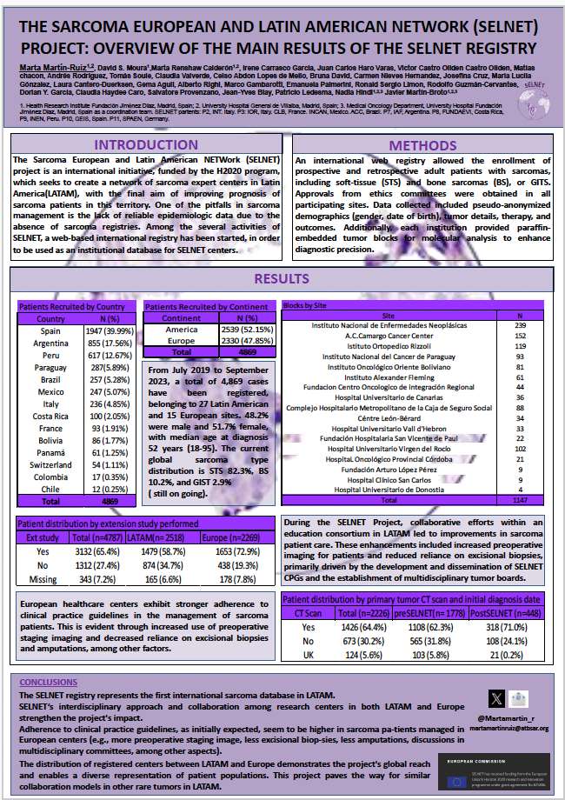
SELNET REGISTRY: first outcomes
CTOS 2023 poster
AAOC 2023 poster (Instituto Nacional del Cancer de Paraguay)

Slide 6
SELNET WP6: Multidisciplinary review of clinical cases- FIIS-FJD
ONLINE REGISTRY (CRF)
ALL sarcoma subtypes
TARGET: 5000
The registry is still OPEN and you can continue registering cases

Slide 7
SELNET REGISTRY: IMPORTANT REMARKS
Data cleaning process is happening for FINAL ANALYLSIS
> 8000 queries
IT IS ESSENTIAL TO FILL THE MINIMUM DATA SET
PLEASE RESPOND QUERIES

Slide 8
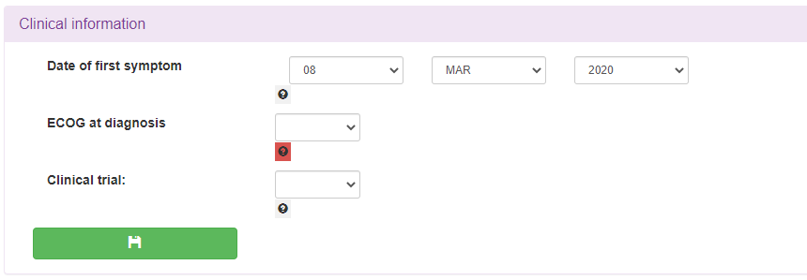
SELNET REGISTRY: Queries
1: Redirect to the specific form
1
2: Open the query dialogue (the query is in status open: red)
2
GEIS-68 (SELNET): Query Management manual V0.1 29Apr2021 SOPDMA5-TEM-6 V2.0

Slide 9
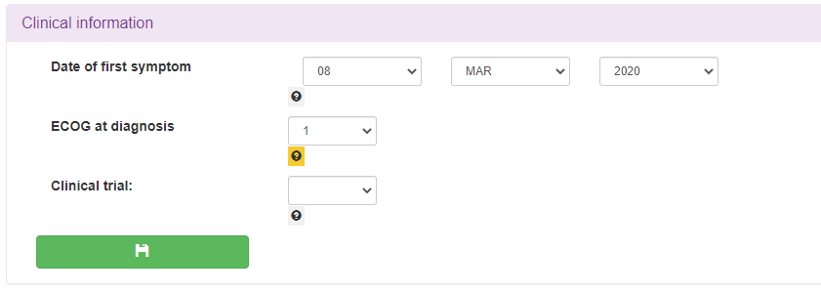
SELNET REGISTRY: Responding to open queries
3: Add any comment/ answer
4: Click “Update query”
If necessary, correct data in the corresponding form and save changes
3
4
5: The query button must appear in yellow (answered). Please, check that is so
5

Slide 10
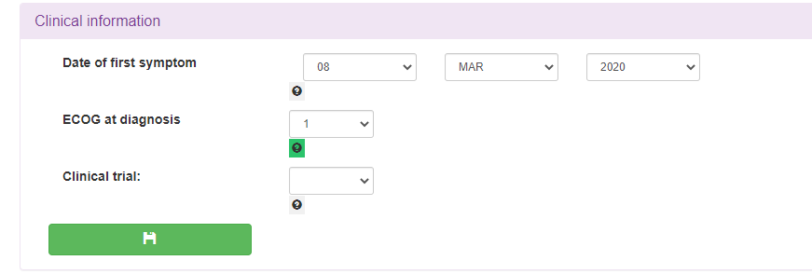
SELNET REGISTRY: Responding to open queries
Creating and closing queries are the task of the Monitor
As seen, when the query is created, the button is in red (Status “Open”).
You just have to make sure that the Query button turns yellow when you fill it.
Once the Monitor close the query:
Doubts (SOFPROMED):
Miguel Vela: mvela@sofpromed.com
Catalina Gayà: cngaya@sofpromed.com
4
4: The query button appears in green (closed)

Slide 11
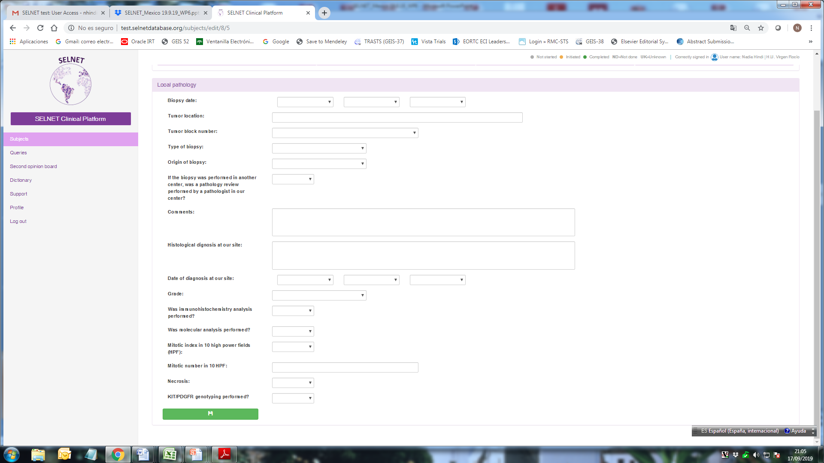
SELNET OBJ 1: PEER REVIEWS OF PATHOLOGIC DIAGNOSIS
LOCAL DIAGNOSIS:
Histologic subtype
Grade (FNCLCC)
IHC data
Molecular analysis data
Local pathology form + anonymized copy from local diagnosis (Upload on CRF)

Slide 12
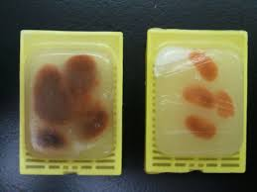
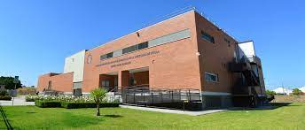
SELNET WP6/WP8:
OBJ 1: PEER REVIEWS OF PATHOLOGIC DIAGNOSIS:
sample circuit
CENTRAL REVIEW
(WP 6)
CITIUS III
Seville University
TRANSLATIONAL
STUDIES (WP 8)
CLINICAL DATA AND LOCAL REPORT ON THE CRF (LOCALLY)

Slide 13
SELNET WP6/WP8:
OBJ 1: NUMBERS (October 2023)
CENTER | REGISTERED CASES | BLOCKS SENT
HUVR- VIRGEN DEL ROCIO | 1058 | 125
IAF- INSTITUTO ALEXANDER FLEMING | 697 | 61
INEN_ NATIONAL INSTITUTE OF NEOPLASTIC DISEASES | 526 | 239
HU SON ESPASES | 268
AC CAMARGO CANCER CENTER | 238 | 152
HU CANARIAS | 231 | 36
INEN_ NATIONAL INSTITUTE OF NEOPLASTIC DISEASES | 230
INSTITUTO NACIONAL DEL CÁNCER DE PARAGUAY | 217 | 93
HU FUNDACIÓN JIMENEZ DÍAZ | 146
INT- ISTITUTO NAZIONALE DEI TUMORI | 121 | 24
FUNDACIÓN CENTRO ONCOLOGICO DE INTEGRACION REG | 116 | 44
IOR- ISTITUTO ORTOPEDICO RIZZOLI | 115 | 112

Slide 14
SELNET WP6/WP8:
OBJ 1: NUMBERS (October 2023)
CENTER | REGISTERED CASES | BLOCKS SENT
HU Vall d’ Hebron | 112 | 33
Caja Costarricense del Seguro Social | 104 | 81
HU Miguel Servet | 98
Centre Leon Berard | 93 | 101
IREN Norte | 89
Instituto Oncológico Oriente Boliviano | 86 | 81
Instituto de Previsión Social de Paraguay | 74
TOTAL | 4884 | 1235

Slide 15
SELNET WP6:
OBJ 1: PEER REVIEWS OF PATHOLOGIC DIAGNOSIS
Network of expert pathologist (WP2)
Central pathologic reviews ongoing
>300 cases already SENT central review
Angelo Paolo Dei Tos, Pathologist network coordinator – University of Padua, Italy.
Lucia Gonzalez– Institute Alexander Fleming, Argentina.
Martina Nesprias – General Hospital of Agudos Carlos G. Durand, Argentina.
Antonio Nascimento – A. C. Camargo Cancer Center, Brazil.
Felipe d’Almeida Costa – A. C. Camargo Cancer Center, Brazil.
Maurizio Donato Acuña – Rafael Ángel Calderón Guardia Hospital, Costa Rica.
Rodolfo Guzmán- H San Juan de Dios, Costa Rica
Alberto Righi – Rizzoli Orthopedic Institute, Italy.
Paola Collini – IRCCS National Cancer Institute, Italy.
Marco Gambarotti- Rizzoli Orthopedic Institute, Italy
Claudia Haydee Sara Caro Sánchez – National Cancer Institute, Mexico.
Hugo Ricardo Domínguez Malagón – National Cancer Institute, Mexico.
Lourdes Huanca – National Cancer Institute of Peru, Peru.
Sandro Ángel Aníbal Casavilca Zambrano – INEN, Peru.
Cleofé Romagosa – Vall d’Hebron Universitary Hospital, Spain.
Rafael Ramos – Son Espases University Hospital, Spain.
José Merino- Fundación Jimenez Díaz Univesity Hospital, Spain
Carmen Nieves Hernández Leon- HU Canarias, Tenerife, Spain

Slide 16
SELNET WP6:
OBJ 1: PEER REVIEWS OF PATHOLOGIC DIAGNOSIS
Central pathology information is implemented on CRF directly by reviewer pathologist or in CITIUS III

Slide 17
SELNET WP6:
OBJ 1: PEER REVIEWS OF PATHOLOGIC DIAGNOSIS
ANALYSIS OF DISCREPANCIES (retrospective, research aim)
Cancer type (misdiagnosis of sarcoma)
Sarcoma subtype
Benign/malignant entity
Grade
FINAL REPORT (Dec 2023)
PUBLICATIONS
Variations in prognosis?
Variations in management?

Slide 18
SELNET WP6:
OBJ 1: PEER REVIEWS OF PATHOLOGIC DIAGNOSIS
PRELIMINARY RESULTS
305 CASES CENTRALLY REVIEWED
72 CASES WITH ANY DIAGNOSTIC DISCREPANCY
 | N (%)
Total cases centrally reviewed | 305 (100)
Cases with any discrepancy | 72 (23.6)
Discrepancy with therapeutic implications | 25 (8.1)
Cases with local diagnosis of malignancy and central diagnosis of NOT malignancy | 1

Slide 19
EXAMPLE OF CHANGES WITH THERAPEUTIC IMPLICATIONS
LOCAL DIAGNOSIS | CENTRAL DIAGNOSIS | THERAPEUTIC IMPLICATIONS
Epithelioid sarcoma | Epithelioid hemangioendothelioma | Different systemic therapy
Myxoid liposarcoma | Hibernoma (molecular analysis NEGATIVE for myxoid liposarcoma) | Non malignancy
Myxoid liposarcoma | Dedifferentiated liposarcoma, grade 2 | Different systemic therapy
Dedifferentiated chondrosarcoma | High grade osteoblastic OS, giant cell rich | CHEMO!
TCG | Malignant Myoephitelioma | Different systemic therapy
Myxofibrosarcoma | Dedifferentiated Liposarcoma, grade 2 | Different systemic therapy
Conventional chondrosarcoma | Osteosarcoma osteoblastic and chondroblastic grade 2 | CHEMO!
LMS | SFT | Different systemic therapy
Agresive Fibromatosis | Desmoplastic fibrosarcoma | Different systemic therapy
OSTEOSARCOMA low grade | OSTEOSARCOMA high grade | CHEMO!
Round cell liposarcoma | SFT | Different systemic therapy

Slide 20
EXAMPLE OF CHANGES WITH THERAPEUTIC IMPLICATIONS
NEXT OBJECTIVES
- Prepare the final analysis for the final EC report
- Prepare PUBLICATION
* Help from pathologist!!

Slide 21
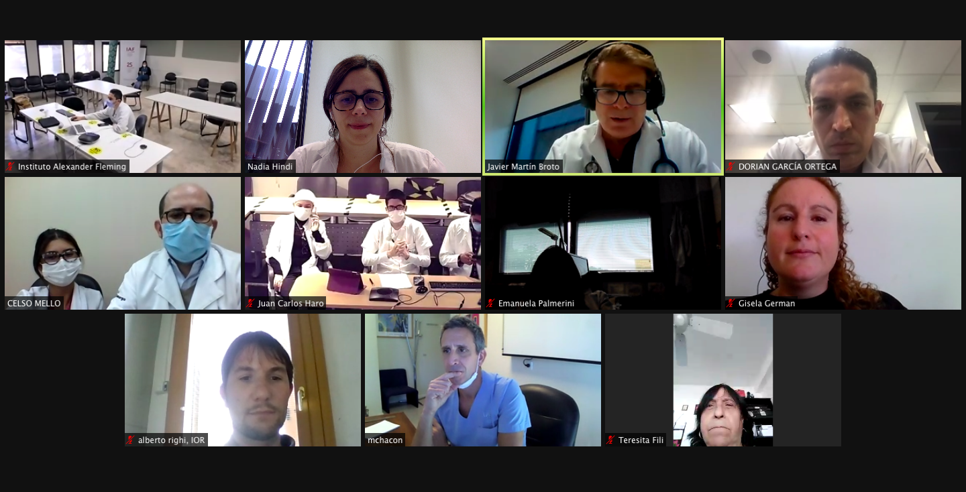
SELNET WP6:
OBJ 2: TO CONDUCT MDT TO REVIEW CLINICAL CASES
Virtual MDT
60’→ 90’
Great participation!!
Monthly
Cases are uploaded in the SELNET website

Slide 22
SELNET WP6:
OBJ 2: TO CONDUCT MDT TO REVIEW CLINICAL CASES<
17 MDTs have been held
5-7 Cases discussed/MDT→ more than 100 cases discussed
Next MDT 12th of December: please join!!!

Slide 23
SELNET WP6:
SECOND OPINION PLATFORM
Second opinion fast-track pathology review
INTRAMUSCULAR MYXOMA with no signs of malignancy.
Mazabraud Syndrome with multiple injuries.
Morphological diagnosis of glomus tumor family
In the past called glomangiopericytoma
Osteosarcoma
Synovial Sarcoma
Esthesioneuroblastoma G1

Slide 24
SELNET WP6 OBJ 2: TO CONDUCT MDT TO REVIEW CLINICAL CASES
SYSTEM IMPACT ASSESSMENT (retrospective, research)
Has treatment plan changed after MDT review? YES/NO
Major changes: eg treatment modality
Minor changes: eg therapy regimen or duration
FINAL REPORT (Feb 2024)
PUBLICATIONS (Case reports with MDT discussion)
Registry Coordination Team

Slide 25
SELNET WP6: DELIVERABLES AND MILESTONES
Delivered with preliminary results
Definitive results in Final Report (Feb 2024)
FIIS-FJD
FIIS-FJD
FIIS-FJD
FIIS-FJD

Slide 26
SELNET WP6 TAKE-HOME MESSAGES
Observational study approved in 39 centres
4884 registered cases → Registry will continue
Institutional tool

Slide 27
WP6: Multidisciplinary review of clinical cases
THANKS
REGISTER YOUR CASES!!!
nhindi@atbsarc.org
dmoura@atbsarc.org
nhindi@selnet-h2020.org
X SELNET VIRTUAL CONSORTIUM MEETING (Nov 2023)

