Slide 1
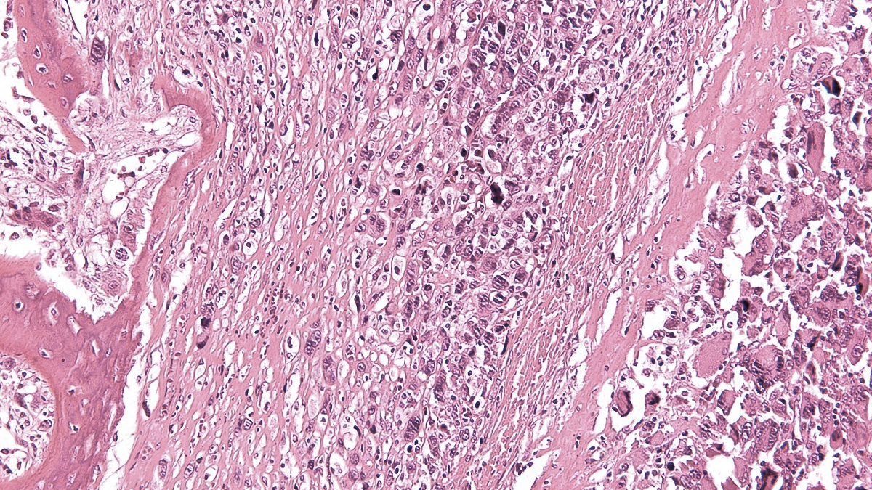
10th SELNET CONSORTIUM MEETING
WP7: Clinical management quality study
Argentina, 8-10 November 2023
Patricio Ledesma (Project Manager)
GEIS, Spain

Slide 2
SELNET WP7 – General goal
“To conduct an ambispective observational study on patients diagnosed with STS, BS, or GIST, with the aim of assessing patient management quality.”
Essential questions:
How are sarcoma patients managed in different countries?
How can patient management be improved to obtain better outcomes?
Method:
- Correlate patient management data with clinical outcomes

Slide 3
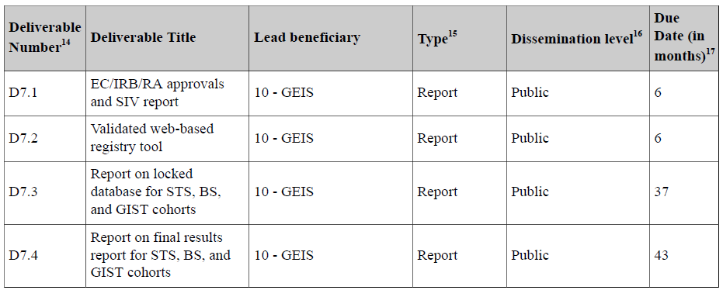
SELNET WP7 – Deliverables
June 2019 (OK)
June 2019 (OK)
June 2023 (OK)
September 2023 (OK)

Slide 4
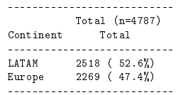
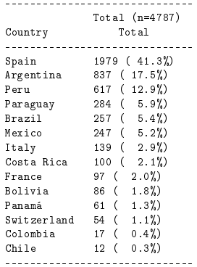
Deliverable 7.4 - Report on final results for STS, BS, and GIST cohorts
Table 1: Recruitment by continent.
Table 2: Recruitment by country (14: 10 LATAM, 4 EU).
First preliminary analysis (to be further cleaned and improved)
Large amount of data (still many missing values)
Very general analysis
D7.4 includes a selection of results from the original full statistical report (90 pages)
Still early, but preliminary relevant insights can be observed
More mature version due by February 2024

Slide 5
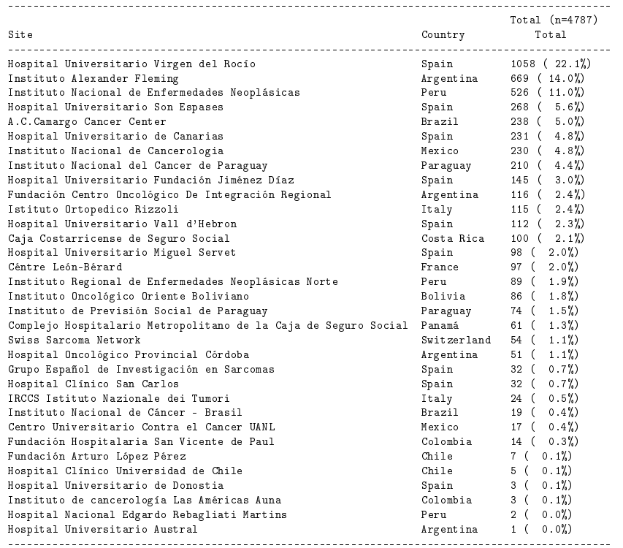
Table 3: Recruitment by site (33 sites: 20 LATAM, 13 EU).

Slide 6
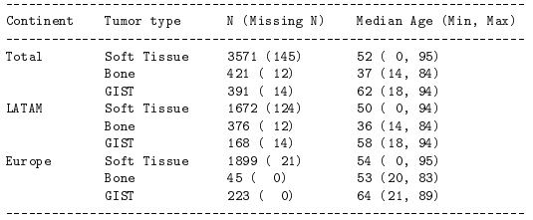
Table 4: Recruitment by tumor type.
Table 6: Median age at initial diagnosis by tumor type.
Table 5: Number of patients by sex.
Table 8: The availability of clinical trials for sarcoma in LATAM is very low, which confirms the great need for more clinical trials in this region.

Slide 7
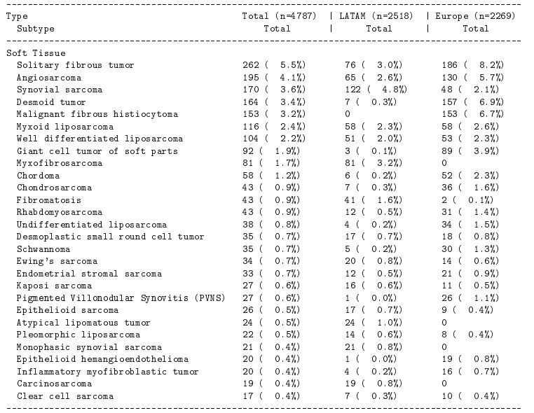
Table 10: Patient distribution by histological subtype (conditioned by translational studies).
Table 15: Performance of tumor extension study at diagnosis is lower in LATAM. Adherence to CPGs in terms of initial staging is higher in European countries.

Slide 8
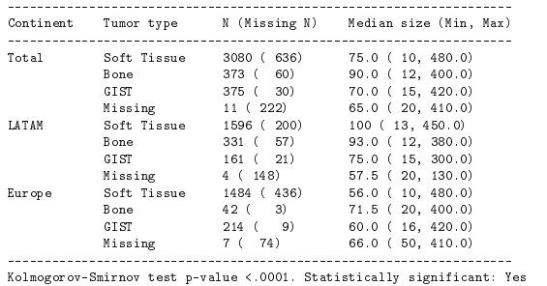
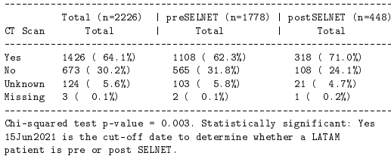
Table 16: In the LATAM population, adherence to CPG has increased during the SELNET Project. More patients underwent presurgical local staging imaging in the most recent period (patients diagnosed after 15 June 2021).
Table 18: Median size of primary tumor, at diagnosis, for STS patients is larger in LATAM compared to Europe.
Table 19: More patients in LATAM presented metastatic disease at initial staging. This fact, together with larger primary tumor size at diagnosis, suggests that LATAM patients were diagnosed at a more advanced stage (probably due to diagnosis delays).

Slide 9
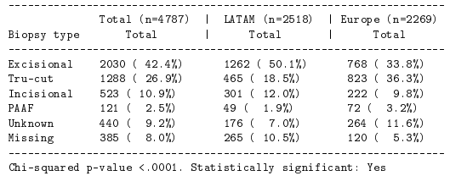
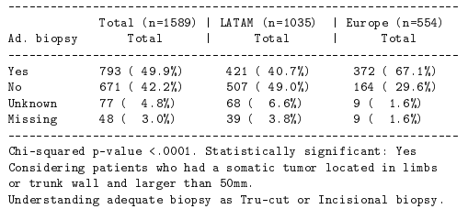
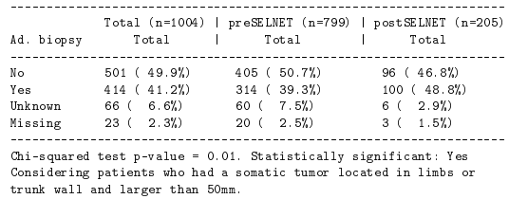
Table 20: Patients in LATAM were diagnosed more frequently with excisional and incisional biopsies, which is not recommended by sarcoma CPG.
Table 21: When only selecting patients with tumors in limbs or trunk wall, the same tendency is observed, with more patients from LATAM having excisional biopsies (less adequate biopsies).
Table 22: During the SELNET Project adherence to CPG in terms of diagnostic biopsy has increased in LATAM. In patients with tumors in limbs and trunk wall, more patients underwent tru-cut or incisional biopsies instead of excisional biopsies.
Table 23: Significantly, more patients in European hospitals were discussed in a multidisciplinary sarcoma committee.

Slide 10
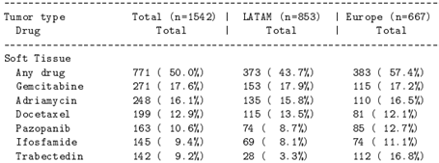
Table 24: During the SELNET Project the number of sarcoma patients managed in LATAM and discussed in multidisciplinary committee significantly increased, reflecting higher adherence to CPG.
Table 29: There are drugs like trabectedin and pazopanib that have been more used in Europe, compared to LATAM, for advanced disease, since access to drugs is more restricted and difficult in LATAM countries for this setting.
Table 27: The rates of limb sparing surgery were higher in patients treated in Europe. More amputations in LATAM.

Slide 11
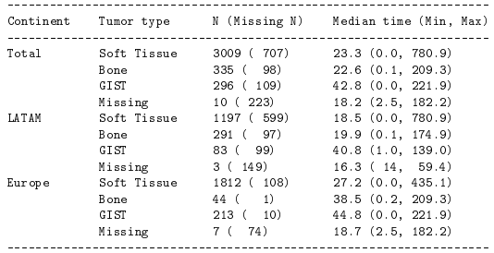
Table 30: Regular follow-up of patients was less frequent in LATAM hospitals.
Table 31: Median overall survival in months from initial diagnosis. Median overall survival in Europe was longer.
Table 33: Median overall survival in months from initial diagnosis by tumor type.

Slide 12
Steps ahead
Reach 5,000 cases by end of December 2023
Data cleaning (query resolution) continues
Definition of specific publications

Slide 13
SELNET WP7 – Conclusions
All the deliverables of WP7 were achieved on time
We met the goal of reaching nearly 5,000 cases (acceptable for European Commission)
Still a lot of data to be completed and cleaned
Preliminary results show sarcoma management aspects that can be improved in LATAM
Conducting sarcoma trials in LATAM is an urgent priority
Specific publications can be discussed (and we can focus the data cleaning efforts for those publications)

Slide 14
Feasibility for clinical trials in LATAM
Key factors to conduct a SELNET-sponsored academic clinical trial:
Availability of study coordinators and data entry staff
Staff at hospitals who can help with ethics and regulatory submissions
Sites can cover trial tests and procedures (lab tests, CT/MRI) at 0 or low cost (1,000/2,000 euros per patient)
Site can provide standard drugs (chemos) without cost (experimental drug will be provided by SELNET Sponsor)

Slide 15
Feasibility Questionnaires Received (14)
Nº | Site Name | Country
1 | Fundación Centro Oncológico Integración Regional | Argentina
2 | OncoBolivia | Bolivia
3 | AC Camargo Cancer Center | Brazil
4 | Fundación Valle del Lili | Colombia
5 | Instituto de Cancerología Las Américas | Colombia
6 | Caja Costarricense | Costa Rica
7 | Hospital Metropolitano | Costa Rica
8 | Instituto Nacional de Cancerología de México (INCAN) | Mexico
9 | Centro Hemato-Oncológico | Panama
10 | Complejo Hospitalario Metropolitano | Panama
11 | Instituto Nacional del Cáncer (INCAN) | Paraguay
12 | Instituto de Previsión Social | Paraguay
13 | Instituto Nacional de Enfermedades Neoplásicas (INEN) | Peru
14 | Instituto Nacional del Cáncer | Uruguay
Parameter | Result
Any previous trial? | 11/14 (76%)
New STS/year (average) | 51
New BS/year (average) | 24
New GIST/year (average) | 10
Coordinator/Data entry staff | 10/14 (71%)
Staff to obtain ethics/regulatory approvals | 9/14 (64%)
Site covers tests at low cost | 9/14 (64%)
Site may provide SoC drugs | 8/11 (73%)
Time to obtain ethics/regulatory approvals | 2-3 months
Time to sign a trial contract | 2 months
14 sites (10 LATAM countries)

Slide 16
SELNET WP7
Thank you
Patricio Ledesma
pledesma@sofpromed.com
Technical support / Data management:
support@sofpromed.com
9th SELNET CONSORTIUM MEETING (March 2023)

