Slide 1
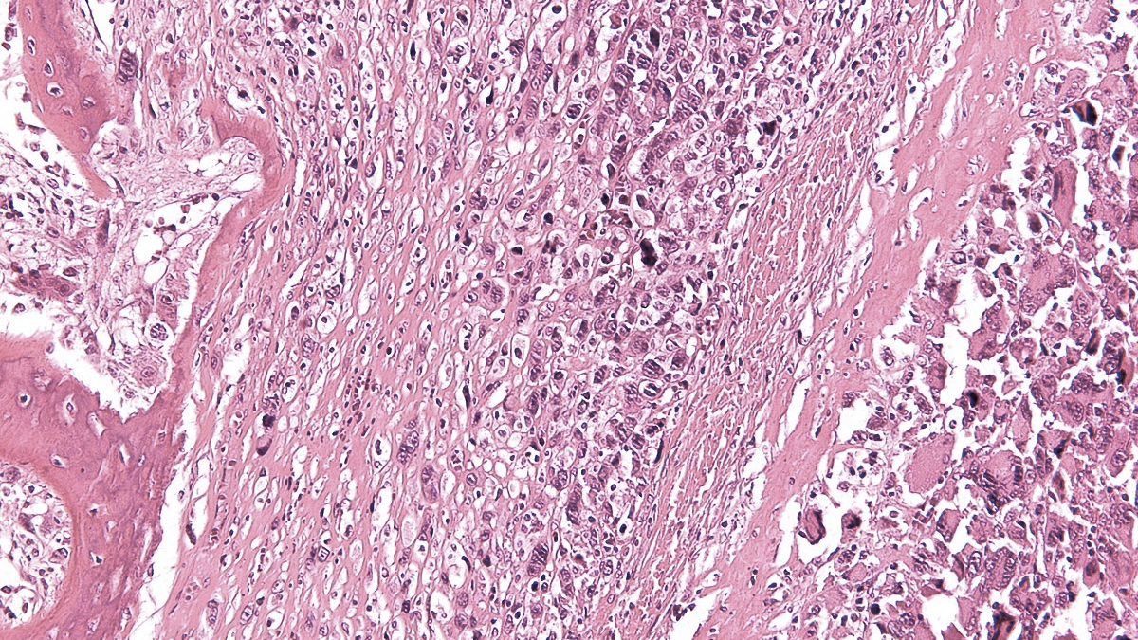
X SELNET
CONSORTIUM MEETING
WP 1 and WP 10: Ethics requirements and Project Management
09th-10th November 2023
Marta Martín-Ruiz, PhD
IIS-FJD,
Madrid, Spain
Buenos Aires, Argentina

Slide 2
SELNET WP1: Ethics requirements - IIS-FJD
All the deliverables of this WP have been submitted and accepted
The Independent Ethics Advisory Board (EAB), composed by M Eriksson, H Gelderblom has F Waisberg has to review the Third Periodic Report and elaborate a Ethics Report 01/01/2022 to 01/12/2022. Need to do for the final report period-> 01/01/2023 to 01/12/2023
Two site visit reports, one from Argentina and the other from Brazil in 2023.
Ensure compliance with Ethic Requirements for every partner.

Slide 3
SELNET timeline
Jan 2019
Dec 2022
Dec 2023
First Period
(Jan 2019- June 2020)
Second Period
(July 2020- Dec 2021)
Third Period
(Jan 2022-Dec 2022)
Fourth Period
(Jan 2023-Dec 2023)
TIME
AMM
AMM
AMM
P1 report
P2 report
P3
report
Final report
REPORTS
Feb 2019
August 2021
August 2022
At the end 2024
PRE-funding (53.33%)*
P1 (15%)
P2 (15%)
P3 (16.67%)
FUNDS

Slide 4
Last amendment
AMM
AMENDMENT:
Increase the PM (IIS-FJD) for the last period.
Partner P6 Camargo center has applied to several national grants for external funding to perform the experiments detailed in the GA, but unfortunately they were not successful in these calls.
IIS-FJD will be transferred from our direct personnel costs to our other direct costs and be used to cover the translational research project in desmoplastic small round cell tumor, which is supervised by the P6.
Changes of Annex 1
Changes of Annex 2

Slide 5
SELNET WP10: PROJECT MANAGEMENT- IIS-FJD
Third Period Report:
Submitted on 27/02/2023. Check in the EU platform.
FINAL Period Report:
EVERY FUNDED PARTNER HAS TO FORESEE ITS OWN BUDGET FOR PERSONEL AND ITS DISTRIBUTION IN PERSON-MONTH FOR THE FINAL REPORT
Send after the X consortium meeting the update of the financial status has to be sent to the coordinator→ November 2023. Financial and administrative Manager IIS-FJD: proyectosinvestigacion@quironsalud.es

Slide 6
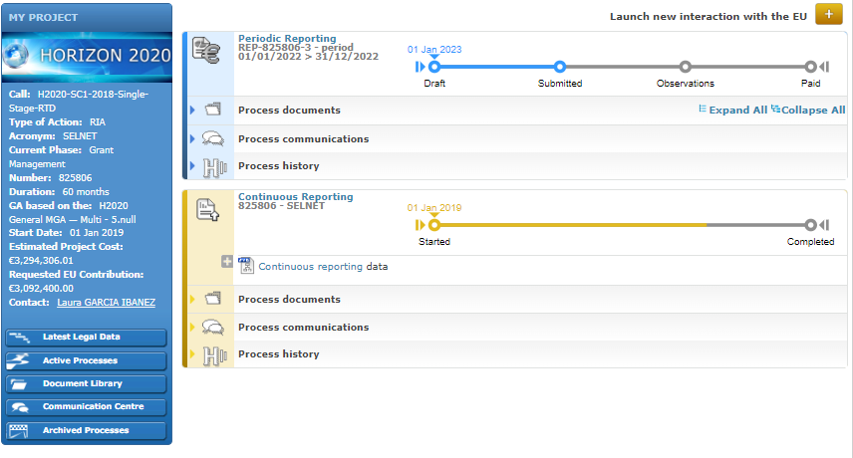
SELNET WP10: PROJECT MANAGEMENT- IIS-FJD

Slide 7
SELNET WP10: PROJECT MANAGEMENT- IIS-FJD
 | TOTAL 1ST PERIOD | TOTAL 2ND PERIOD | TOTAL 3RD PERIOD | TOTAL | EU FUNDING GA | % | Remaining 4th period
PARTNER 1 IIS-FJD | - | 38.398,84 € | 182.856,79 € | 221.255,63 € | 567.270,06 € | 39,00% | 346.014,43 €
PARTNER 2 INT | 128.319,79 € | 253.149,85 € | 53.215,64 € | 434.685,28 € | 450.000,00 € | 96,60% | 15.314,72 €
PARTNER 3 IOR | 117.503,31 € | 171.350,89 € | 117.810,99 € | 406.665,19 € | 432.000,00 € | 94,14% | 25.334,81 €
PARTNER 4 CLB | 82.118,42 € | 145.218,84 € | 121.587,99 € | 348.925,25 € | 486.000,00 € | 71,80% | 137.074,75 €
PARTNER 5 INCAN | NA | NA | NA | - | NA | - | NA
PARTNER 6 ACC | NA | NA | NA | - | NA | - | NA
PARTNER 7 IAF | 66.898,81 € | 56.601,25 € | 47.952,35 € | 171.452,41 € | 194.400,00 € | 88,20% | 22.947,59 €
PARTNER 8 FUNDAEVI | 1.867,50 € | - | 71.256,86 € | 73.124,36 € | 180.000,00 € | 40,62% | 106.875,64 €
PARTNER 9 INEN | 26.163,99 € | 38.988,75 € | 31.209,20 € | 96.361,94 € | 176.400,00 € | 54,63% | 80.038,06 €
PARTNER 10 GEIS | 59.260,00 € | 44.266,61 € | 60.457,76 € | 163.984,37 € | 216.979,93 € | 75,58% | 52.995,56 €
PARTNER 11 SPAEN | 8.982,08 € | 2.025,00 € | 10.550,00 € | 21.557,08 € | 75.600,00 € | 28,51% | 54.042,92 €
TOTAL | 491.113,90 € | 750.000,03 € | 696.897,58 € | 1.938.011,51 € | 2.778.649,99 € | 69,75% | 840.638,48 €
At the end of the project after accepted the final report at 2024

Slide 8
SELNET WP10: PROJECT MANAGEMENT- IIS-FJD
Next deliverables dates!!
TOTAL of 9
Deliverable | Current | Extension
D2.2 | 48 | 60
D2.3 | 48 | 60
D2.4 | 48 | 60
D4.2 | 48 | 60
D5.3 | 36 | 60
D6.1 | 43 | 57
D6.2 | 43 | 57
D7.3 | 43 | 55
D7.4 | 43 | 57
D8.1 | 43 | 55
D8.2 | 43 | 55
D8.3 | 43 | 60
D9.4 | 48 | 60
D10.4 | 48 | 60
D10.5 | 48 | 60
Next deliverables
D2.2 : Final report of accreditation results in each country [60]
D2.3 : Diagnosis network creation report [60]
D2.4 : Foundation of Latin American sarcoma network report [60]
D4.2 : Update on clinical guidelines [60]
D5.3 : Clinical and translational training report [60]
D8.3 : Final results for the translational study in rare sarcomas [60]
D9.4 : Final dissemination report [60]
D10.4 : Report on minutes and presentation of relevant project meetings [60]
D10.5 : Report on written feedback from ethics advisory board [60]
WP 2
WP 4
WP 5
WP 8
WP 9
WP 10
Notes:
57 mean

Slide 9
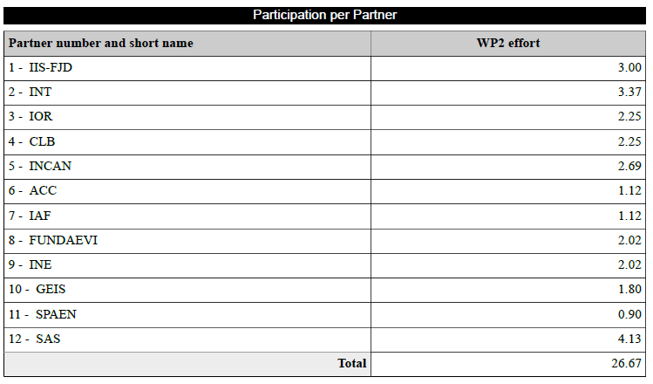
SELNET WP10: PROJECT MANAGEMENT- IIS-FJD
WP 2
WP 4
Notes:
57 mean

Slide 10
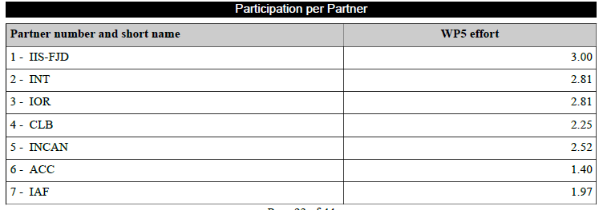
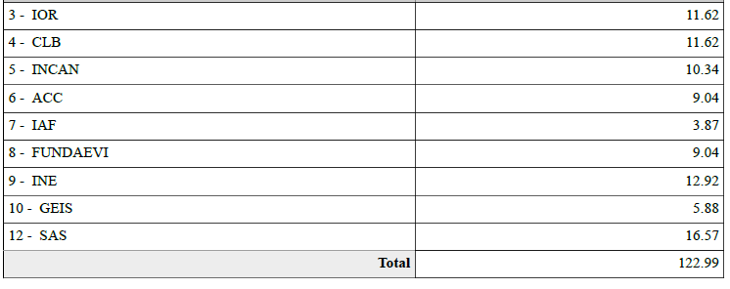
SELNET WP10: PROJECT MANAGEMENT- IIS-FJD
WP 5
WP 8
Notes:
57 mean

Slide 11
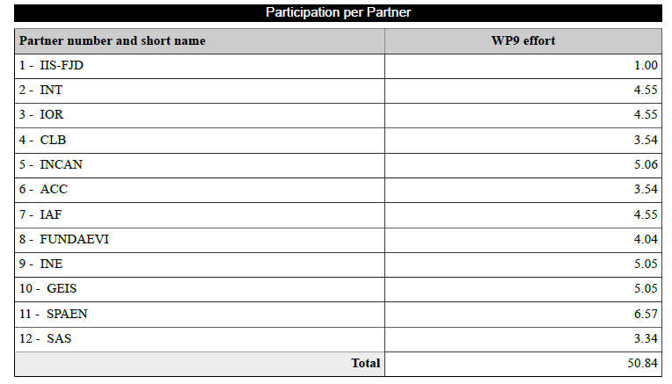
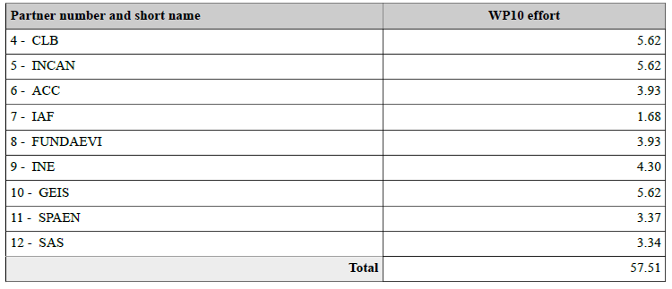
SELNET WP10: PROJECT MANAGEMENT- IIS-FJD
WP 9
WP 10
Notes:
57 mean

Slide 12
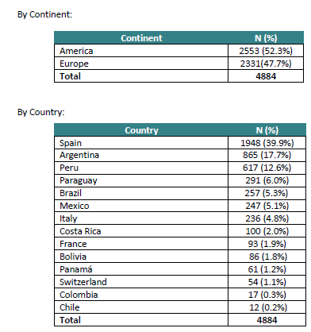
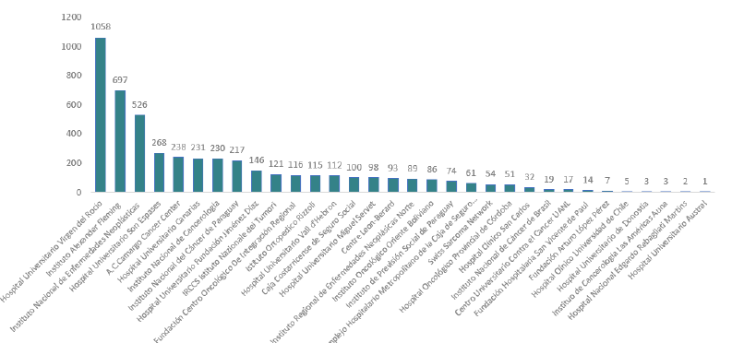
SELNET WP10: PROJECT MANAGEMENT- IIS-FJD
Highlight
Cases registered on eCRF (WP7):

Slide 13
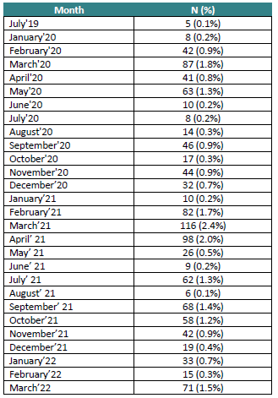
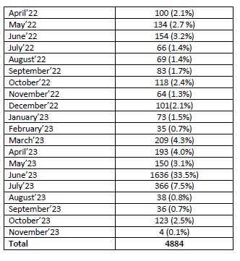
SELNET WP10: PROJECT MANAGEMENT- IIS-FJD
Highlight
Cases registered on eCRF (WP7):
Over 100 cases per month:
May 2022
June 2022
October 2022
December 2022
March 2023
April 2023
May 2023
June 2023
July 2023
October 2023
After Peru Meeting
Before and after CR Meeting
After Brazil Meeting
GEIS studies
Before BA Meeting

Slide 14
SELNET WP10: PROJECT MANAGEMENT- IIS-FJD
Highlight
Virtual multidisciplinary tumor boards (MTBs) WP6:
SELNET MTB – April 28, 2021 (organization IAF and IIS-FJD)
SELNET MTB – May 27, 2021 (organization AAC and IIS-FJD)
SELNET MTB – June 18, 2021 (organization INT and IIS-FJD)
SELNET MTB – July 21, 2021 (organization INEN and IIS-FJD)
SELNET MTB – September 24, 2021 (organization IOR and IIS-FJD)
SELNET MTB – October 13, 2021 (organization FUNDAEVI and IIS-FJD)
SELNET MTB – November 25, 2021 (organization IIS-FJD)
SELNET MTB – December 15, 2021 (organization CLB and IIS-FJD)
SELNET MTB – January 13, 2022 (organization INCAN and IIS-FJD)
SELNET MTB – February 23, 2022 (organization Hospital Oncológico de la provincia de Córdoba and IIS-FJD)
SELNET MTB – March 30, 2022 (organization Instituto Nacional de Câncer e Oncoclinicas and IIS-FJD)
SELNET MTB – May 26, 2022 (organization FALP and IIS-FJD)
SELNET MTB – June 23, 2022 (organization INCAN (Paraguay) and IIS-FJD)
SELNET MTB – July 28, 2022 (organization Hospital Oncológico Provincial, Córdoba and IIS-FJD)
SELNET MTB – September 22, 2022 (organization Clínica las Américas and IIS-FJD)

Slide 15
SELNET WP10: PROJECT MANAGEMENT- IIS-FJD
Highlight
Virtual multidisciplinary tumor boards (MTBs) WP6:
SELNET MTB – October 27, 2022 (organization Instituto Oncológico Oriente Boliviano and IIS-FJD)
SELNET MTB – November 24, 2022 (organization INEN and IIS-FJD)
SELNET MTB – December 20, 2022 (organization CLB and IIS-FJD)
SELNET MTB – Januray 26, 2023 (organization IAF and IIS-FJD)
SELNET MTB – March 30, 2023 (organization Costa Rica and IIS-FJD)
SELNET MTB – May 18, 2023 (organization Panama and IIS-FJD)
SELNET MTB – July 13, 2023 (organization INCan and IIS-FJD)
SELNET MTB – September 28, 2023 (organization Vall D´Hebron and IIS-FJD)
SELNET MTB – December 12, 2023 (organization IIS-FJD)
A mean of 45-60 attendants each MTB
In each MTB session, 5-8 challenging real cases (soft- tissue, bone sarcoma and GIST) are discussed in a multidisciplinary way. Indeed the duration of the MTBs has increased to 90 minutes (and in some days extended to 120 minutes) due to the interest raised. = 168 cases

Slide 16
SELNET WP10: PROJECT MANAGEMENT- IIS-FJD
Highlight
Pathology educational webinars:
21st JULY 2022
Dr. Judith Bovee presented a talk about “Chondrogenic tumors of bone: an update” A total of 171 participants was registered. Prof Paolo dei Tos chaired this educational webinar.
13th OCTOBER 2022
The speaker was Dr. Sabrina Croce, from Institut Bergonié, Bordeaux, she presented “Mesenchymal tumor of GYN tract: an update”. There were 180 participants. Educational webinar within SELNET pathology network, chaired by Dr. Alberto Righi.
13th DECEMBER 2022
The speaker was Dr. Marta Sbaraglia, from University-Hospital of Padova, she presented “NTRK rearranged sarcomas: fact or fiction?”. A total of 190 Attendants. Prof Paolo dei Tos chaired this educational webinar.

Slide 17
SELNET WP10: PROJECT MANAGEMENT- IIS-FJD
Highlight
Pathology educational webinars:
14th JUNE 2023
Prof Paolo dei Tos presented a talk about "Clinical relevance of soft tissue tune diagnosis“. A total of 182 participants was registered.
NEXT on 19th DECEMBER 2023.
All the videos are available for SELNET consortium members at https://selnet-h2020.org/scientific-activity/education/

Slide 18
SELNET WP10: PROJECT MANAGEMENT- IIS-FJD
Highlight
WP 3
DONE
Ongoing
End of year
Publication of paper of healthcare barriers: draft ongoing: Matías Chacón and Marta Martín-Ruiz

Slide 19
SELNET WP10: PROJECT MANAGEMENT- IIS-FJD
We are a total of 40 sites: 13 EU, 26 LATAM and 1 US.
4 Countries in UE.
10 Countries in LATAM, on going Uruguay and Dominican Republic.
1 State in US, external associate member.
TASK
Each institution must to send me (martamartinruiz@atbsarc.org): all the names of the SELNET members with email, number phone and picture for update the agenda and the web page.
Deadline: 20 November 2023

Slide 20
SELNET WP10: PROJECT MANAGEMENT- IIS-FJD
Communication!
WP10 (IIS-FJD) NEWS SELNET-WPs
@selnet_h2020
Sarcoma European & LatinAmerica Network
WP9 (IAF)
SOCIAL MEDIA
SELNET
@SelnetH2020
https://selnet-h2020.org/

Slide 21
SELNET WP10: PROJECT MANAGEMENT- IIS-FJD
Gracias, merci, grazie, obrigada, thank you!
Buenos Aires, Argentina
Marta Martín Ruiz, PhD
Project Manager
SELNET coordination team; IIS-FJD
martamartinruiz@atbscar.org
marta.mruiz@quironsalud.es
X SELNET CONSORTIUM MEETING (November 2023)

