Slide 1
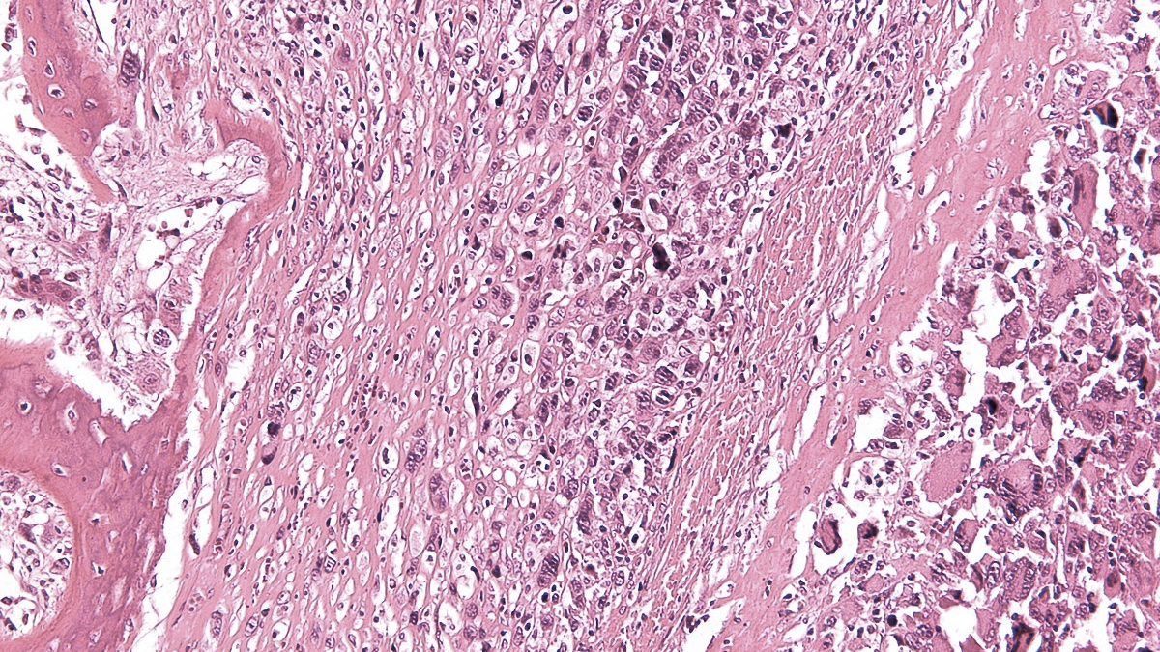
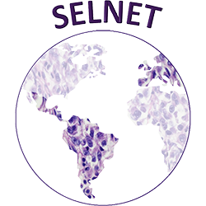
X SELNET
CONSORTIUM MEETING
WP 3: Healthcare barriers in Latam
09th-10th November 2023
Marta Martín-Ruiz and Matías Chacón
IIS-FJD, IAF
Madrid, Spain
Buenos Aires, Argentina

Slide 2
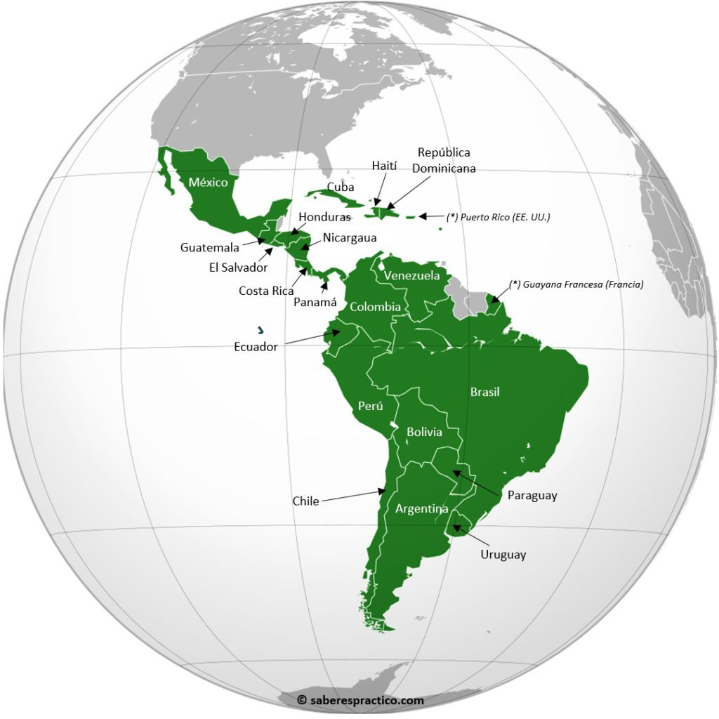
New cases of cancer/ year: 1.402.411
2
Cuba (11,300,000- 46.794 tumors)
Méjico (129,000,000- 195,500 tumors)
Republica Dominicana (10,900,000-19,800 tumors)
Guatemala (18,000,000-16.600 tumors)
Honduras (9,900,000- 10.600 tumors)
El Salvador (6,500,000-9600 tumors)
Nicaragua (6,600,000- 7.990 tumors)
Costa Rica ( 5,000,000-13.100 tumors)
Venezuela (28,000,000- 58.424 tumors)
Panamá (4,315,000-7.600 tumors)
4
Colombia (50,880,000-113.221 tumors)
Ecuador (11,300,000- 29.236 tumors)
1
Perú (32,900,000- 68.849 tumors)
Brasil (212,000,000- 592.212 tumors)
Chile (19,450,000- 54.227 tumors)
Paraguay (7,133,000-12.920 tumors)
Uruguay (3,500,000- 15.757 tumors)
3
Argentina (46,0000,000- 130.878 tumors)
IARC 2020
Matías Chacón

Slide 3
New cases of sarcomas/ year: 14.024
2
Cuba (11,300,000- 467 sarcomas)
Méjico (129,000,000- 1.955 sarcomas)
Republica Dominicana (10,900,000-198 sarcomas)
Guatemala (18,000,000- 166 sarcomas)
Honduras (9,900,000- 106 sarcomas)
El Salvador (6,500,000- 96 sarcomas)
Nicaragua (6,600,000- 80 sarcomas)
Costa Rica ( 5,000,000- 131 sarcomas)
Venezuela (28,000,000- 584 sarcomas)
Panamá (4,315,000- 76 sarcomas)
4
Colombia (50,880,000- 1132 sarcomas)
Ecuador (11,300,000- 293 sarcomas)
1
Perú (32,900,000- 688 sarcomas)
Brasil (212,000,000- 5.920 sarcomas)
Chile (19,450,000- 542 sarcomas)
Paraguay (7,133,000-130 sarcomas)
Uruguay (3,500,000- 15.7 sarcomas)
3
Argentina (46,0000,000- 1.380 sarcomas)
IARC 2020
Matías Chacón

Slide 4
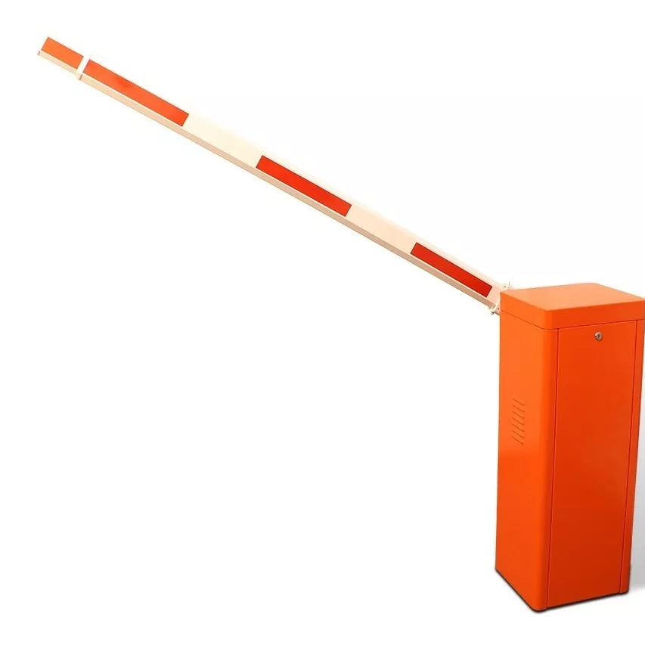
Barriers
Lack of registry data base
Lack of time
Lack of Laws
Lack of reference centers
Lack of interest
Lack of patients
Lack of MDT
Corruption
Inequities
Drugs
Radiation therapy
Education
Radiology technology
Pathologist
Pathology techniques
Time between those items
Molecular pathology
Ignorance
Complexity of the health system

Slide 5
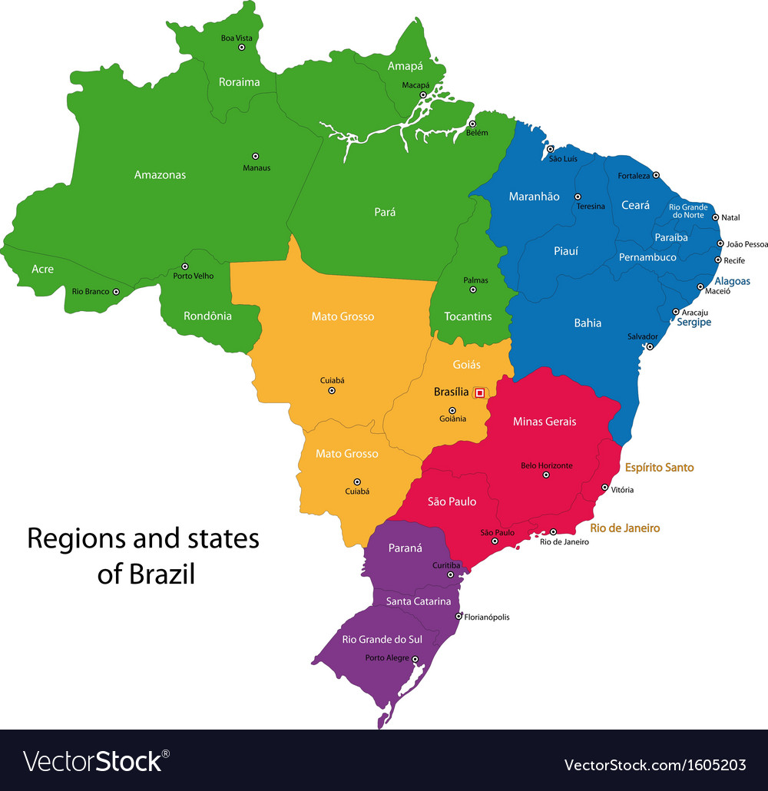
- Lack of uniform access to Healthcare
- Lack of Officially Designated Sarcoma RC
- Lack of Referral Policies
- Limited resources for diagnosis (molecular pathology not covered)
- Limited resources for Sarcoma medical education
- Lack of robust, active and interconnected sarcoma cooperative group
Brasil: Barriers and opportunities
- Lack of uniform access to Healthcare
- Lack of Officially Designated Sarcoma RC
- Lack of Referral Policies
- Limited resources for diagnosis (molecular pathology not covered)
- Limited resources for Sarcoma medical education
- Lack of robust, active and interconnected sarcoma cooperative group
To improve Reference centers implementation (surgery, oncology, radiation and pathology).
Continous medical education
Courtesy of C. Mello

Slide 6
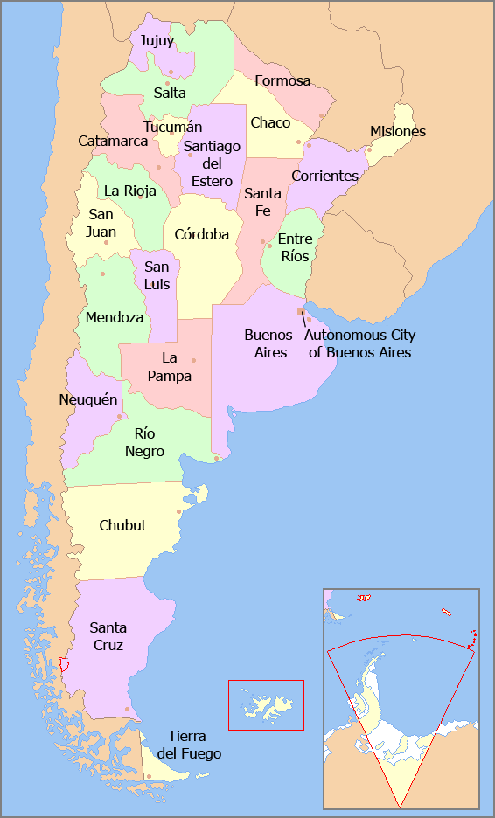
Argentina: Barriers
1- Large country with Socioeconomic disparities, non availability of qualified professionals
2- Location of reference centers
3- Lack of funding to investigate
4- Lack of interest in the general medical community
5- Less feasibilities than other tumor models to CT
6- Heterogenity of the health system
7- Access
8- Unestable economy
SELNET
Change authorities

Slide 7
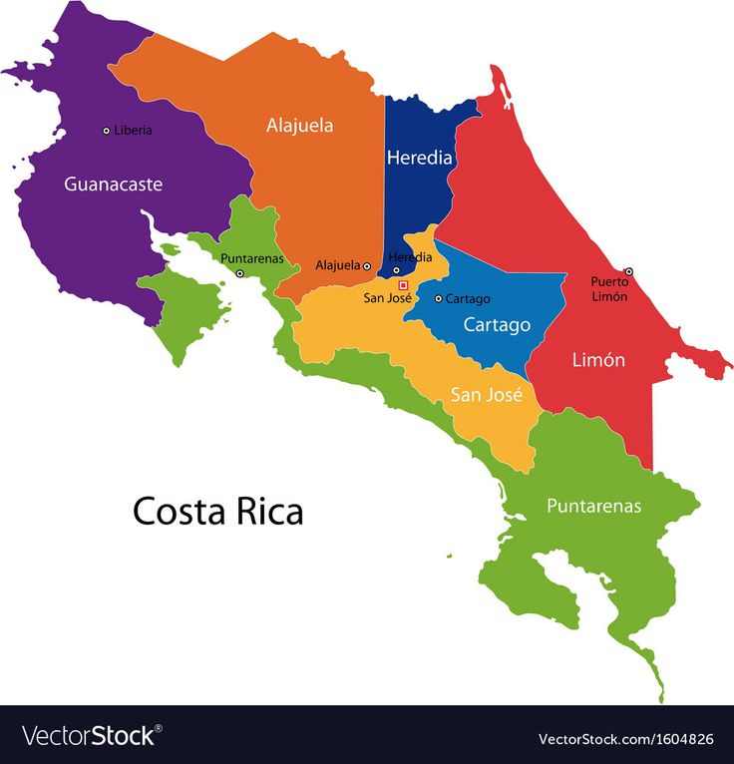
Costa Rica: Barriers and opportunities
1-Lack of uniform access to health at the social security level. Disparity in quality of treatment
2-High number of sarcoma surgeries in centers without a multidisciplinary sarcoma specialists
3-Absence of referral policies to Sarcoma Functional Units with Multidisciplinary Teams in sarcoma.
4-Long times for imaging (mainly MRI which is key in sarcoma patients) or surgery in sarcoma patients
5-Long time to drug Access that are not on the official list of social security medicines
6-Lack of sarcoma database
7-Long waiting time for radiation therapy
7-Limitations in Training Programs for the Diagnosis and Treatment of Patients with Sarcoma
1-Lack of uniform access to health at the social security level. Disparity in quality of treatment
2-High number of sarcoma surgeries in centers without a multidisciplinary sarcoma specialists
3-Absence of referral policies to Sarcoma Functional Units with Multidisciplinary Teams in sarcoma.
4-Long times for imaging (mainly MRI which is key in sarcoma patients) or surgery in sarcoma patients
5-Long time to drug Access that are not on the official list of social security medicines
6-Lack of sarcoma database
7-Long waiting time for radiation therapy
7-Limitations in Training Programs for the Diagnosis and Treatment of Patients with Sarcoma
1- To Improve access to health in social security for patients with sarcomas through programs aimed at the first levels of care with sarcoma information
2- Creation of referral policies for centers with Sarcoma Functional Units
3- To improve access to drugs used in sarcoma with high clinical evidence
4- To create a database of sarcomas where diagnosis and outcomes could be evaluated
5-To develop training programs in the diagnosis and treatment of patients with sarcoma
Courtesy of N. Jimenez

Slide 8
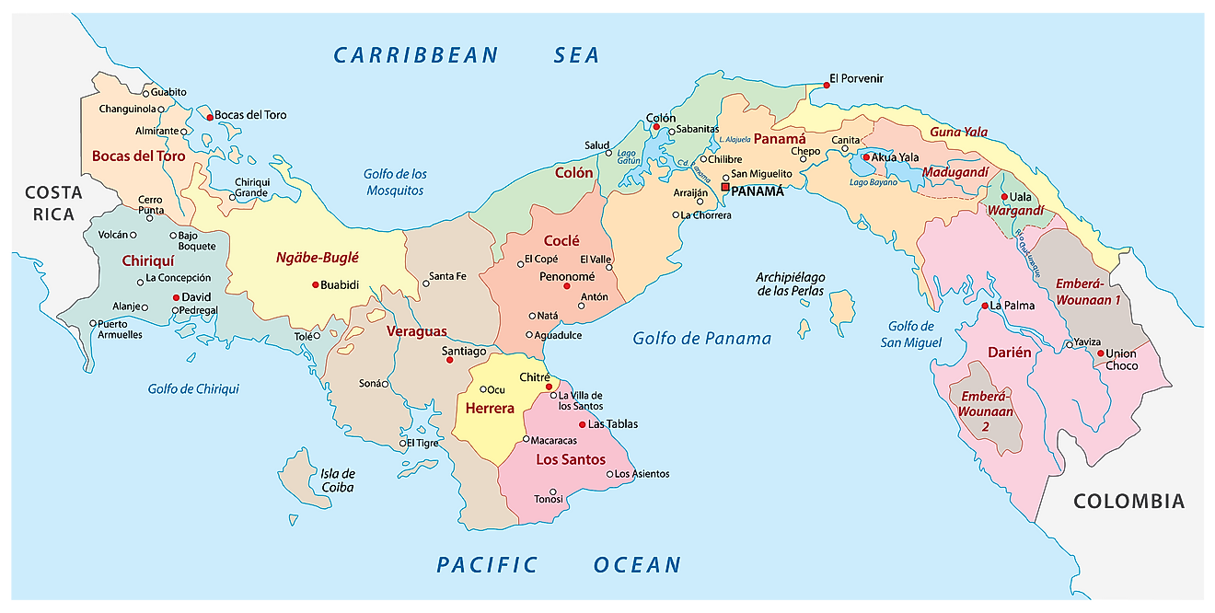
Panamá: Barriers and opportunities
1. Fragmented health system with inequitable distribution of resources by region, which causes inadequate access to care depending on geographic area.
2. Late diagnosis
3. Limited medical experience and limited implementation of management guidelines in diagnosis, treatment and follow-up of sarcomas
4. Lack of human resources with specialization in management of sarcomas.
5. Lack of Multidisciplinary board in sarcomas.
6. Overload system, resulting in delayed diagnosis, referral and treatment.
7. Suboptimal reference system with long waiting times.
8. A single cancer center without resources for optimal multidisciplinary treatment of sarcomas.
9. High percentage of sarcoma surgeries performed by non specialised surgeries team.
10. Restricted access to new drugs approved for the management of sarcomas
11. Lack of national sarcoma registries
1. Fragmented health system with inequitable distribution of resources by region, which causes inadequate access to care depending on geographic area.
2. Late diagnosis
3. Limited medical experience and limited implementation of management guidelines in diagnosis, treatment and follow-up of sarcomas
4. Lack of human resources with specialization in management of sarcomas.
5. Lack of Multidisciplinary board in sarcomas.
6. Overload system, resulting in delayed diagnosis, referral and treatment.
7. Suboptimal reference system with long waiting times.
8. A single cancer center without resources for optimal multidisciplinary treatment of sarcomas.
9. High percentage of sarcoma surgeries performed by non specialised surgeries team.
10. Restricted access to new drugs approved for the management of sarcomas
11. Lack of national sarcoma registries
Courtesy of M Pacheco

Slide 9
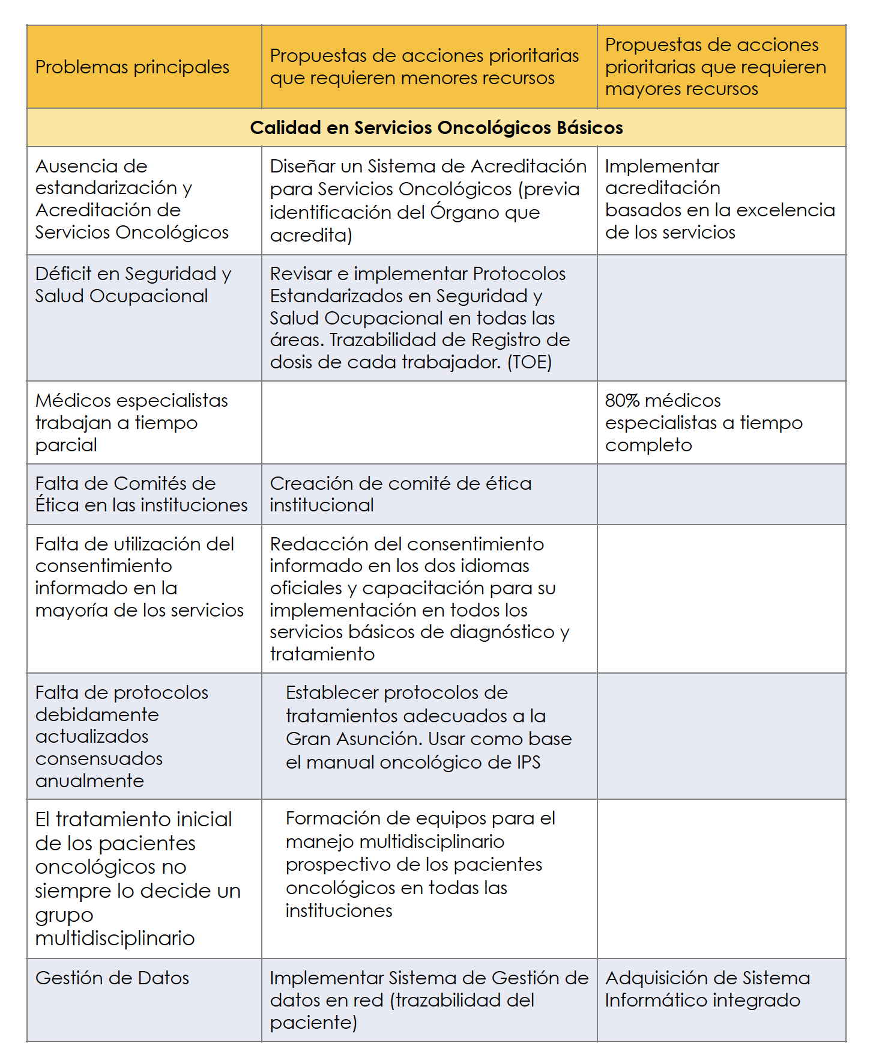
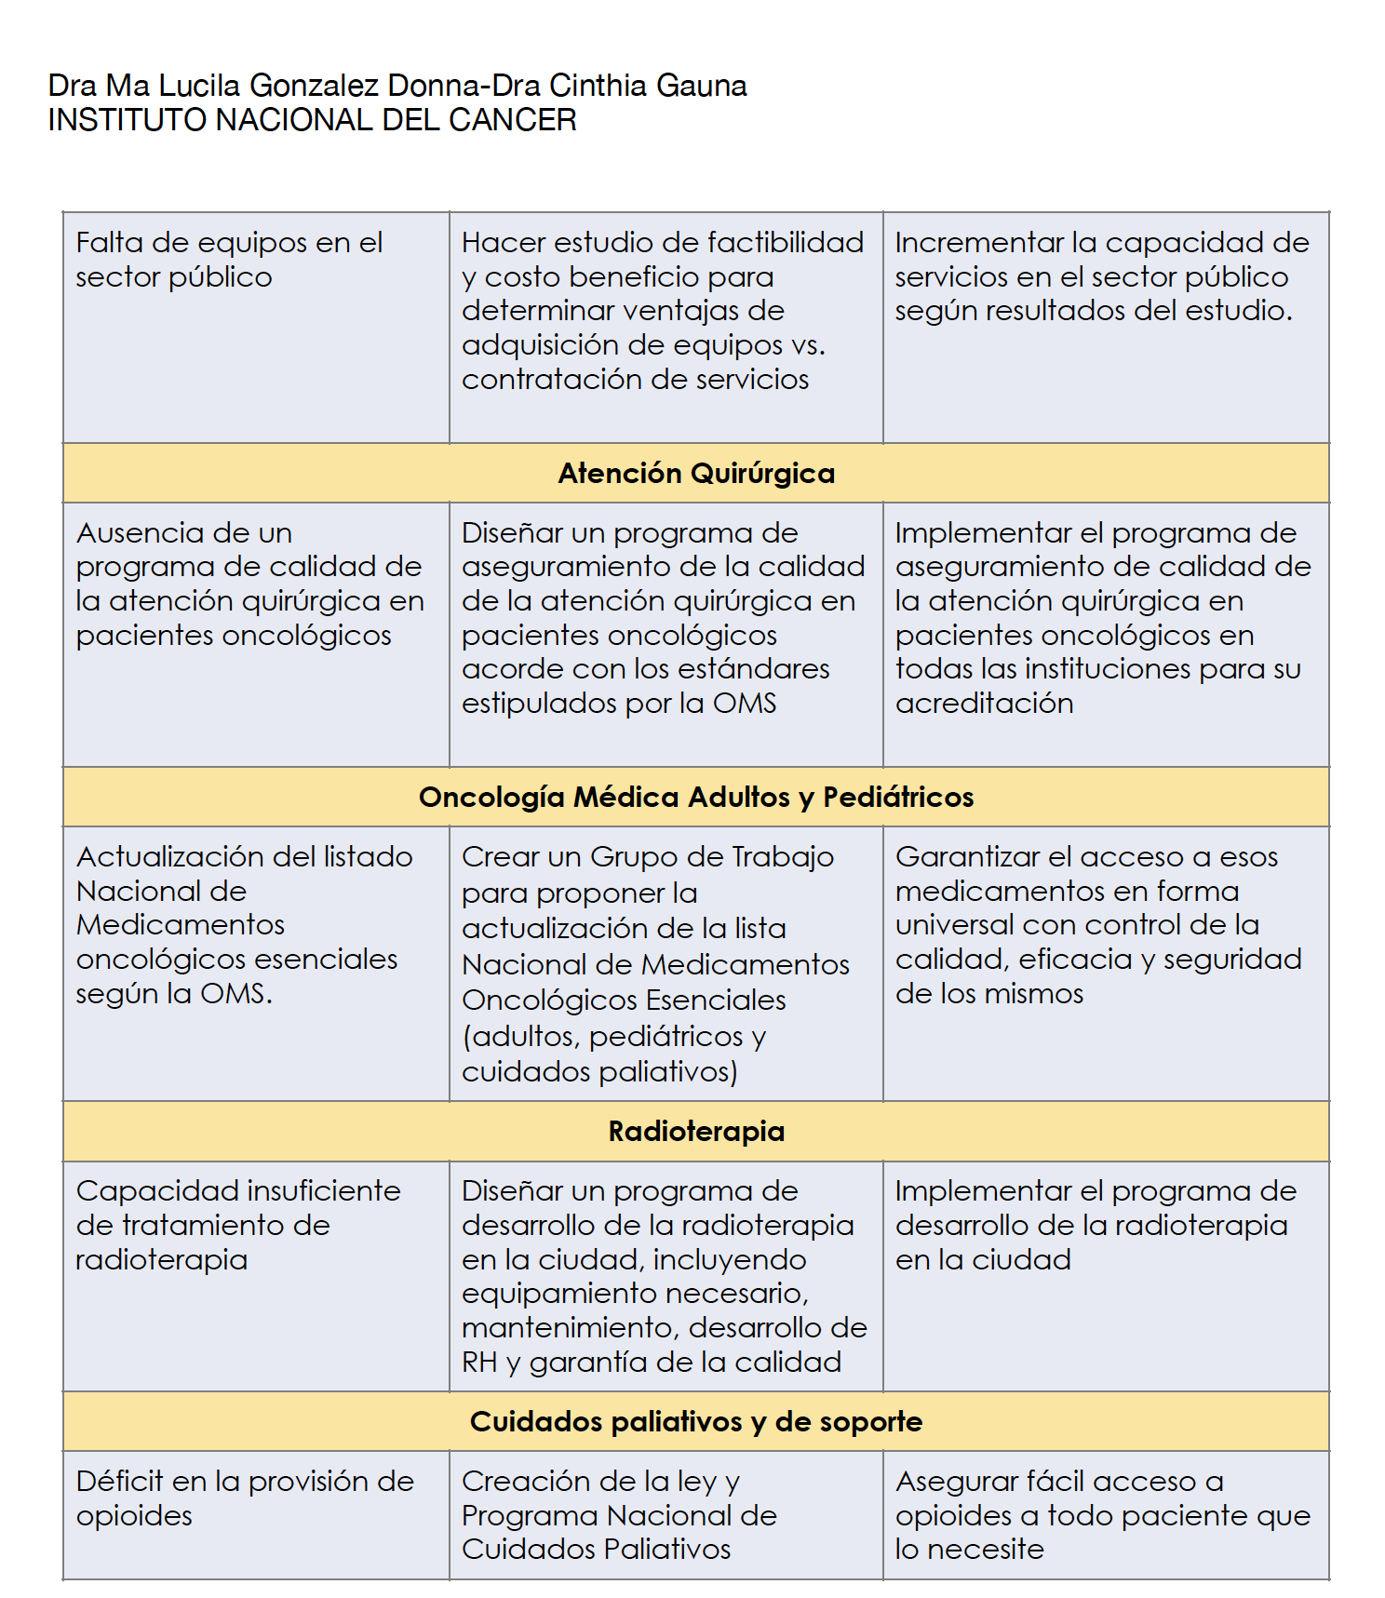
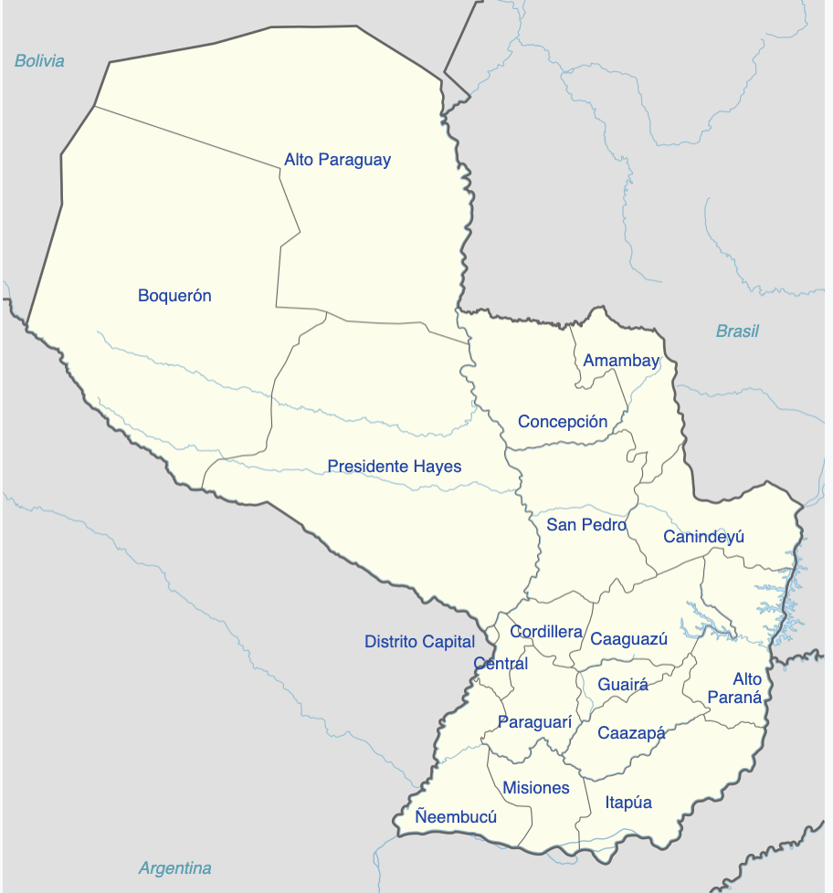
Paraguay: Barriers and opportunities
Cancer Care (data from CCCAN report) developed a list of the "Main problems identified" in each of these areas and the "Proposed priority actions" for cancer care
Courtesy of ML Gonzalez Donna

Slide 10
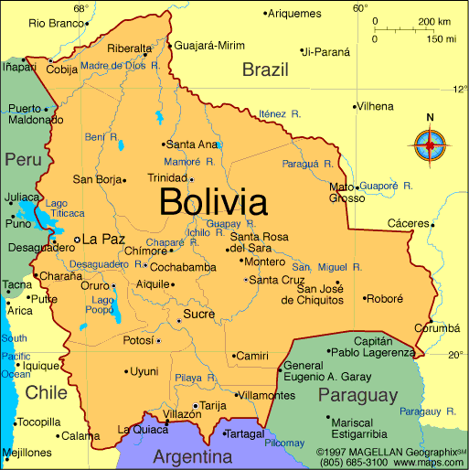
Bolivia: Barriers and opportunities
1. No data about isarcoma ncidence
2. Inadequate guidelines for the management
3. Lack of equipment for the diagnosis and treatment
4. Abscence of drugs for the management of sarcomas in the National List of Essential Medicines (LINAME).
5. Not uniform distribution of patients diagnosed with sarcomas.
6. Limited medical training for multidisciplinary managment of sarcoma patients
7. No access to molecular tests: NGS, cytogenetics, FISH
8. No resources for cancer research in general.
9. Lack of knolwledge of sarcoma in the population
10. Late referral of sarcoma patients
11. Non specialised pathologists
1. No data about isarcoma ncidence
2. Inadequate guidelines for the management
3. Lack of equipment for the diagnosis and treatment
4. Abscence of drugs for the management of sarcomas in the National List of Essential Medicines (LINAME).
5. Not uniform distribution of patients diagnosed with sarcomas.
6. Limited medical training for multidisciplinary management in diagnosis and treatment
7. No access to molecular tests: NGS, cytogenetics, FISH
8. No resources for cancer research in general.
9. Lack of knolwledge of sarcoma in the population
10. Late referral of sarcoma patients
11. Non specialised patohologists
1- The creation of the 1st multidisciplinary unit in the management of sarcomas (Surgical oncologists, traumatologists oncologists, radiotherapists, clinical oncologists, pathologists, radiologists)
2. 5-year sarcoma registriy is in process to evaluate epidemiology and incidence.
Courtesy of R. Limón

Slide 11
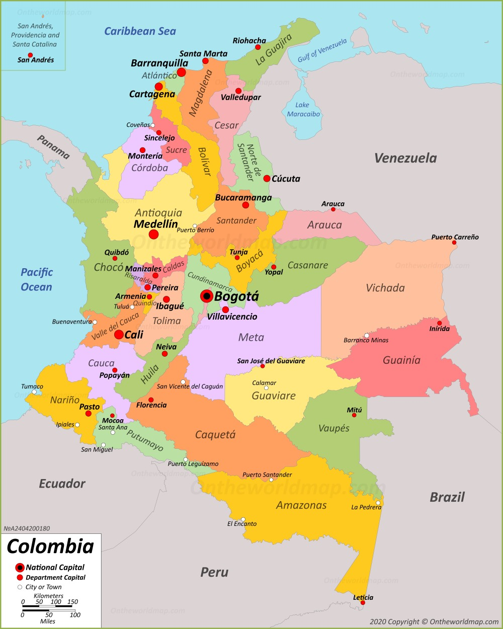
National health system: sarcoma reference center
There is no officially recognized Sarcoma Center by Governmental Agencies
There are traditional cancer centers that have a long history in the care of sarcomas

Slide 12







Argentina: High Cost drug Flow
Physician
Patient
Funder
Patient
Pharmacy
The patient must authorize the order: presents prescription, medical history, tests that support the diagnosis
The Social security system informs pharmacy that the patient will receive treatment and details the treatment scheme for its provision
Treatment is defined by the prescribing physician
Access
Drugstore
Prescription flow
Drug Flow
Authorization of the drug

Slide 13



Argentina: Public High Cost drug Flow
Public Hospital physician
Patient
National Drug Bank
Drug Bank Province
Access
Federal Plans/Programs (e.g. include Health, Immunization, HIV, Maternal and Child)
Treatment is defined by the prescribing physician
When the Federal Program does not have the drug available, the patient can claim it in the last instance, in the Ministery of Social Action
Ministery of Social Actions
In order for the patient to receive public coverage, he/she must:
Being treated in a public hospital
Prove that you do not have private coverage
Prove that you do not have the financial resources to pay for treatment
Once this is proven, the patient can receive the drug from the Drug Bank, Including Health, Social Development
Prescription flow
Drug Flow
Authorization of the drug

Slide 14
Tools from SELNET to improve care in sarcoma patients
Modifiable Variables
Education
MDT
Guidelines
Reference centers
Local Data
Clinical trials
Access to diagnosis and treatment
Publications
Non-modifiable Variables
Health system
Inequities
Goverments
Population and territory
Low Incidence
Screening tools
Local economy

Slide 15
SELNET
Sarcoma as a model to improve diagnosis and clinical care of rare tumors through a European and Latin American multidisciplinary network
Appropriate management of sarcoma patients is hindered by the absence of referral policies to reference centers (RCs), incorrect or delayed diagnosis, non-adherence of therapies to clinical practice guidelines (CPGs), and lack of expertise by practitioners, which increases the risk of relapse and death.

Slide 16
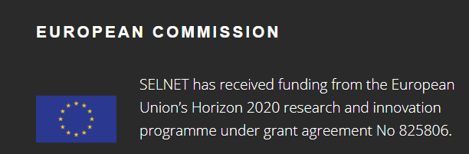
SELNET
Publication of paper of healthcare barriers: draft ongoing: Matías Chacón and Marta Martín-Ruiz
Ongoing
End of year
Gracias, merci, grazie, obrigada, thank you!
Marta Martín Ruiz, PhD
Project Manager
SELNET coordination team; IIS-FJD
martamartinruiz@atbscar.org
marta.mruiz@quironsalud.es
X SELNET CONSORTIUM MEETING (November 2023)

