Slide 1
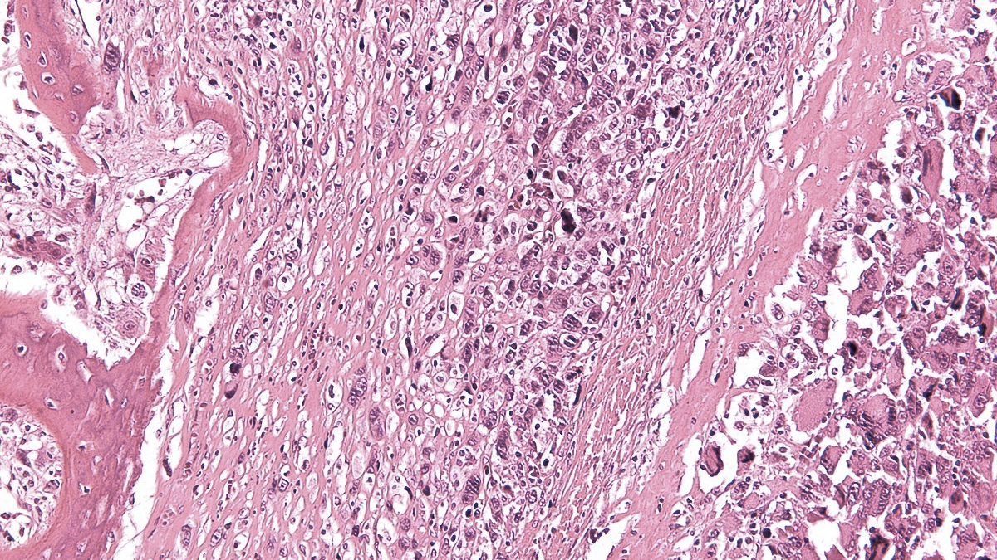
X SELNET
CONSORTIUM MEETING
------WORK PACKAGE 8------
09th November 2023
David S. Moura, IIS-FJD, Madrid, Spain

Slide 2
SELNET WP 8
WP 7
WP 6
WP 8
WP8 OBJ 1 To create SELNET biobank
WP8 OBJ 2 To establish pre-clinical sarcoma models for future research
WP8 OBJ 3 To conduct a translational study to explore potential biomarkers of response in rare sarcomas

Slide 3
SELNET WP 8
OBJECTIVE 1: TO CREATE SELNET BIOBANK
Deliverable 8.1 submitted at 31/07/2023
Biobank at 31/10/2023
1069 tumor blocks included in the biobank
22% of all the cases registered

Slide 4
SELNET WP 8
Centre | Cases registered | Blocks sent
Hospital Universitario Virgen del Rocío | 1058 | 125
Instituto Alexander Fleming | 697 | 61
Instituto Nacional de Enfermedades Neoplásicas | 526 | 239
Hospital Universitario Son Espases | 268 | -
A.C.Camargo Cancer Center | 238 | 152
Hospital Universitario Canarias | 231 | 36
Instituto Nacional de Cancerología | 230 | -
Instituto Nacional del Cáncer de Paraguay | 217 | 93
Hospital Universitario Fundación Jiménez Díaz | 146 | -
IRCCS Istituto Nazionale dei Tumori | 121 | 24
Fundación Centro Oncológico De Integración Regional | 116 | 44
Istituto Ortopedico Rizzoli | 115 | 112

Slide 5
SELNET WP 8
Centre | Cases registered | Blocks sent
Hospital Universitario Vall d’Hebron | 112 | 33
Caja Costarricense de Seguro Social | 104 | 81
Hospital Universitario Miguel Servet | 98 | -
Centre Leon-Berard | 93 | 101
Instituto Regional de Enfermedades Neoplásicas Norte | 89 | -
Instituto Oncológico Oriente Boliviano | 86 | 81
Instituto de Previsión Social de Paraguay | 74 | -
Complejo Hospitalario Metropolitano de la Caja de Seguro Social | 61 | 53
Swiss Sarcoma Network | 54 | -
Hospital Oncológico Provincial Córdoba | 51 | 21
Hospital Clínico San Carlos | 32 | 6
Instituto Nacional de Cáncer de Brasil | 19 | -

Slide 6
SELNET WP 8
Centre | Cases registered | Blocks sent
Centro Universitario Contra el Cancer UANL | 17 | -
Fundación Hospitalaria San Vicente de Paul | 14 | 22
Fundación Arturo López Pérez | 7 | 9
Hospital Clínico Universidad de Chile | 5 | -
Hospital Universitario de Donostia | 4 | 4
Instituto de Cancerología Las Américas Auna | 3 | -
Hospital Nacional Edgardo Rebagliati Martins | 2 | -
Hospital Universitario Austral | 1 | -
TOTAL | 4884 | 1235 (25.3%)

Slide 7
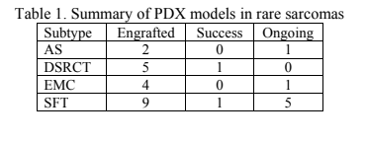
SELNET WP 8
OBJECTIVE 2 TO ESTABLISH PRE-CLINICAL SARCOMA MODELS Deliverable 8.2 submitted at 31/07/2023
List of preclinical models at 31/10/2023

Slide 8
SELNET WP 8
OBJECTIVE 3 TO CONDUCT A TRANSLATIONAL STUDY TO EXPLORE POTENTIAL BIOMARKERS OF RESPONSE IN RARE SARCOMAS
Deliverable 8. To be submitted until 31/12/2023

Slide 9
SELNET WP 8
Centro | Angiosarcoma | DSRCT | EMC | SFT
Instituto Nacional de Enfermedades Neoplásicas | 22 | 1 | 5 | 41
Instituto Alexander Fleming | 6 | 4 | - | 9
Fundación Arturo López Pérez | - | 1 | - | -
A.C.Camargo Cancer Center | 29 | 11 | - | 43
Istituto Ortopedico Rizzoli | 20 | - | 27 | 68
Centre Leon-Berard | 68 | 1 | - | 33
Hospital Universitario Virgen del Rocío | 8 | 4 | 7 | 92
Complejo Hospitalario Metropolitano de la Caja de Seguro Social | 1 | - | - | -
Hospital Universitario Vall d’Hebron | 3 | - | 1 | 29
Hospital Universitario Canarias | 5 | 1 | - | 20
Hospital Universitario de Donostia | 2 | 1 | - | 1
Hospital Oncológico Provincial Córdoba | - | - | - | 2
Caja Costarricense de Seguro Social | 1 | - | - | 1
Hospital Clinico San Carlos | - | 2 | - | 4
IRCCS Istituto Nazionale dei Tumori | - | - | 24 | -
TOTAL | 165 | 26 | 64 | 343
 |  |  | TOTAL | 598

Slide 10
SELNET WP 8
DEADLINE FOR TRANSCRIPTOMICS RESULTS/ FINAL REPORT: 31/12/2023
SFT design for discovery cohort (N=200):
96 cases from CELAC countries
104 cases from Europe
Validation cohort to be built with INT cases plus other CELAC countries cases

Slide 11
SELNET WP 8
EMC:
24 internal samples analyzed by Nanostring, info data analysis ongoing.
30 external samples received and 26/30 currently pre-Nanostring selection (4 excluded).
DSRCT:
26 tumor samples will be analysed by RNA-Seq
Angiosarcoma:
76 external cases
68 internal cases
144 cases for RNA-Seq

Slide 12
SELNET WP NUMBER/ NAME- PARTICIPANTS
PUBLICACIONES:
A Novel NFIX-STAT6 Gene Fusion in Solitary Fibrous Tumor: A Case Report. David S Moura, Juan Díaz-Martín, Silvia Bagué, Ruth Orellana-Fernandez, Ana Sebio, Jose L Mondaza-Hernandez, Carmen Salguero-Aranda, Federico Rojo, Nadia Hindi, Christopher D M Fletcher, Javier Martin-Broto. Int J Mol Sci. 2021 Jul 13;22(14):7514. doi: 10.3390/ijms22147514.
Samuel Hidalgo-Ríos, Jaime Carrillo-García, David S. Moura, Silvia Stacchiotti, Antonio López-Pousa, Andrés Redondo, Antoine Italiano, Antonio Gutiérrez, Giovanni Grignani, Nadia Hindi, José-Antonio López-Guerrero, Xavier García del Muro, Javier Martínez Trufero, Emanuela Palmerini, Ana Sebio García, Daniel Bernabeu, Axel Le Cesne, Paolo Giovanni Casali, Jean-Yves Blay, Josefina Cruz Jurado, Javier Martin-Broto. Peripheral Inflammatory Indexes Neutrophil/Lymphocyte Ratio (NLR) and Red Cell Distribution Width (RDW) as Prognostic Biomarkers in Advanced Solitary Fibrous Tumour (SFT) Treated with Pazopanib. Cancers 2022, 14(17), 4186; https://doi.org/10.3390/cancers14174186
3. Jose L Mondaza-Hernandez, David S Moura, María Lopez-Alvarez, Paloma Sanchez-Bustos, Elena Blanco-Alcaina, Carolina Castilla-Ramirez, Paola Collini, Jose Merino-Garcia, Jorge Zamora, Jaime Carrillo-Garcia, Roberta Maestro, Nadia Hindi, Jesus Garcia-Foncillas, Javier Martin-Broto. ISG15 as a prognostic biomarker in solitary fibrous tumour. Cell Mol Life Sci. 2022 Jul 21;79(8):434. doi: 10.1007/s00018-022-04454-4.
4. Nadia Hindi, Jaime Carrillo-García, Elena Blanco-Alcaina, Marta Renshaw, Pablo Luna, José Durán, Natalia Jiménez, Pilar Sancho, Rafael Ramos, David S Moura, Javier Martín-Broto. Platinum-Based Regimens Are Active in Advanced Pediatric-Type Rhabdomyosarcoma in Adults and Depending on HMGB1 Expression. Int J Mol Sci. 2023 Jan 3;24(1):856. doi: 10.3390/ijms24010856

Slide 13
SELNET WP NUMBER/ NAME- PARTICIPANTS
PUBLICACIONES:
5. María López-Álvarez, Cristina González-Aguilera, David S Moura, Paloma Sánchez-Bustos, José L Mondaza-Hernández, Marta Martín-Ruiz, Marta Renshaw, Rafael Ramos, Carolina Castilla, Elena Blanco-Alcaina, Nadia Hindi, Javier Martín-Broto. Efficacy of Eribulin Plus Gemcitabine Combination in L-Sarcomas. Int J Mol Sci. 2022 Dec 30;24(1):680.doi: 10.3390/ijms24010680.
6. Javier Martin-Broto, Andres Redondo, David S Moura, Claudia Valverde, Jose Manuel Morales, Antonio Lopez-Pousa, Javier Martinez-Trufero, Antonio Gutierrez, Roberto Díaz-Beveridge, Pablo Luna, Virginia Martinez-Marin, David Marcilla, Ivan Arribas, Patricio Ledesma, Jose Antonio Lopez-Martin, Davide Di Lernia, Jorge Zamora, Nadia Hindi. A phase II trial of weekly nab-paclitaxel for progressive and symptomatic desmoid tumors. Nat Commun. 2022 Oct 21;13(1):6278. doi: 10.1038/s41467-022-33975-6.
7. Javier Martin-Broto, Claudia Valverde, Nadia Hindi, Bruno Vincenzi, Javier Martinez-Trufero, Giovanni Grignani, Antoine Italiano, Javier Lavernia, Ana Vallejo, Paolo Dei Tos, Francois Le Loarer, Ricardo Gonzalez-Campora, Rafael Ramos, Diana Hernández-Jover, Antonio Gutierrez, Cesar Serrano, Maria Monteagudo, Rocio Letón, Mercedes Robledo, David S Moura, Marta Martin-Ruiz, Jose A López-Guerrero, Julia Cruz, Antonio Fernandez-Serra, Jean-Yves Blay, Elena Fumagalli, Virginia Martinez-Marin. REGISTRI: Regorafenib in first-line of KIT/PDGFRA wild type metastatic GIST: a collaborative Spanish (GEIS), Italian (ISG) and French Sarcoma Group (FSG) phase II trial. Mol Cancer. 2023 Aug 9;22(1):127. doi: 10.1186/s12943-023-01832-9.
8. Javier Martin-Broto, Josefina Cruz, Nicolas Penel, Axel Le Cesne, Nadia Hindi, Pablo Luna, David S Moura, Daniel Bernabeu, Enrique de Alava, Jose Antonio Lopez-Guerrero, Joaquin Dopazo, Maria Peña-Chilet, Antonio Gutierrez, Paola Collini, Marie Karanian, Andres Redondo, Antonio Lopez-Pousa, Giovanni Grignani, Juan Diaz-Martin, David Marcilla, Antonio Fernandez-Serra, Cristina Gonzalez-Aguilera, Paolo G Casali, Jean-Yves Blay, Silvia Stacchiotti. Pazopanib for treatment of typical solitary fibrous tumours: a multicentre, single-arm, phase 2 trial. Lancet Oncol. 2020 Mar;21(3):456-466. doi: 10.1016/S1470-2045(19)30826-5

Slide 14
SELNET WP NUMBER/ NAME- PARTICIPANTS
PUBLICACIONES:
9. Hindi N, Carrasco García I, Sánchez-Camacho A, Gutierrez A, Peinado J, Rincón I, Benedetti J, Sancho P, Santos P, Sánchez-Bustos P, Marcilla D, Encinas V, Chacon S, Muñoz-Casares C, Moura D, Martin-Broto J. Trabectedin Plus Radiotherapy for Advanced Soft-Tissue Sarcoma: Experience in Forty Patients Treated at a Sarcoma Reference Center. Cancers (Basel). 2020 Dec 12;12(12):3740. doi: 10.3390/cancers12123740.
10. Martin-Broto J, Mondaza-Hernandez JL, Moura DS, Hindi N. A Comprehensive Review on Solitary Fibrous Tumor: New Insights for New Horizons. Cancers (Basel). 2021 Jun 10;13(12):2913. doi: 10.3390/cancers13122913.

Slide 15
SELNET WP 8
Thank you
X SELNET CONSORTIUM MEETING (November 2023)

